Slide 1
Embedded Picture Mnemonics
Notes:
Using Printing Like a Pro

Slide 2
Source: Printing Like a Pro

Slide 3
Downers

Slide 8
Rounders

Slide 14
Curvers
(Special)

Slide 17
Curvers

Slide 19
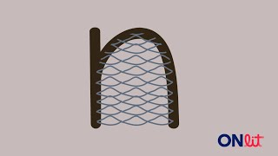

Slide 23
Diggers

Slide 26
Notes:
<qu> as blendable “coo” - UFLI, Reading Mastery, etc.

Slide 28
Sliders

Slide 30
Notes:
<w> as blendable “woo” - UFLI, Reading Mastery, etc.

Slide 31
Notes:
<y> as blendable “yee” - UFLI, Reading Mastery, etc.

Slide 33
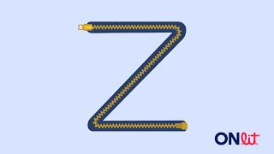
Notes:
zed

