Slide 1
Suffix Slide Deck
Grade 3
GECDSB

Slide 2
-ish
Read with me
meaning: adjective – like / origin
foolish
impish
reddish
wimpish
tannish
babyish
fiftyish
childish
clownish
bearish
bluish
devilish
elfish
feverish
foolish

Slide 3
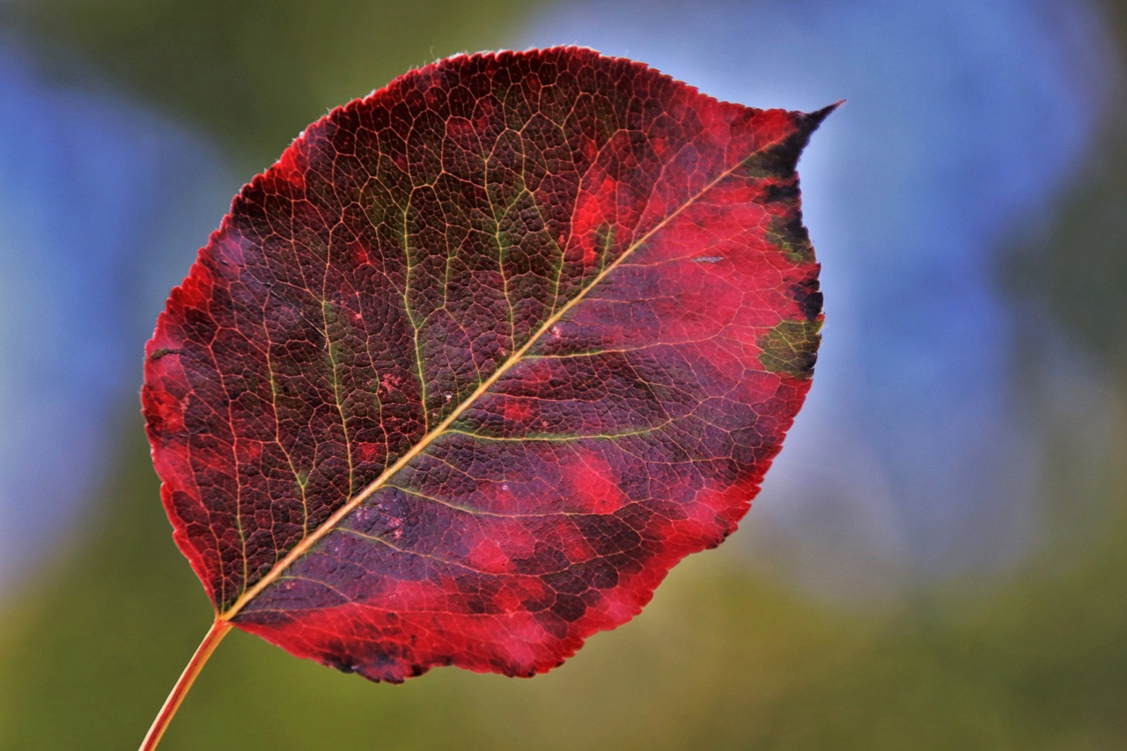
In autumn, leaves turn different colours. This leaf is reddish.

Slide 4
Let's talk it out!
Say the “-ish” word.
Have students say the “-ish” word.
Discuss the word meaning (like).
Use the “-ish” word in a sentence for the following:
Don’t throw snowballs on school property. You know you will get in trouble if you do something this … (foolish).
My brother makes me angry. He tells me I am …. when I play with my doll (babyish).
I do not like to eat snails. Even thinking about it makes me ….(squeamish).
My dad is not feeling well today. He is tired and acting …(sluggish).

Slide 5
-ish
Meaning: like
feverish
selfish
stylish
When I go to the salon and get my hair and nails done, I feel ________ .
If you only think about yourself and don’t think of others, you might be _________
I am feeling ________ . I don’t feel well. I am burning up.
stylish
selfish
feverish
Change words & sentences frequently to review

Slide 6
Make new words!:
brown + ish 🡪
long + ish 🡪
young + ish 🡪
baby + ish 🡪

Slide 7
-ful
Read with me
meaning: adjective – full of / having
boastful
disdainful
dutiful
bashful
fateful
armful
shameful
hopeful
disgraceful
beautiful
bountiful
cheerful
disrespectful
peaceful
cupful

Slide 8
The child on top is so helpful. She is helping her brother climb up!

Slide 9
Let's talk it out!
Say the “-ful” word.
Have students say the “-ful” word.
Discuss the word meaning (full of).
Use the “-ful” word in a sentence for the following:
It takes me awhile to warm up to new people. Some people say I am shy or … (bashful).
Smoking is not good for your health. It is …(harmful) to your body.
My sister smiles a lot. People like her because she is ….(cheerful).
We must be careful with the words we use. Mean words can be … (hurtful).

Slide 10
-ful
Meaning: full of/having
armful
respectful
cupful
respectful
Teachers like it when we are polite and ________ .
Put a _______ of laundry detergent into the washing machine.
I carried an ____________ of wood from the forest to the campfire.
cupful
armful
Change words & sentences frequently to review

Slide 11
Make new words!:
spoon + ful 🡪
shame + ful 🡪
use + ful 🡪
grate + ful 🡪
play + ful 🡪

Slide 12
-ous
Read with me
meaning: full of
fabulous
murderous
odorous
slanderous
numerous
marvellous
venomous
rigorous
jealous
luminous
carnivorous
disastrous
joyous
dangerous
monstrous

Slide 13
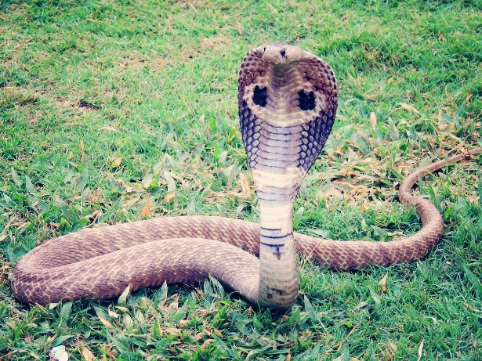
Some snakes are venomous. They can poison animals when they strike.

Slide 14
Let's talk it out!
Say the “-ous” word.
Have students say the “-ous” word.
Discuss the word meaning (full of).
Use the “-ous” word in a sentence for the following:
Animals that eat meat are … (carnivorous).
It is ….. if you don’t look both ways before you cross the street. You could get hurt! (dangerous)
I am afraid of heights. Thinking of climbing up a mountain makes me….(nervous).
My brother has …… trading cards. They fill up three baskets. (numerous)

Slide 15
-ous
Meaning: full of
fabulous
jealous
monstrous
jealous
I am so __________ of my friend. She just got Taylor Swift tickets!
The cake my sister made me for my birthday is _____________ . It has three layers!
The hair stylist did a _____________ job cutting my hair. I love it!
monstrous
fabulous
Change words & sentences frequently to review

Slide 16
Make new words!:
joy + ous 🡪
danger + ous 🡪
rigor + ous 🡪
humour + ous 🡪
humung + ous 🡪

Slide 17
-ic
Read with me
meaning: adjective/noun - having to do with
electric
critic
clinic
alphabetic
mystic
mechanic
historic
politic
ethic
ethnic
geographic
parenthetic
poetic
authentic
prehistoric

Slide 18
To be athletic, you have to work out, eat well, and practice.

Slide 19
Let's talk it out!
Say the “-ic” word.
Have students say the “-ic” word.
Discuss the word meaning (having to do with).
Use the “-ic” word in a sentence for the following:
She is so …. (dramatic). When she enters a room, she thinks she is a star in a movie.
The island contains a large number of important …. (prehistoric) monuments.
The new student received an ….(enthusiastic) welcome on her first day of school.
They painted all the wood with … (metallic) silver paint.

Slide 20
-ic
Meaning: having to do with
scientific
comic
topic
I have to choose a _______ for my habitat inquiry.
You have to ask good questions when doing _________ experiments.
She tells great jokes and is always funny. She might be a _________ when she grows up!
topic
scientific
comic
Change words & sentences frequently to review

Slide 21
Make new words!:
com + ic 🡪
mag + ic 🡪
class + ic 🡪
electr + ic 🡪
histor + ic 🡪

Slide 22
-al
Read with me
meaning: of the kind, relating to
formal
original
capital
accidental
legal
literal
personal
dental
eternal
neutral
educational
additional
national

Slide 23
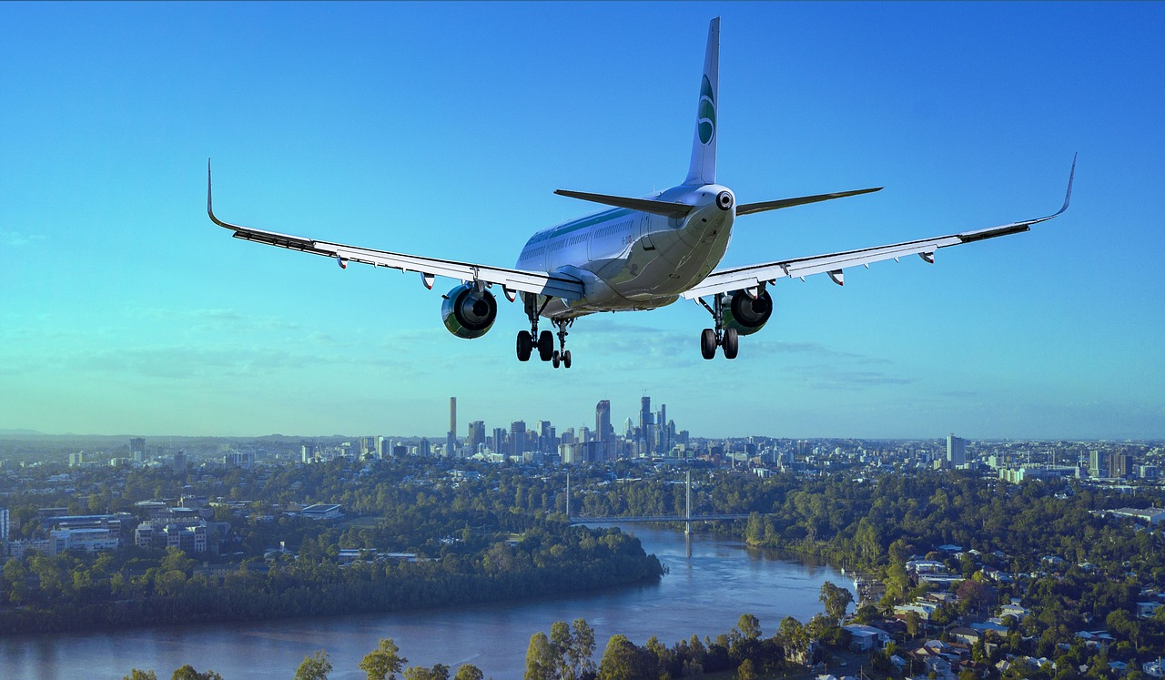
The arrival of the plane into the airport is on time.

Slide 24
Let's talk it out!
Say the “-al” word.
Have students say the “-al” word.
Discuss the word meaning (of the kind, relating to).
Use the “-al” word in a sentence for the following:
They wore fancy clothes to the … (formal) dance.
My mom made a … (dental) appointment because she has a toothache.
If you need some … (legal) advice, call a lawyer.
The … (postal) worker brings us our mail every day.

Slide 25
-al
Meaning: of the kind, relating to
renewal
dismissal
approval
The family has a yearly __________ for the streaming service.
The teacher has to give her ___________ of your topic before you can proceed.
The bell for school ____________ occurs at 3:15.
renewal
approval
dismissal
Change words & sentences frequently to review

Slide 26
Make new words!:
education + al 🡪
critic + al 🡪
person + al 🡪
origin + al 🡪
nation + al 🡪

Slide 27
-ive
Read with me
meaning: relating or belonging to
supportive
effective
directive
exhaustive
narrative
defensive
massive
excessive
reflective
disruptive
active
attractive
objective
aggressive
obstructive

Slide 28
The detective is finding clues to solve the crime.

Slide 29
Let's talk it out!
Say the “-ive” word.
Have students say the “-ive” word.
Discuss the word meaning (relating, belonging to).
Use the “-ive” word in a sentence for the following:
They complained about …. (excessive) noise coming from the upstairs apartment.
Antibiotics are … (effective) for fighting bacteria that cause infections.
He started to get … (aggressive) and began to shout.
My mom stays … (active) by walking everyday.

Slide 30
-ive
Meaning: relating or belonging to
creative
descriptive
narrative
narrative
She is writing a ____________ about the adventures she had on her vacation.
The ______________ children used sticks, leaves, and stones to create a classroom forest.
The students gave a _____________ account of their field trip to the farm.
creative
descriptive
Change words & sentences frequently to review

Slide 31
Make new words!:
detect + ive 🡪
elect + ive 🡪
capt + ive 🡪
subject + ive 🡪
destruct + ive 🡪

