Slide 1

Suffix Slide Deck
Language Comprehension
Grade 2
GECDSB

Slide 2

-ing
Read with me
meaning: present tense verb
sleeping
eating
running
jumping
baking
lifting
digging
thinking
picking
drinking
washing
diving
kicking
throwing
liking

Slide 3
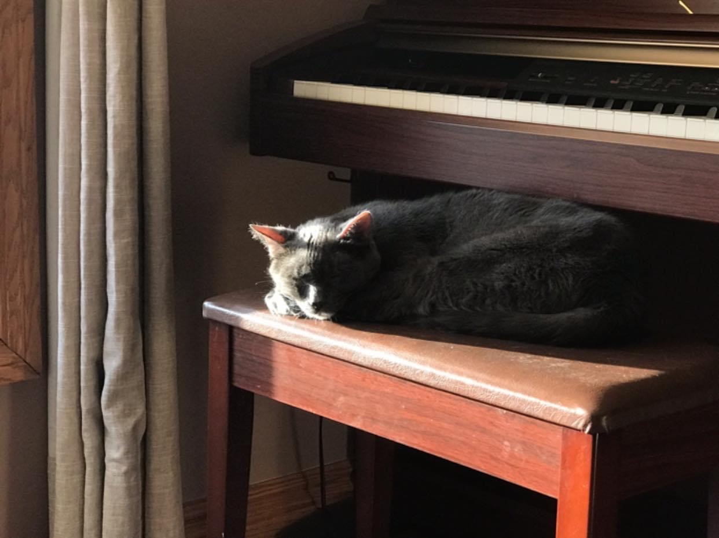
The old cat is “sleeping” on the piano bench.
Your turn: Use the word “sleeping” in a sentence.

Slide 4
Let's talk it out!
Say the “-ing” word.
Have students say the “-ing” word.
Discuss the word meaning (present tense verb).
Discuss and use the “ing” word in a sentence for the following:
She is sitting at the table, …. (eating) a sandwich and … (drinking) juice.
The children are in the pool. They love …(swimming) on hot days.
The rabbit is … (hopping) from one side of the garden to the other.
I love to garden. I am … (growing) tomatoes, peppers, and beans.

Slide 5


-ing
meaning: present tense verb
building
selling
painting
The children made lemonade and will be ________ it outside.
The artist is _________ a picture of a flower. She is using pink and green paint.
The group on the floor took out blocks and are ________ towers.
selling
painting
building
Change words & sentences frequently to review

Slide 6
Make new words:
cry + ing 🡪
wash + ing 🡪
kick + ing 🡪
peek + ing 🡪
stay + ing 🡪

Slide 7
-er
Read with me
meaning: adjective (more than)
smarter
colder
darker
lazier
luckier
colder
plumper
deeper
quicker
deeper
sweeter
slower
cheaper
earlier
emptier

Slide 8
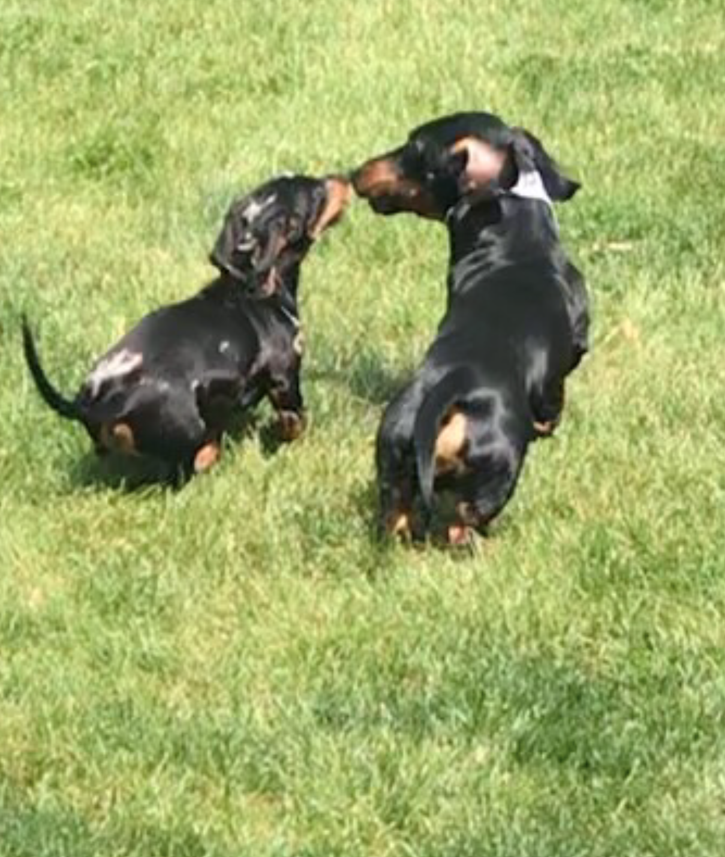
This puppy is “smaller” (point to the one on the left), but this one is “bigger” (point to one on the right).
Your turn: Which dog will eat more food for dinner? Why? Use the word “smaller” and “bigger” in your answer.

Slide 9
Let's talk it out!
Say the “-er” word.
Have students say the “-er” word.
Discuss the word meaning (used when we compare things).
Use the “er” word in a sentence for the following:
What is colder, a popsicle or a glass of milk?
What is faster, a lion or a cheetah?
What is tastier, French fries or pizza?
What is louder, a barking dog or an airplane?

Slide 10
-er
meaning: word endings change when we compare things
lighter
older
brighter
The grandfather is ________ than the baby.
A mouse is _________ than an elephant.
I think candy is ________ than chocolate .
older
lighter
sweeter
Change words & sentences frequently to review

Slide 11
Make new words!:
angry + er 🡪
cheap + er 🡪
dark + er 🡪
deep + er 🡪
lucky + er 🡪

Slide 12
-est
Read with me
meaning: adjective/ superlative
barest
cosiest
cutest
hairiest
itchiest
largest
fewest
eldest
biggest
fondest
proudest
coldest
muddiest
lightest
briefest

Slide 13
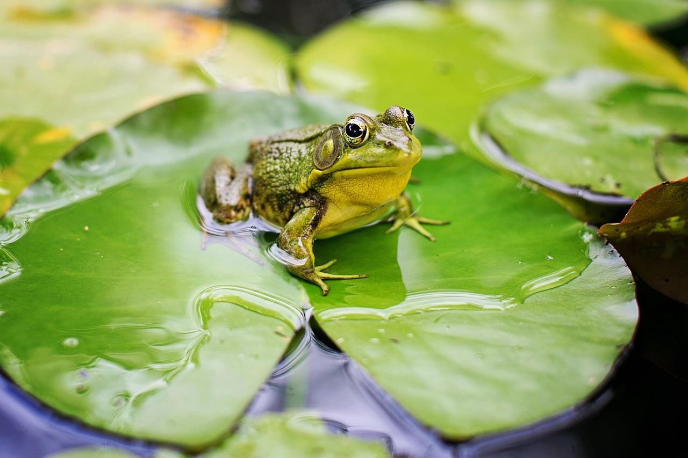
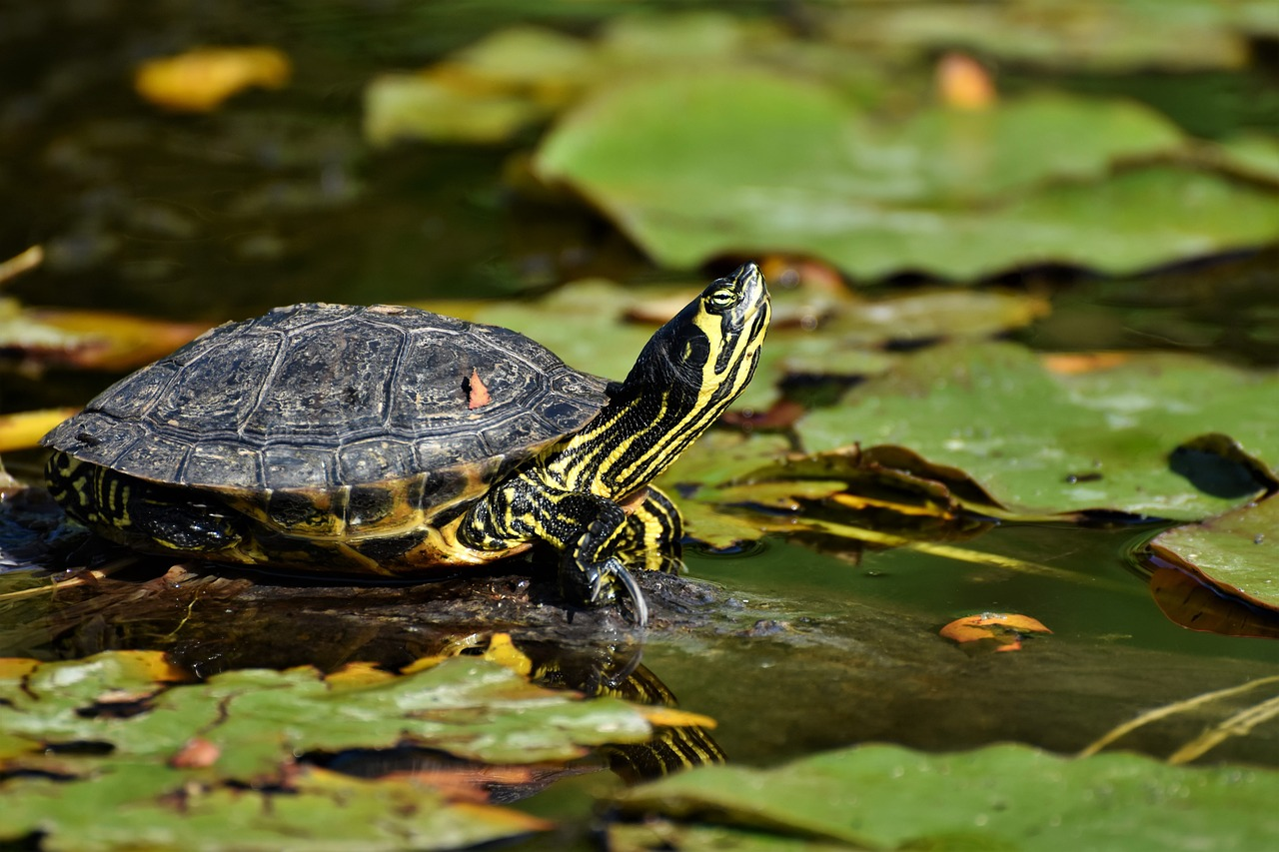
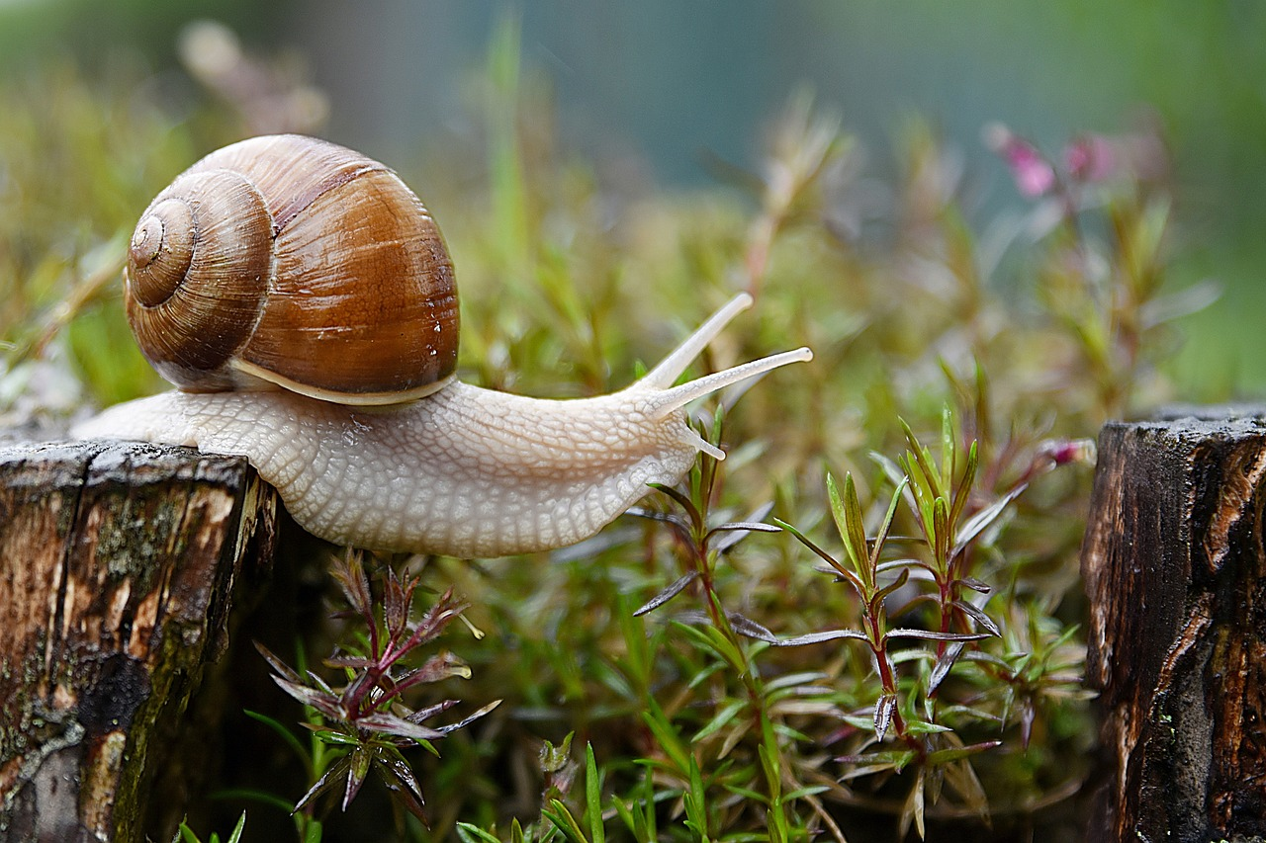
A frog is a slow animal. A turtle is even slower. However, the snail is the slowest.
Your turn: Use the words “slow”, “slower”, and “slowest” in sentences.
If as rabbit is fast and a horse is faster, what about a cheetah?

Slide 14
Let's talk it out!
Say the “-est” word.
Have students say the “-est” word.
Discuss the word meaning (used when we describe the highest quality or degree).
Use the “er” and “est” suffixes for the following:
hot
big
young
brave

Slide 15
-est
meaning: when we describe the highest quality or degree
smallest
oldest
lightest
The teenager is old. His father is older. His grandfather is the ______ .
A rabbit is small. A mouse is smaller. An ant is the _________
An egg is light. A pencil is lighter. A feather is the ________ .
oldest
smallest
lightest
Change words & sentences frequently to review

Slide 16
Make new words!:
tall + est 🡪
proud + est 🡪
loud + est🡪
cold + est 🡪
short + est 🡪

Slide 17
-ly
Read with me
meaning: adverb
likely
loudly
hourly
bravely
partly
largely
madly
quietly
happily
gently
lately
immediately
really
finally
carelessly

Slide 18
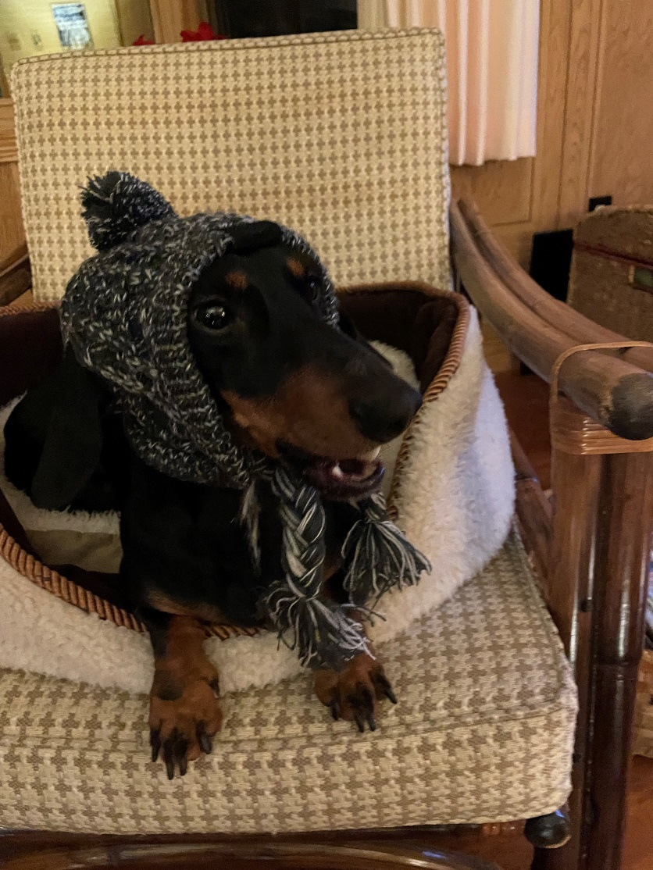
He was going outside to play in the snow, so his mom tied his hat “tightly” under his chin to keep his head warm.
Your turn: What can you put on “tightly” or “loosely”?
Use those words in sentences.

Slide 19
Let's talk it out!
Say the “-ly” word.
Have students say the “-ly” word.
Discuss the word meaning (telling how).
Use the “-ly” word in a sentence for the following:
She was careful carrying the eggs. She carried the eggs…(carefully).
The rabbit was quick to get away from the fox. The rabbit ran ….(quickly).
The children remained quiet when the teacher was speaking. The children were … (quietly) waiting.
He was proud of the work he did on his story. He presented his story …(proudly).

Slide 20
-ly
meaning: can be added to adjectives to become adverbs – telling how
sadly
loosely
softly
The grandmother ________ sang to the baby.
The girl waved goodbye to her friend _________ when she left for vacation.
His shoe fell off because he did his shoe laces up ________ .
softly
sadly
loosely
Change words & sentences frequently to review

Slide 21
Make new words!:
glad + ly 🡪
smooth + ly 🡪
slow + ly 🡪
kind + ly 🡪
week + ly 🡪

Slide 22
-er
Read with me
meaning: someone who / someone that
teacher
singer
baker
driver
dancer
painter
cleaner
leader
writer
player
farmer
helper

Slide 23
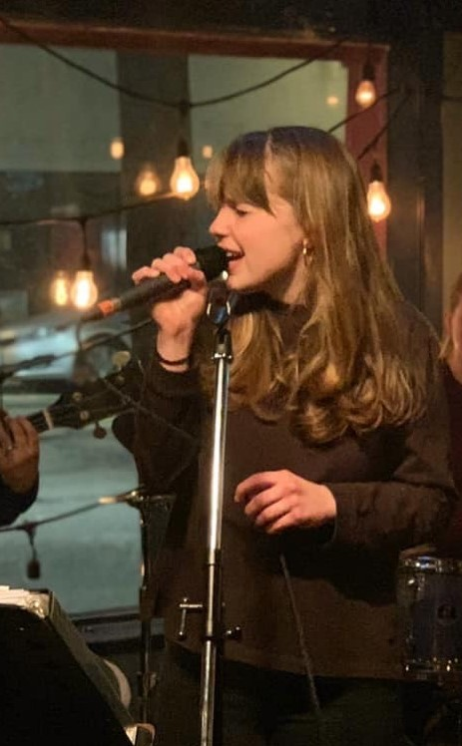
This person is a “singer”. She writes songs and sings them.
Your turn: What do you think she is singing about?
Use the word “singer” in your answer.

Slide 24
Let's talk it out!
Say the “-er” word.
Have students say the “-er” word.
Discuss the word meaning (someone who/someone that).
Discuss and use the “-er” word in a sentence for the following:
Old MacDonald has a farm with lots of farm animals. He is a …(farmer).
Every year, someone new teaches me. Every year I get a new …(teacher).
My neighbour has beehives in his backyard and raises bees. He is a …( beekeeper).
The person in baseball who pitches the ball to the batter is the …(pitcher).

Slide 25
-er
Meaning: someone one or someone that
performer
baker
skater
Actors are good at performing. Another name for an actor is a _________ .
In order to play hockey, you need to learn how to skate. A hockey player needs to be a good ________ .
It is my mom’s birthday next week. I want to get her a fancy baked cake with chocolate and strawberries. I will call the ________ and order it.
performer
skater
baker
Change words & sentences frequently to review

Slide 26
Make a tree:
teach + er 🡪
lead + er 🡪
farm+ er 🡪
help+ er 🡪
paint +er 🡪

Slide 27
-or
Read with me
meaning: one who or one that
instructor
operator
visitor
doctor
collector
creator
professor
supervisor
spectator
actor
inventor
distributor
advisor
competitor
investigator

Slide 28
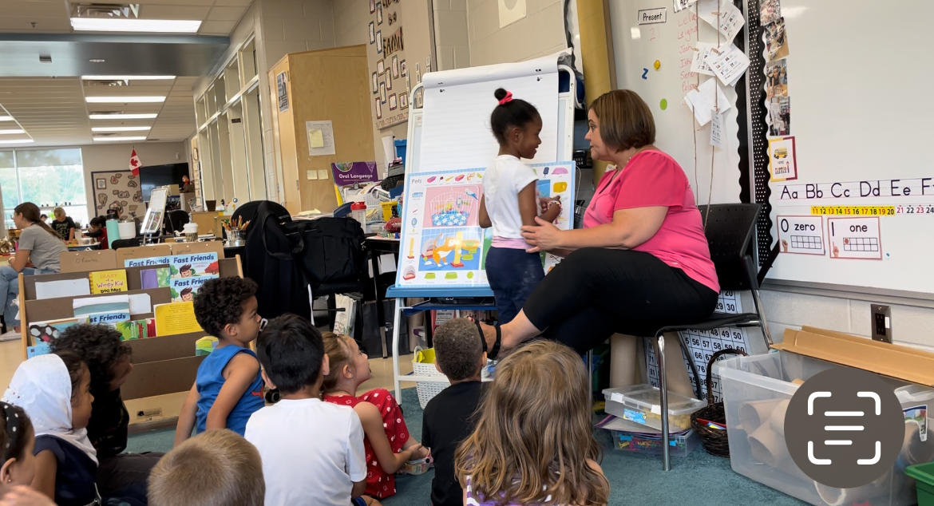
Another word for a teacher is an “educator”.
Your turn: Look at the picture and use “educator” in a sentence. Who are your educators this year?

Slide 29
Let's talk it out!
Say the “-or” word.
Have students say the “-or” word.
Discuss the word meaning (one who or one that).
Discuss and use the “-or” word in a sentence for the following:
A person who acts in a play is called an …(actor).
Do you know about Thomas Edison? He invented the light bulb and lots of other things. He was a great …(inventor).
I love collecting comic books. I have over 100 comic books! I am a comic book …(collector).

Slide 30
-or
Meaning: one who or one that
author
visitor
editor
Pass your paper to your partner. They can edit it and make changes. They will be your ________ .
I am allowed to visit my aunt in the hospital. However all _________ have to wear masks .
Dav Pilkey writes my favourite books about Captain Underpants. He is the best ________ ever!
editor
visitors
author
Change words & sentences frequently to review

Slide 31
Make new words!:
visit + or 🡪
doct + or 🡪
act + or 🡪
protect + or 🡪
invent + or 🡪

Slide 32
-y
Read with me
meaning: adjective
sleepy
funny
happy
sandy
handy
lumpy
bumpy
windy
itchy
fizzy
frilly
dusty

Slide 33
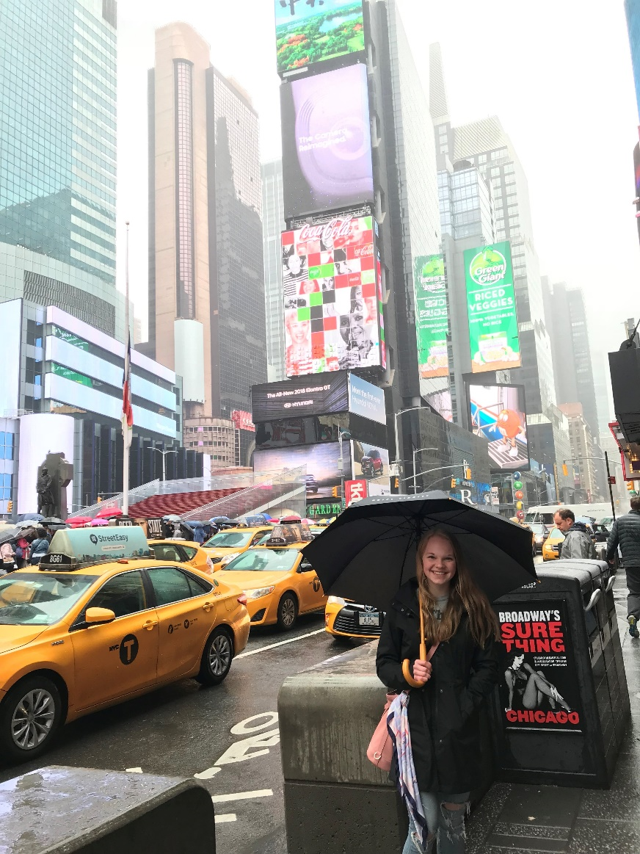
How can you tell it is a “rainy” day?
Your turn: Talk about this picture.
Use the word “rainy”.

Slide 34
Let's talk it out!
Say the “-y” word.
Have students say the “-y” word.
Discuss the word meaning (inclined to or like the word it is affixed to).
Use the “-y” word in a sentence for the following:
She did not brush her hair that morning. Her hair was a mess. It was….(messy).
I love to eat apples and grapes. They are good for my health. The are …(healthy) foods.
The sky is grey and there are lots of clouds. I think it will be …(cloudy) all day.
I love to have fun and tell jokes. My friends think I am ….(funny).

Slide 35
-y
meaning: inclined to or like the word it is affixed to
windy
noisy
furry
windy
The hat blew off the boy’s head. It was a ________ day.
The cat had black and white fur. The girl loved to pet her _________ cat.
The kids were making a lot of noise in the gym. The teacher reminded them to not be ________ .
furry
noisy
Change words & sentences frequently to review

Slide 36
Make new words!:
sleep + y 🡪
bump + y 🡪
hair + y 🡪
fluff+ y 🡪
push+ y 🡪

Slide 37
-ful
Read with me
meaning: adjective – full of / having
cupful
colourful
harmful
bashful
mouthful
armful
painful
hopeful
graceful
beautiful
thoughtful
cheerful
respectful
peaceful
mindful

Slide 38
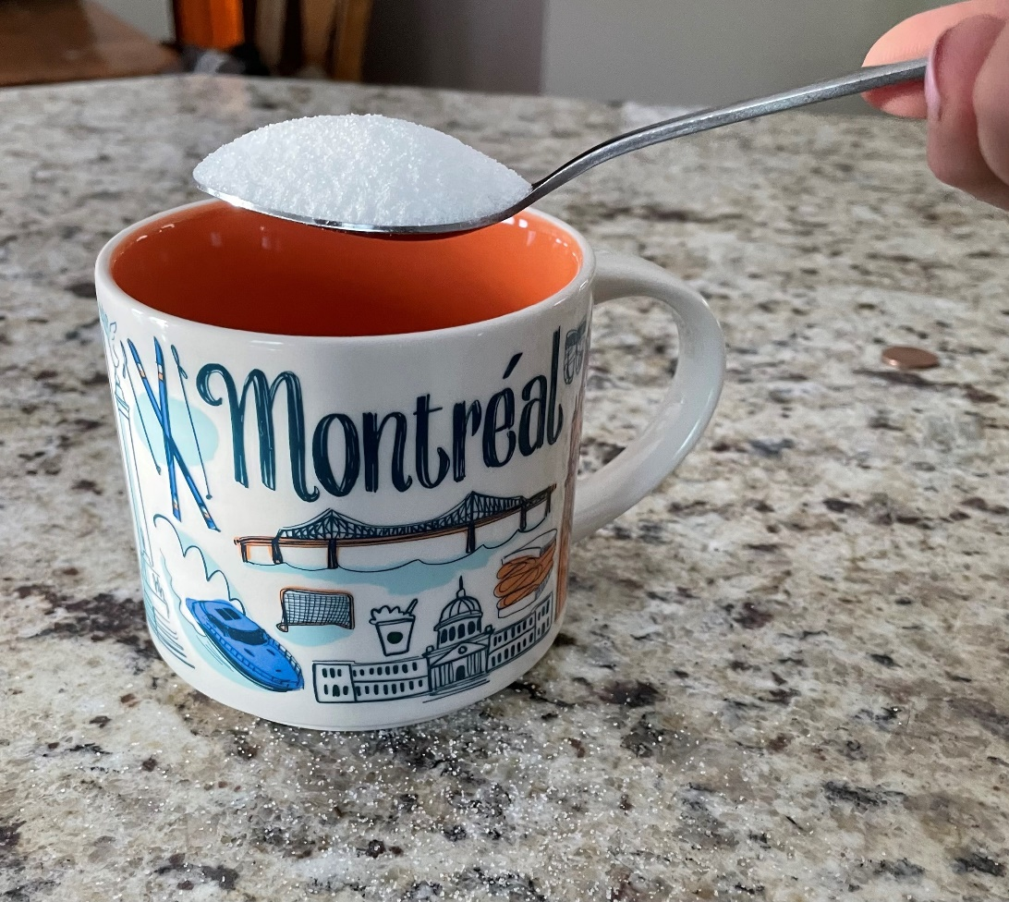
She is putting a “spoonful” of sugar into her tea.
Your turn: Do you like sugar? What would you put a “spoonful” of sugar into. Use the “spoonful”.
What other foods would you have a spoonful of? Use the word “spoonful”.

Slide 39
Let's talk it out!
Say the “-ful” word.
Have students say the “-ful” word.
Discuss the word meaning (full of).
Use the “-ful” word in a sentence for the following:
She put the whole cookie into her mouth. It was a ….(mouthful).
When Tom said mean words to his friend, it hurt his friend’s feelings. Tom’s words were …(hurtful).
My sister went on vacation to take a rest. Her vacation was …(restful).
I grabbed a lot of chips from the bowl with my hand. I had a ….(handful) of chips.

Slide 40
-ful
Meaning: full of
plateful
wasteful
thankful
wasteful
Throwing fresh fruit out is ________ .
The girl was _________ that her lost dog was found.
He put a hamburger, a pickle, french fries, and a salad on his plate. He ate a ________ of food
thankful
plateful
Change words & sentences frequently to review

Slide 41
Make new words!:
bash + ful 🡪
power + ful 🡪
play + ful 🡪
harm + ful 🡪
cheer + ful 🡪

Slide 42
-less
Read with me
meaning: adjective – without / cannot be
sleepless
harmless
colourless
defenceless
penniless
cloudless
lifeless
aimless
restless
endless
helpless
careless
painless
hatless
sleeveless

Slide 43
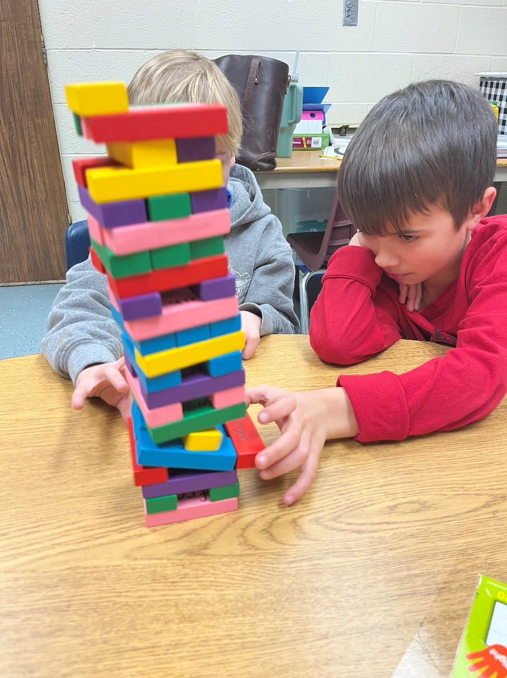
The boys are playing a game. What happens if one of them is “careless”?
Your turn: Talk about the picture. Use the word “careless”.

Slide 44
Let's talk it out!
Say the “-less” word.
Have students say the “-less” word.
Discuss the word meaning (without).
Use the “-less” word in a sentence for the following:
In the summer when it is hot you might wear a shirt with no sleeves. This kind of shirt is called … (sleeveless).
It was a beautiful summer day. The sun was bright. There were no clouds. The sky was …(cloudless).
If I don’t get sleep at night and am ….(sleepless), I get grumpy!
My dad has raked all the leaves, now the lawn is …(leafless).

Slide 45
-less
Meaning: without
helpless
shoeless
treeless
When I broke my leg, I couldn’t help my grandmother clean and I felt ________ .
The girls took off their shoes when the walked in the sand. They loved being _________
They cut the trees down in the forest and no the area is ________ .
helpless
shoeless
treeless
Change words & sentences frequently to review

Slide 46
Make new words!:
age + less 🡪
sleeve + less 🡪
end + less 🡪
rest + less 🡪
fear + less 🡪

Slide 47
-ness
Read with me
meaning: noun – state, condition, quality
dampness
dryness
weakness
blackness
fitness
rudeness
kindness
calmness
deepness
coldness
sickness
sweetness
smugness
sadness
wellness

Slide 48
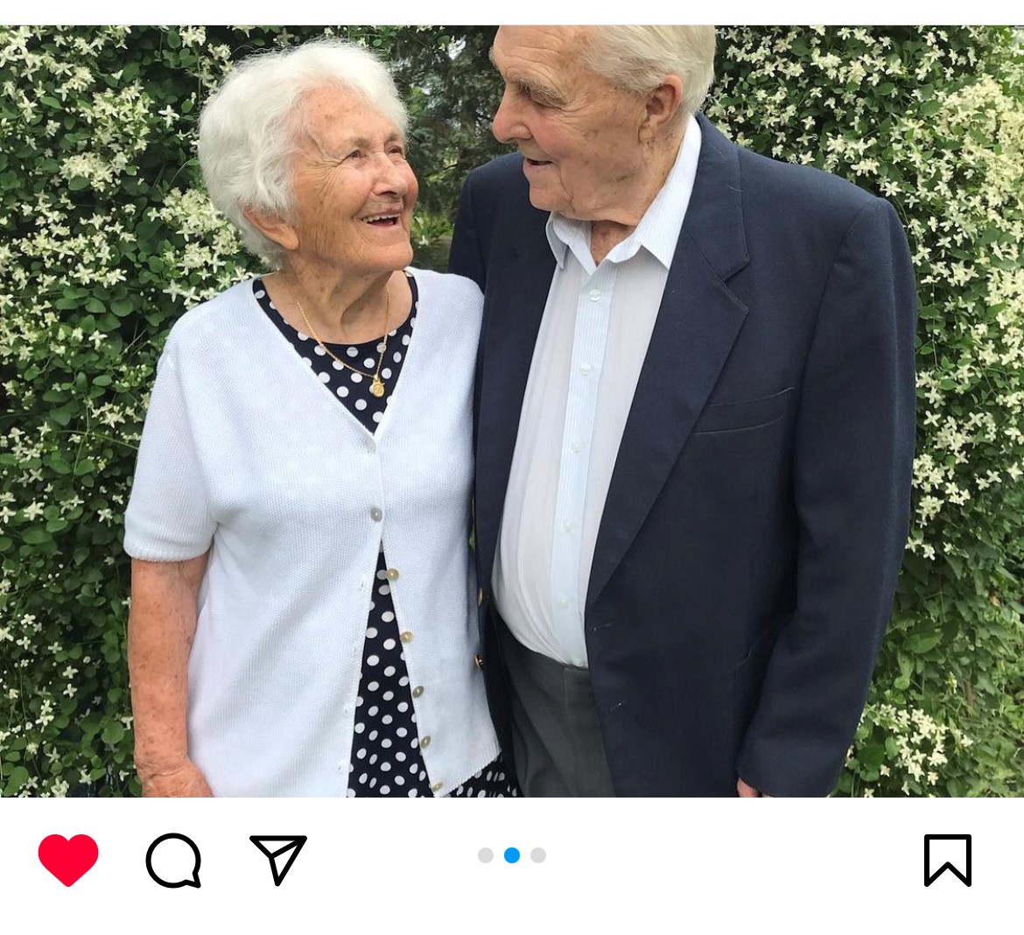
This couple has been together for a long time. Their “happiness” makes us all smile.
Your turn: Talk about this picture and use the word “happiness”.

Slide 49
Let's talk it out!
Say the “-ness” word.
Have students say the “-ness” word.
Discuss the word meaning (state of, condition, quality).
Use the “-ness” word in a sentence for the following:
To stay fit, you must eat well and exercise. Having a … (fitness) plan is important.
The boy was sad because his dog ran away. You could see the …(sadness) in his eyes.
We need to be kind to each other. Can you think of some acts of …(kindness)?
The power went out in our house, the light are off and it is dark. I am scared to be in …(darkness).

Slide 50
-ness
Meaning: state of
sweetness
shortness
politeness
sweetness
I love ice cream because it is sweet. The ________ makes me happy!
There was only a short amount of time left to finish the test. The _________ of time caused me to hurry up.
My teacher likes it when we are polite. He says ________ occurs when we use words like “please” and “thank you”.
shortness
politeness
Change words & sentences frequently to review

Slide 51
Make new words!:
damp + ness 🡪
sick + ness 🡪
fit + ness 🡪
wit + ness 🡪
fond + ness 🡪

Slide 52
+ ion (-tion,-sion)
Read with me
meaning: state of / act of / result of
fiction
option
motion
creation
section
friction
station
notion
fraction
temptation
action
junction
eruption
inspiration
reflection
vibration
direction
expansion
expression
confusion

Slide 53
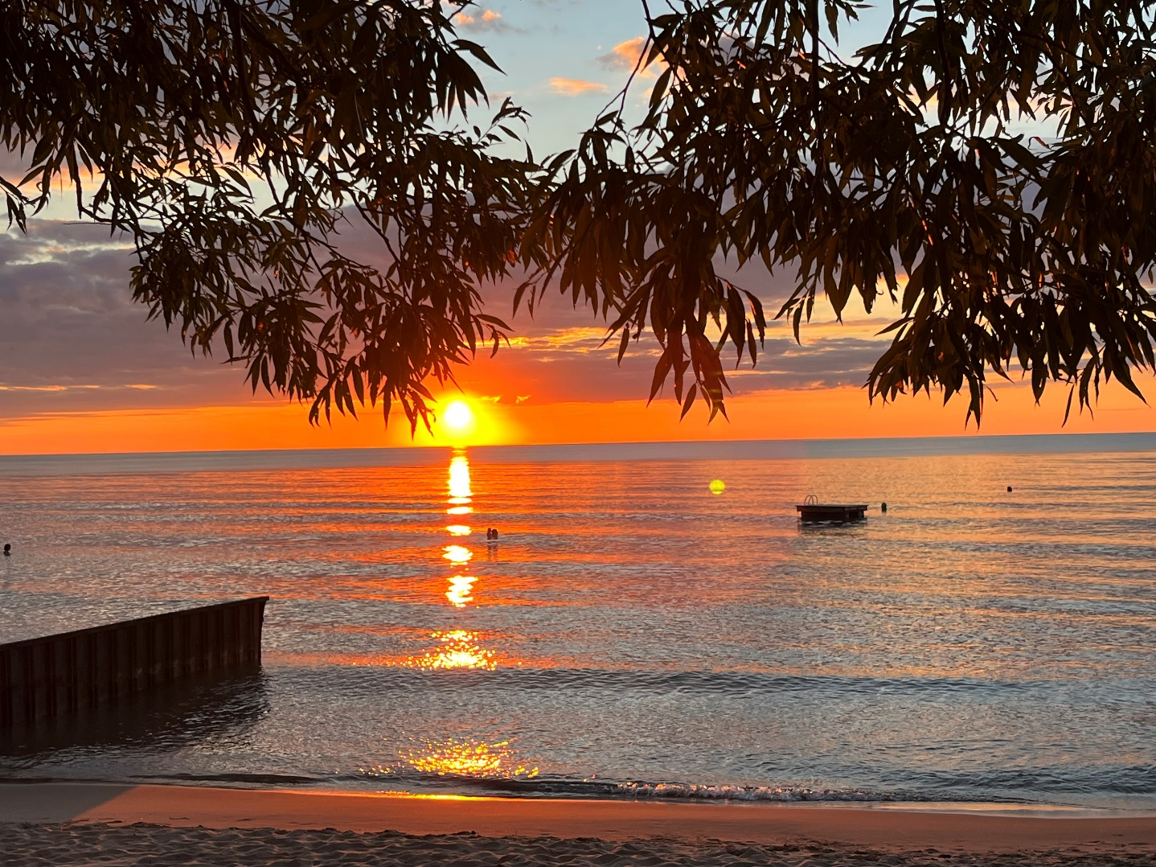
The sun’s “reflection” on the lake is beautiful.
Your turn: What is a “reflection?” Describe the picture and use the word “reflection”. Where else can you see reflections?

Slide 54
Let's talk it out!
Say the “-ion” word.
Have students say the “-ion” word.
Discuss the word meaning (act of or state of).
Use the “-ion” word in a sentence when discussing:
When would you like to have a celebration?
Do you have a favourite expression? Share!
What are the directions to your house? Tim Horton’s? etc.

Slide 55
-ion
Meaning: act of or state of
vibration
instruction
adoption
When I make the /zzzz/ and /vvvvv/ sounds my voice box vibrates. I can feel the ________ on my neck.
My family is getting a kitten. We will adopt one from the Humane society. The ________ will occur next week.
Our teacher will instruct us what to do when we have a practice fire alarm. We must listen carefully to each ________ .
vibration
adoption
instruction
Change words & sentences frequently to review

Slide 56
Word sums:
direct + ion 🡪
reflect + ion 🡪
erupt + ion 🡪
express + ion 🡪
act+ ion 🡪

Slide 57
-able
Read with me
Meaning: able to, can do, be
fixable
adjustable
preferable
achievable
likable
durable
touchable
imaginable
agreeable
loveable
avoidable
enjoyable
payable
suitable
excitable

Slide 58
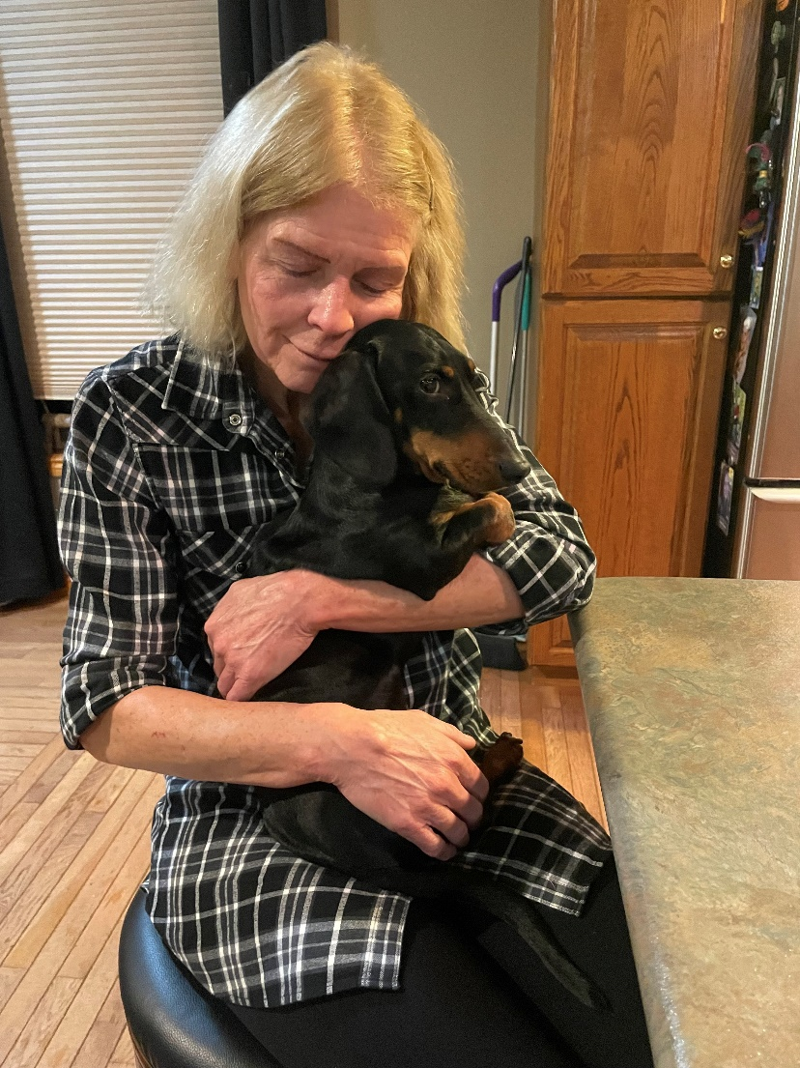
This woman is hugging her dog. The dog is “loveable”.
Your turn: Do you have something that is “loveable”? Use “loveable” in a sentence.

Slide 59
Let's talk it out!
Say the “-able” word.
Have students say the “-able” word.
Discuss the word meaning (can do).
Use the “-able” word in a sentence for the following:
My friend told me a story about a monster. His description was so good that the story was …(believable).
Do you enjoy going to the movies? I find movies about superheroes …(enjoyable).
When you go on long walks it is important to wear …(comfortable) shoes so your feet don’t hurt.
My brother broke my toy. He told me not worry because it is…(fixable) and he can fix it.

Slide 60
-able
Meaning: can do or be
answerable
shareable
trainable
Our family got a dog at the humane society. I have trained him to fetch. The vet said he was ________ .
My mom gave my friend and I one bag of pretzels and two plates. She told us to share. This treat is _________ .
My teacher asked us questions about a book we read. All the questions were easy and ________ .
trainable
shareable
answerable
Change words & sentences frequently to review

Slide 61
Make new words!:
fix + able 🡪
allow + able 🡪
com + pare + able 🡪
drink + able 🡪
respect + able 🡪

Slide 62
-ible
Read with me
Meaning: able to, can do, be
edible
flexible
legible
resistible
collectible
sensible
terrible
accessible
possible
convertible

Slide 63
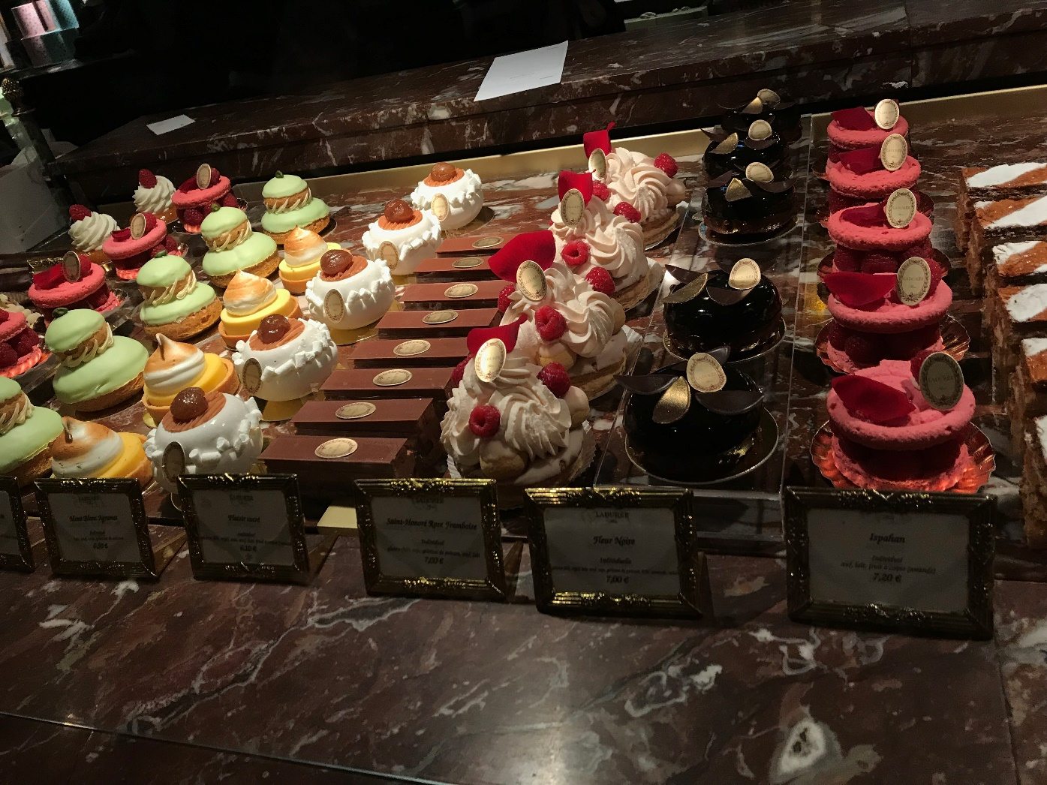
This counter is full of “irresistible” desserts.
Your turn: What would you do if you saw this counter?
Use “irresistible” in a sentence.

Slide 64
Let's talk it out!
Say the “-ible” word.
Have students say the “-ible” word.
Discuss the word meaning (able, can do, or be).
Discuss and use the “-ible” word in a sentence for the following:
I hate broccoli. I hate the way it tastes! It tastes …(terrible).
When I grow up, I want to be the prime minister or a doctor or a teacher. Anything is…(possible) if you work hard and dream big!
My sister is starting school next year. She is in a wheelchair. The school has ramps, so it is ….(accessible) for her.

Slide 65
-ible
Meaning: able, can do or be
edible
responsible
flexible
flexible
Can you criss-cross your legs? If so, you are ________ .
Did you know some people put flowers on their salad? Some flowers are _________ . You can eat them!
In order to babysit, you should be at 12 years old and take the babysitting course. This way you learn how to be ________ .
edible
responsible
Change words & sentences frequently to review

Slide 66
Make a tree:
flex + ible 🡪
poss + ible 🡪
express + ible 🡪
sens + ible 🡪
leg + ible 🡪

Slide 67
-ure
Read with me
meaning: a process, a condition, a result of an action
future
capture
mixture
suture
creature
puncture
denture
sculpture
pressure
nature
architecture
moisture
structure
torture
feature

Slide 68
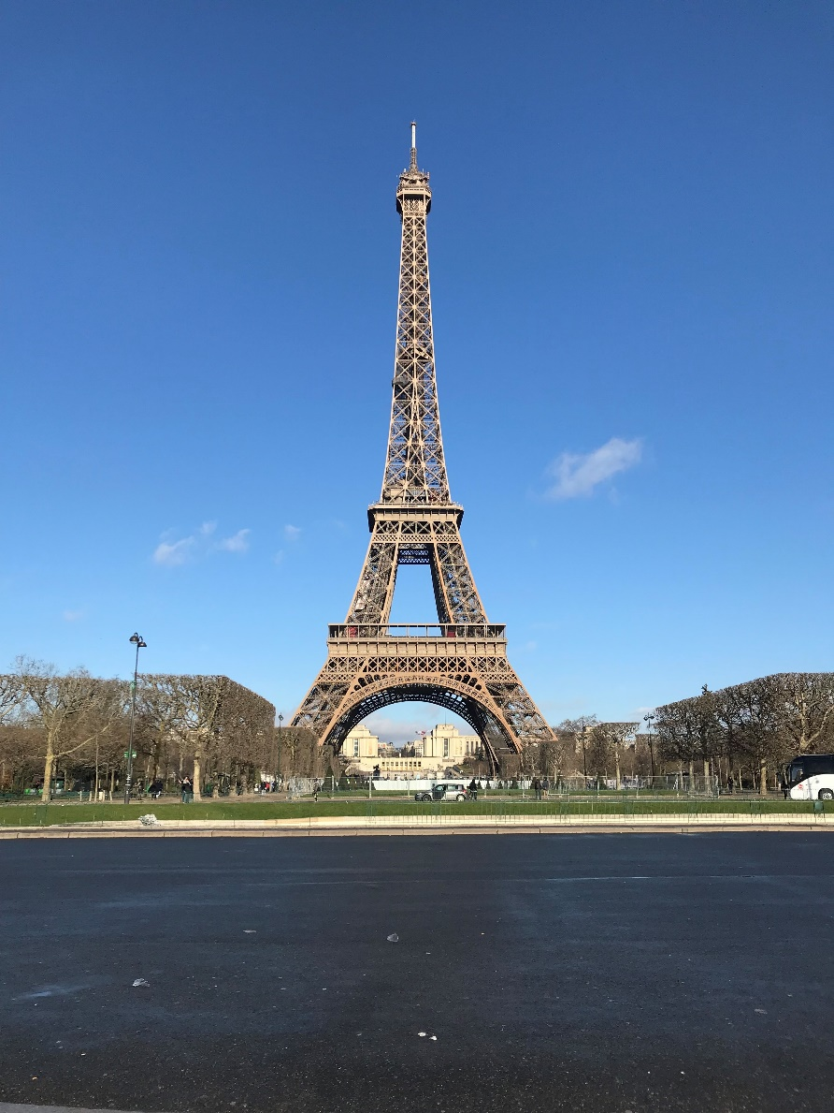
This is a “structure” in Paris.
Your turn: Does anyone know the name of this structure? Use the word “structure” in your answer. Think of other structures.

Slide 69
Let's talk it out!
Say the “-ure” word.
Have students say the “-ure word.
Discuss the word meaning (a process, a condition, a result of an action).
Discuss and use the “-ure” word in a sentence for the following:
If I mix red paint and blue paint, my …(mixture) will be purple.
My parents want me to enjoy the beauty of ….(nature), so we are going camping in the forest.
The sun dries the ….(moisture) on the ground. Plants suck the …(moisture) from the earth.

Slide 70
-ure
Meaning: a process, a condition, a result of an action
measure
sculpture
fracture
The artist likes to sculpt. She made a ________ of Taylor Swift.
The figure skater fell while doing a spin. She had to get an x-ray of her hand. The x-ray showed a _________ in her wrist.
I love to watch my brother bake cookies. He takes out all the ingredients, carefully ________ them, then mixes them in the bowl.
sculpture
fracture
measures
Change words & sentences frequently to review

Slide 71
Make new words!:
press + ure 🡪
moist + ure 🡪
struct + ure 🡪
dent + ure 🡪
capt+ ure 🡪

Slide 72
-ist
Read with me
meaning: someone who
dentist
artist
tourist
cartoonist
finalist
bicyclist
scientist
pianist
therapist
harpist
activist
journalist

Slide 73
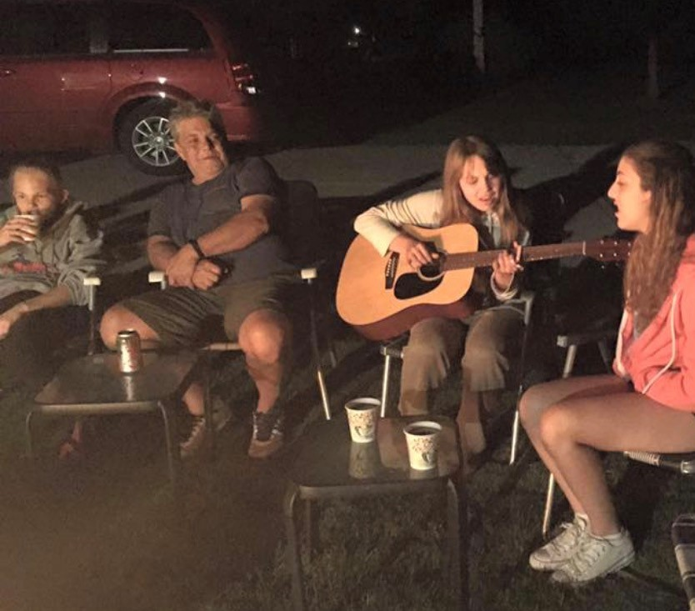
This “guitarist” is playing songs by a campfire. What do we call a person who plays a guitar?
Your turn: Use the word “guitarist” in a sentence. What does a vocalist do? A pianist? A harpist? A flutist?

Slide 74
Let's talk it out!
Say the “-ist” word.
Have students say the “-ist” word.
Discuss the word meaning (someone who).
Discuss and use the “-ist” word in a sentence for the following:
I love all kinds doing all kinds of art: painting, drawing, sketching. When I grow up, I want to be an …(artist).
I love learning about different places around the world. I want to travel to so many countries! I want to be a …(tourist).
I love taking care of our earth. I pick up litter and recycle. We need to take care of the environment. When I grow up, I want to be an …(environmentalist)

Slide 75
-ist
Meaning: someone who
scientist
dentist
pianist
My music teacher plays the piano beautifully. She teaches me at lunch time so that I can be a ________
The professional who checks and cleans your teeth is a _________
The ________ is working in her lab. She is looking at human cells under a microscope.
pianist
dentist
scientist
Change words & sentences frequently to review

Slide 76
Make new words!:
solo + ist 🡪
chem + ist 🡪
pharmac + ist 🡪
flor + ist 🡪
final + ist 🡪

Slide 77
-ish
Read with me
meaning: somewhat, sort of
foolish
stylish
reddish
sluggish
selfish
babyish
smallish
childish
clownish
newish
ticklish
skittish
squeamish
feverish
biggish

Slide 78
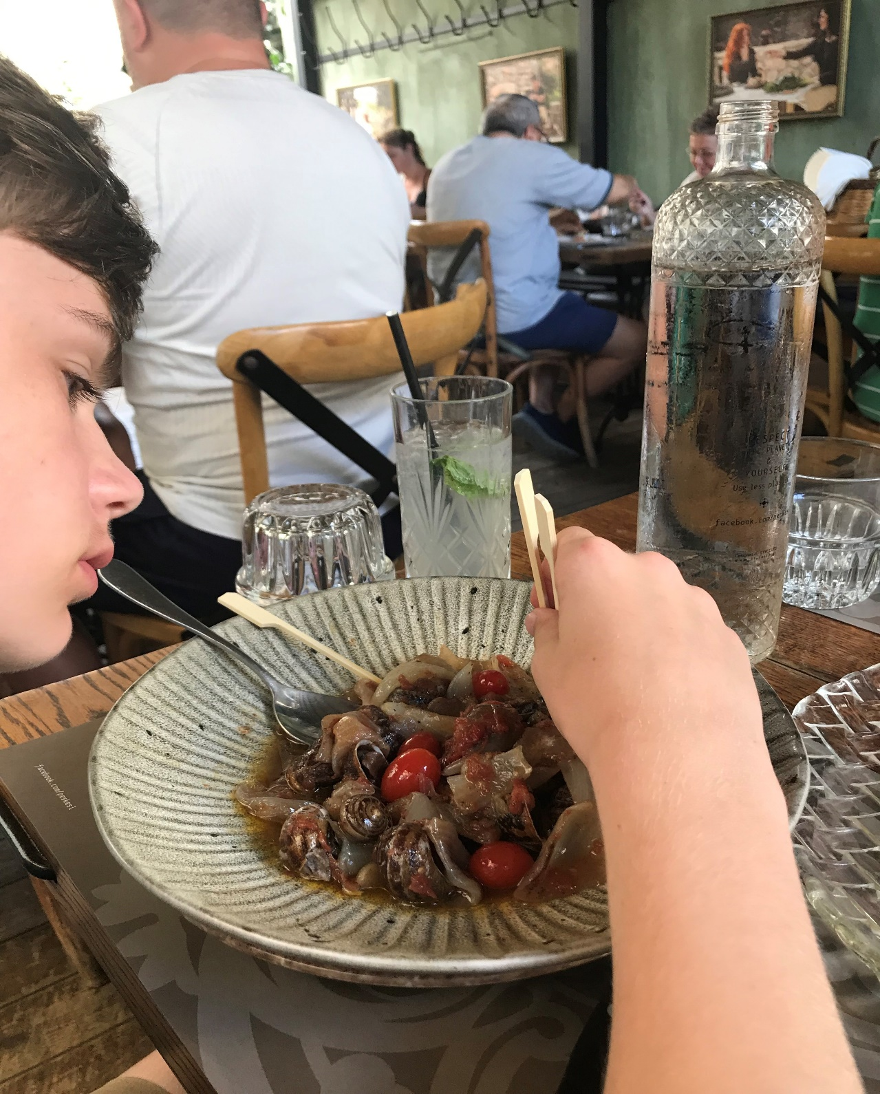
This bowl of snails is making me “squeamish”! How about you?
Your turn: Use the word “squeamish” to describe the picture. What other foods make you squeamish?

Slide 79
Let's talk it out!
Say the “-ish” word.
Have students say the “-ish” word.
Discuss the word meaning (sort of, somewhat).
Discuss and use the “-ish” word in a sentence for the following:
My brother was whining like a baby when he didn’t get his own way. I told him not to be … (babyish).
I don’t feel well. I feel hot and tired. My mom said that I am …(feverish) and ….(sluggish). I am going to stay in bed and rest!
If you think about yourself and talk about yourself all the time, people might say that you are …(selfish).

Slide 80
-ish
Meaning: approximately, somewhat, sort of
foolish
clownish
newish
clownish
She is acting silly in gym. Her teacher told her not to act ________
I asked my friend if her dress was new. She said she got it a few months ago so it is still _________ .
At recess, some kids were acting like fools and throwing sticks. They were being ________ .
newish
foolish
Change words & sentences frequently to review

Slide 81
Make new words!:
cold + ish 🡪
child + ish 🡪
red + ish 🡪
sweet + ish 🡪
devil + ish 🡪

