Slide 1
Prefix Slide Deck:
Grade 3
GECDSB

Slide 2
post-
Read with me
meaning: after
postpone
postdate
post-mortem
postnatal
postoperative
postpartum
post-war
postscript
post-industrial
postgame

Slide 3
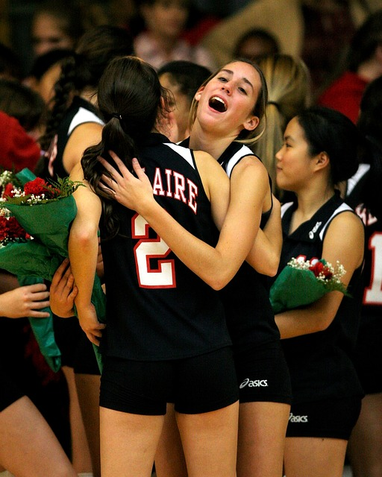
Now that the team has won the championship game, they will be able to relax a little in the postseason.

Slide 4
Let's talk it out!
Say the “post-” word.
Have students say the “post-” word.
Discuss the word meaning (after).
After a woman delivers a baby she receives “postnatal” care to ensure that she and the baby are healthy.
My dad had his gall bladder removed and had “postoperative” care by the nurses. They made sure his incision was healing.
Our test was “postponed” because there was a snow day!

Slide 5
post-
meaning: after
postpone
postgame
postgraduate
postgame
The coach was giving feedback to the football team __________.
My brother is a _____________ . He went to university for many years to become a science professor.
My friend had to __________ his birthday party because he was sick.
postgraduate
postpone
Change words & sentences frequently to review

Slide 6
Let's make new words:
post + season →
post + graduate→
post + game →
post + date →
post + war →

Slide 7
under-
Read with me
meaning: beneath, lower, below
underneath
underwear
underscore
understand
undercharge
underside
undercoat
underestimate
underhand
undermine
undergraduate
underpass
understudy
underactive
underage

Slide 8
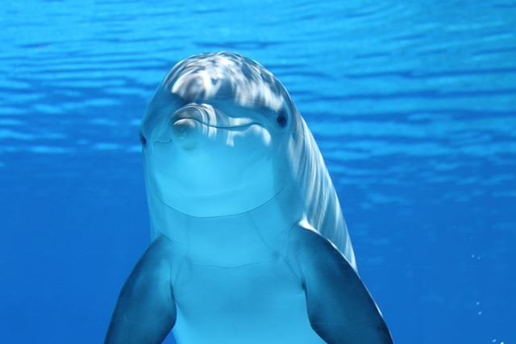
If you go scuba diving or snorkeling you might be able to see some underwater animals.

Slide 9
Let's talk it out!
Say the “under-” word.
Have students say the “under-” word.
Discuss the word meaning (below, lower, less).
When it is cold outside, you might want to put on an “undershirt” before your sweater to keep you body warm.
The chicken was “undercooked” It was pink in the middle.
Our teacher has us “underline” words that we don’t know the meaning of.

Slide 10
under-
meaning: beneath, lower, below
underground
underestimate
understudy
The actor in the musical had a sore throat so his ___________ had to fill in that night.
The gardener digs into the soil and plants the seeds _____________ .
I can’t believe I did well on the math test. I shouldn’t ______________ my ability!
understudy
underground
underestimate
Change words & sentences frequently to review

Slide 11
Let’s make new words:
under + pass →
under + age →
under + wear →
under + coat →
under + study →

Slide 12
over-
Read with me
meaning: above, too much
overreact
overboard
overbooked
overcast
overcoat
overeat
overslept
overdone
overexcited
overgrown
overpopulated
overextended
overfed
overrule
overcorrect

Slide 13
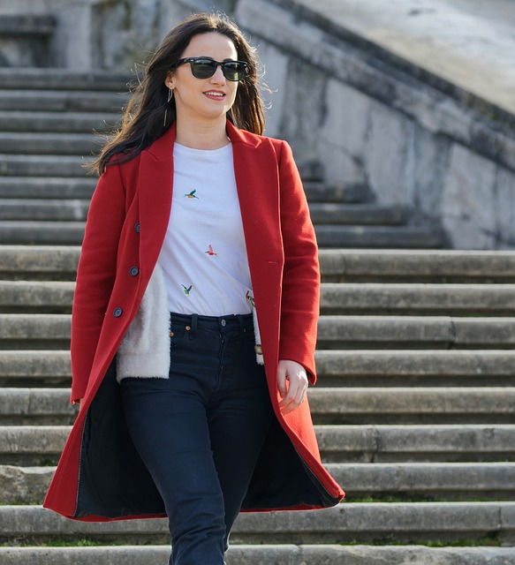
When it is cool outside, you can wear an overcoat.

Slide 14
Let's talk it out!
Say the “over-” word.
Have students say the “over-” word.
Discuss the word meaning (above, too much).
I was late for school because I “overslept”.
My friend was “overcharged” for the sweater she purchased. It was worth $20 and the store charged her $30!
The teacher librarian sent notes home with students who had “overdue” library books.

Slide 15
over-
meaning: above, too much
overworked
overcast
overjoyed
overcast
My family was going to go to the beach but the sky is __________ and it might rain.
In today’s busy world, many adults feel _____________ and tired.
Our principal was ______________ that our school was selected for a new outdoor learning area.
overworked
overjoyed
Change words & sentences frequently to review

Slide 16
Let’s make new words:
over + react →
over + board →
over + slept →
over + done →
over + rule →

Slide 17
anti- / ant-
Read with me
meaning: against / opposite to
anticlockwise
antiseptic
antidote
antisocial
antonym
antagonistic
antagonist

Slide 18
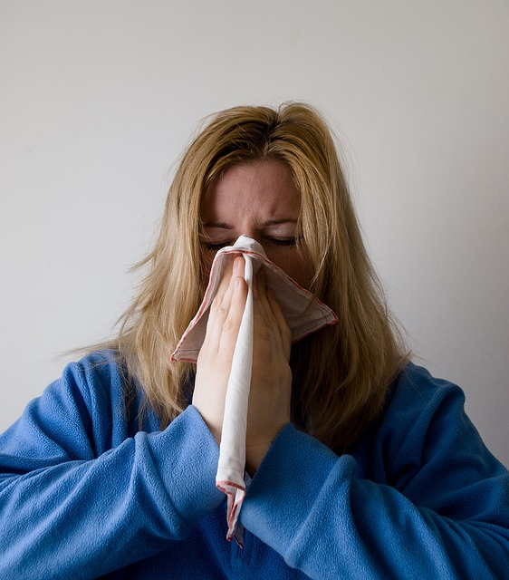
If you have a head ache and sore throat, the doctor might have to give you an antibiotic.

Slide 19
Let's talk it out!
Say the “anti-/ant-” word.
Have students say the “anti-/ant-” word.
Discuss the word meaning (against, opposite).
My doctor gave me an “antibiotic” to clear up my ear infection.
My classroom has an “antibacterial” handwash pump by the door that we have to use before we have lunch.
The “antonym” for wet is dry. The “antonym for “dirty” is “clean”.

Slide 20
anti-/ant-
meaning: against, opposite
antiworked
antifreeze
antagonist
antogonist
The _____________ in the story Little Red Riding Hood is the wolf.
The mechanic puts _____________ into our car to prevent it from overheating.
If my dad eats spicy foods, he needs to take an _________ to calm his stomach down.
antifreeze
antacid
Change words & sentences frequently to review

Slide 21
Let’s make new words:
anti + clock + wise →
anti + septic →
anti + dote →
anti + social →

Slide 22
sub-
Read with me
meaning: under, beneath, lower
submarine
suburban
subconscious
substitute
subdivision
subside
subdue
subject
subsection
submachine
submerge
submerse
subscribe
subordinate
subdivision

Slide 23
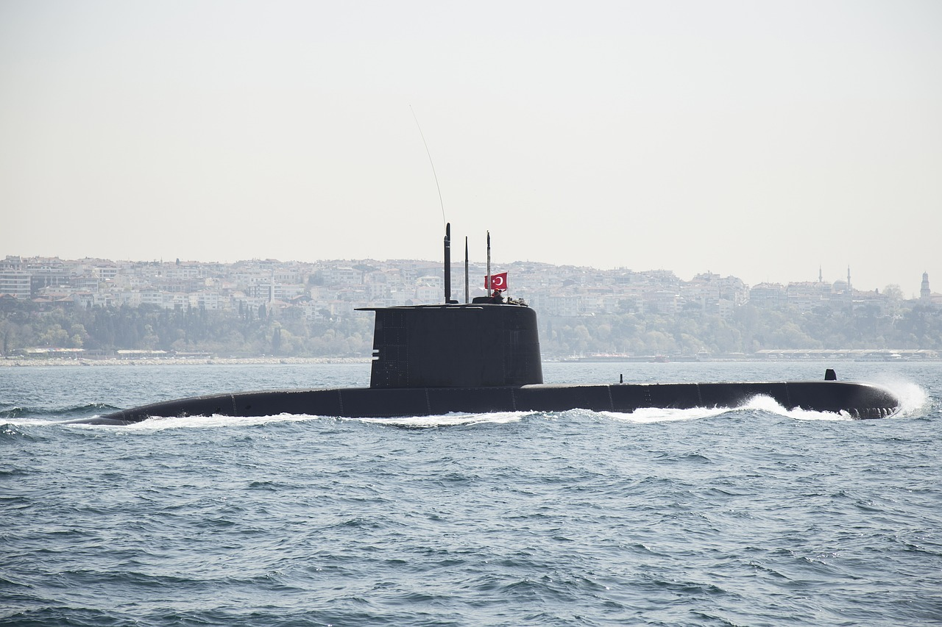
A submarine is a watercraft that operates under water.

Slide 24
Let's talk it out!
Say the “sub-” word.
Have students say the “sub” word.
Discuss the word meaning (under, beneath, lower).
The “subway” takes you in and out of the city.
A “subheading” appears under a heading in a text.
“Subsoil” is a layer of earth beneath the surface.

Slide 25
Sub-
meaning: under, beneath, lower
subdivided
subzero
substitute
The weather reporter predicted _____________ temperature as the thermometer reading dropped below 0 degrees Celsius.
The four of us _____________ the cookie by spitting it up then splitting it again.
Our teacher was home sick and we had a _________ .
subzero
subdivided
substitute
Change words & sentences frequently to review

Slide 26
Let’s make new words:
sub + side →
sub + marine→
sub + merge →
sub + merse →
sub + urban →

Slide 27
trans-
Read with me
meaning: across
transport
transform
transparent
transcend
transpire
transient
transplant
transcribe
transit
translate
transcript
transfer
transmission
transfigure
transfix

Slide 28
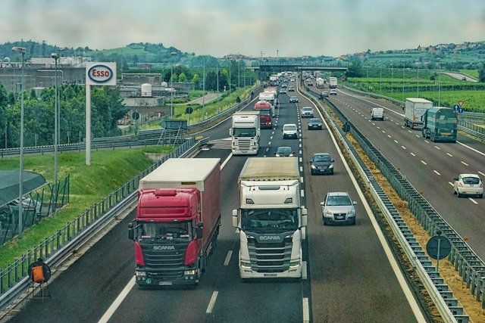
These transport trucks haul foods and products from one city in Canada to another.

Slide 29
Let's talk it out!
Say the “trans-” word.
Have students say the “trans-” word.
Discuss the word meaning (across).
Do you ever “transfer” money from one bank account to another?
My neighbour is new to the community and speaks only French. I am helping her learn English by “translating” words for her.
The Titanic was taking a “transatlantic” voyage from England to New York City.

Slide 30
trans-
meaning: across
transform
transmit
transit
transit
Taking public ________ to and from work is a great way to reduce pollution
The city is going to _________ an old farmhouse into an art gallery.
We had to isolate in 2020 and 2021 because the Covid virus was easy to __________ from person to person.
transform
transmit
Change words & sentences frequently to review

Slide 31
Let’s make new words:
trans + port →
trans + form→
trans + fix →
trans + plant →
trans + spire →

Slide 32
non-
Read with me
meaning: not
nonfiction
nonliving
nonflying
nonstick
nonsense
nontoxic
nonmember
nonstop
nonnegotiable
nonspecific
non-profit
noncontact
nonbeliever
nonessential
non-skid

Slide 33
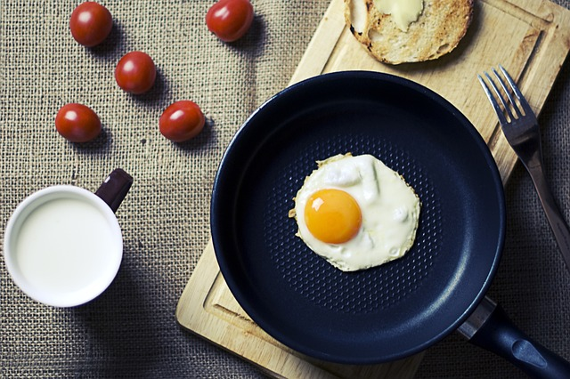
Having a nonstick frying pan is great for making fried eggs and pancakes.

Slide 34
Let's talk it out!
Say the “non-” word.
Have students say the “non-” word.
Discuss the word meaning (not).
He is a “nonadmirer” of flowers.
John is “noncooperative” these days and refuses to learn.
We had to categorize items as living or “nonliving” in our science activity.

Slide 35
non-
meaning: not
nonflying
nontoxic
nonfiction
It is safe to eat and breathe ________ substances.
My library teacher helps me find _________ books about animals.
Penguins, emus, and ostriches, are __________ birds.
nontoxic
nonfiction
nonflying
Change words & sentences frequently to review

Slide 36
Let’s make new words:
non + sense→
non + stop→
non + profit →
non + traditional →
non + violent →

Slide 37
mid-
Read with me
meaning: middle
midday
middle
mid-air
midway
midweek
midterm
midsize
midline
midbrain
midwife
midwinter
midstream
midsection
midyear
midship

Slide 38
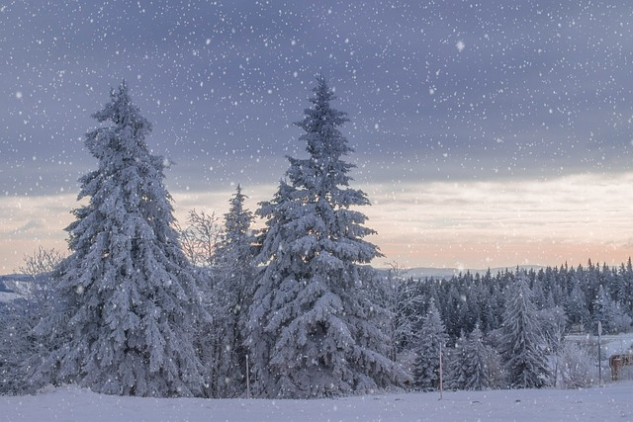
In mid-January, we often get snow.

Slide 39
Let's talk it out!
Say the “mid-” word.
Have students say the “mid-” word.
Discuss the word meaning (middle).
We often go outside in the “midafternoon” and get fresh air.
We drove for several hours to our grandparents and arrived at “midnight”.
On Hallowe’en, my parents give out mid-size chocolate bars.

Slide 40
mid-
meaning: middle
midsize
midnight
middle
My family purchased a ________ car.
My sister went out with her friends and didn’t get home until ________ . My parents were angry!
I am the __________ child in my family. I have an older brother and younger sister.
midsize
midnight
middle
Change words & sentences frequently to review

Slide 41
Let’s make new words:
mid + week→
mid + town→
mid + point →
mid + life →
mid + term →

Slide 42
in-/im-
Read with me
meaning: not
indirect
incorrect
intolerable
independent
invisible
imperfect
impolite
impatient
immobile
imbalance
incomplete
inadequate
inactive
informal
insecure

Slide 43
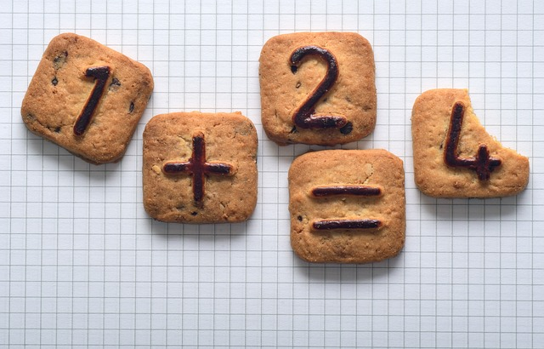
This is inaccurate. Check your work again.

Slide 44
Let's talk it out!
Say the “in-/im-” word.
Have students say the “in-/im-” word.
Discuss the word meaning (not).
My little sister thinks that she is “invisible” and that no one can see her!
It is easy to become “inactive”, stay inside, and watch t.v. when the weather gets cold.
I am new at doing this so please don’t be “impatient” with me.

Slide 45
in-/im-
meaning: not
independent
impolite
incomplete
It is ________ to not say please and thank you.
If you don’t finish your assignment, the teacher will tell you it is ____________.
I want to do the work by myself. I want to be ______________ .
impolite
incomplete
independent
Change words & sentences frequently to review

Slide 46
Let’s make new words:
im + perfect →
im + mobile→
in + adequate →
in + valid→
in + flexible →

Slide 47
inter-
Read with me
meaning: between, among
internet
international
intersection
interview
intercept
imperfect
impolite
impatient
immobile
imbalance
incomplete
inadequate
inactive
informal
insecure

Slide 48
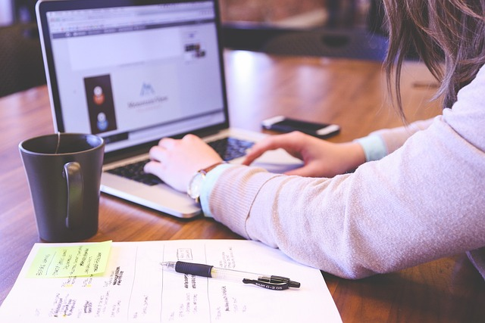
We can use the internet to for many things such as finding information, communicating with friends, and playing games.

Slide 49
Let's talk it out!
Say the “inter-” word.
Have students say the “inter-” word.
Discuss the word meaning (between, among).
We went to a play. At “intermission”, we purchased some pop and snacks.
English is an international language. Schools in many countries teach children how to speak and write in English.
If you “interrupt” someone when they are talking, you are being rude.

Slide 50
inter-
meaning: between, among
interoffice
internet
intersection
internet
The __________ is a linked system of networks that helps us connect on a global scale.
People who work in large office buildings often have to send ___________ mail. This ensures that information goes between offices.
Safe drivers follow traffic signs at ______________ .
interoffice
intersections

Slide 51
Let’s make new words:
inter + connect→
inter + cept→
inter + est →
inter + act→
inter + vene→

Slide 52
intra-
Read with me
meaning: within
intranet
intravenous
intracellular
intramural
intraoral
intracoastal
intracranial
intradermal
intradepartmental

Slide 53
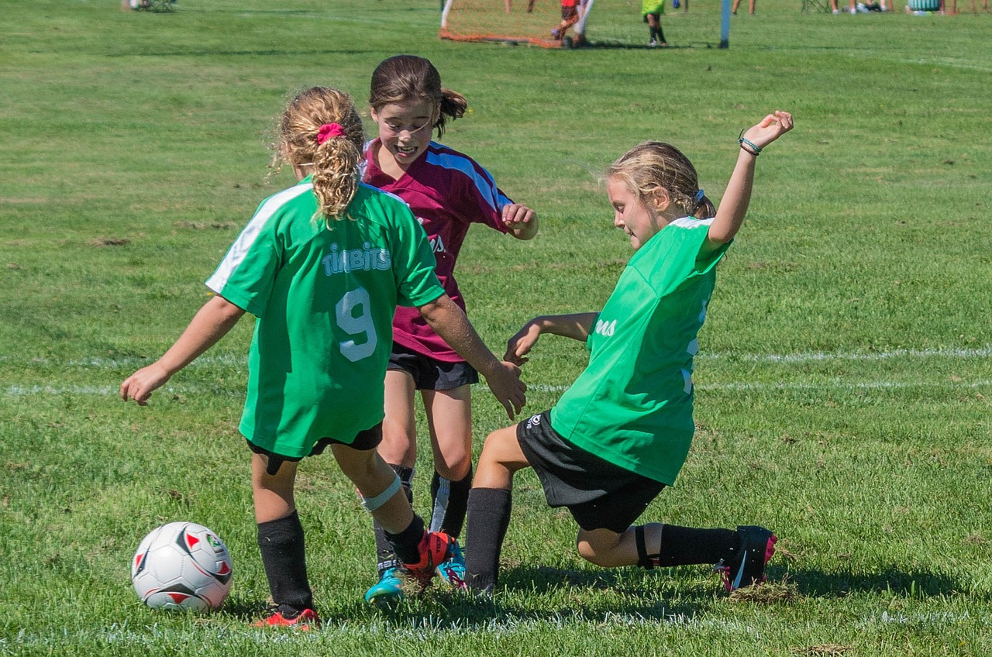
Playing intramural sports in your own school is a great way to keep fit, make friends and have fun.

Slide 54
Let's talk it out!
Say the “intra-” word.
Have students say the “intra-” word.
Discuss the word meaning (within).
Animals engage in “intraspecies” competition. This means they compete with other animals in the same species.
When a doctor gives you antibiotics, the medicine enters your body and has an “intracellular” battle with bacteria.

Slide 55
intra-
meaning: within
intramural
intraschool
intravenous
intraschool
My classmates and I won for our school in the ____________ spelling Bee.
The doctors are giving her an ______________ drip, which administers the medicine directly into her veins..
Olivia played ______________ basketball in high school.
intravenous
intramural
Change words & sentences frequently to review

Slide 56
Let’s make new words:
intra + cellular →
intra + oral→
intra + venous →
intra + mural→
intra + coastal →

