Slide 1
Prefix Slide Deck:
Language Comprehension
Grades 1 and 2
GECDSB

Slide 2
un-
Read with me
meaning: not, undo, opposite of
undo
unbutton
untie
uncover
unfair
unkind
unlock
unscrew
unfold
unpack
unhappy
unclean

Slide 3
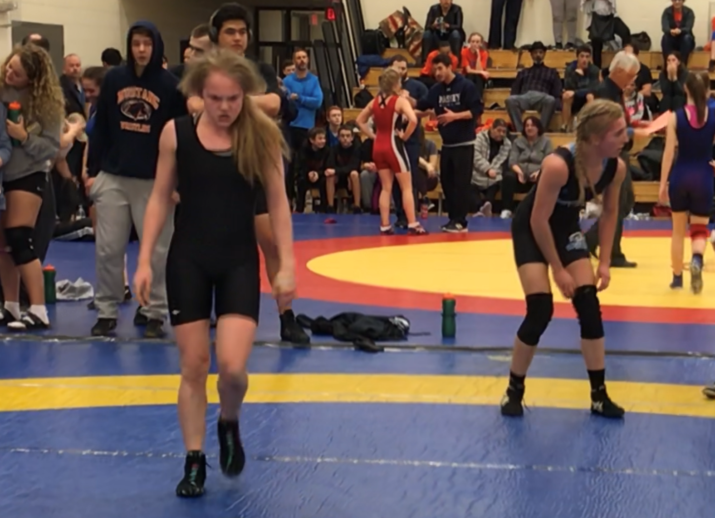
This wrestler is “unhappy”. Why do you think she is “unhappy”?
Your turn: Use the word “unhappy” in a sentence. What do you think happens next?

Slide 4
Let's talk it out!
Say the “un-” word.
Have students say the “un-” word.
Discuss the word meaning (not, undo, reverse).
When have you been “unhappy” about something?
When would you “unlace” something?
When would you “unload” something?

Slide 5
un-
meaning: not, undo, opposite of
unlock
unpack
untie
unlock
You will need to ________ the door to get in.
I will _________ the ribbon.
Mum told me to ________ my bag.
untie
unpack
Change words & sentences frequently to review

Slide 6
Let's make new words!!
un + do 🡪
un + pack 🡪
un + tie 🡪
un + cover 🡪
un + dress 🡪

Slide 7
re-
Read with me
meaning: again
retell
redo
reset
revise
rewrite
rebuild
recount
research
remove
renew

Slide 8
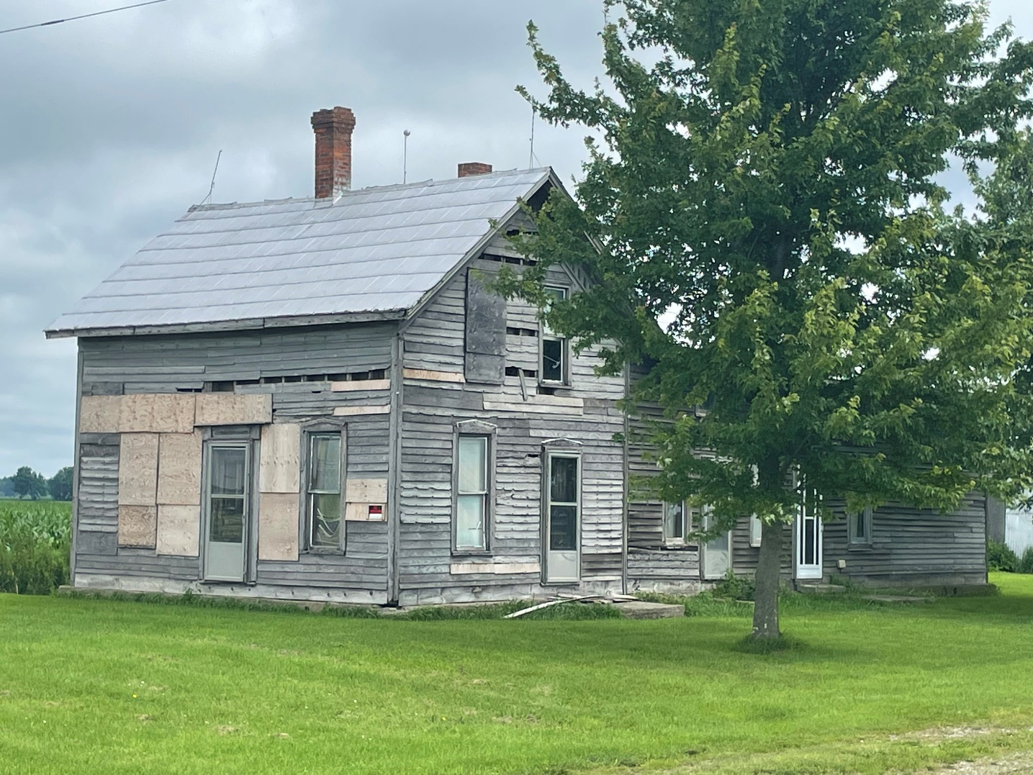
The family has to “rebuild” this house before they can move in.
Your turn: What can you “rebuild”? Use the word “rebuild in a sentence.

Slide 9
Let's talk it out!
Say the “re-” word.
Have students say the “re-” word.
Discuss the word meaning (again, back).
What is a “replay” at a sports event? Why do referees look at “replays” during a game?
If your teacher could “rearrange” your desks, who would you like to sit by?
Do you “reread” the decodable stories from UFLI? Why? Why not?

Slide 10
re-
meaning: again, back
recount
repack
retie
recount
You will need to ________ the birthday candles to see if I need to buy more.
I will _________ the ribbon because it came undone.
Mom told me to ________ my suitcase because the weather was changing..
retie
repack
Change words & sentences frequently to review

Slide 11
Let's make new words!:
re + start 🡪
re + call 🡪
re + fill 🡪
re + write 🡪
re + try 🡪

Slide 12
in-
Read with me
meaning: not
inactive
incorrect
invisible
inflexible
inconsiderate
independent
incapable
inexpensive
inhumane
inaccurate

Slide 13
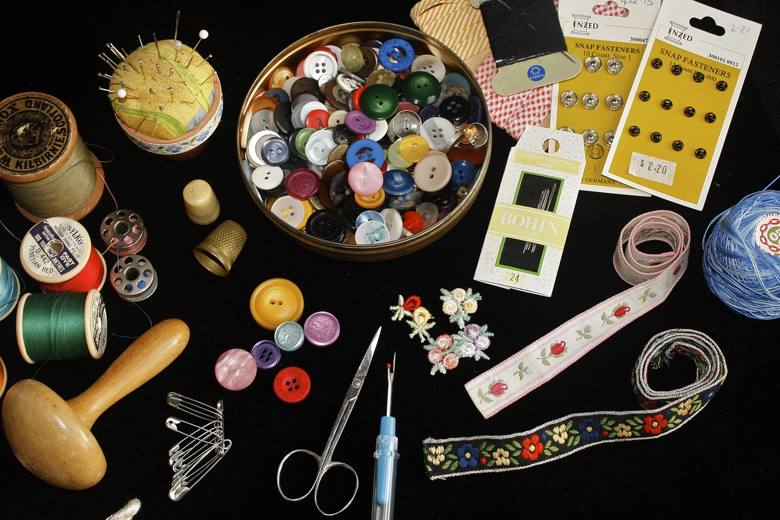
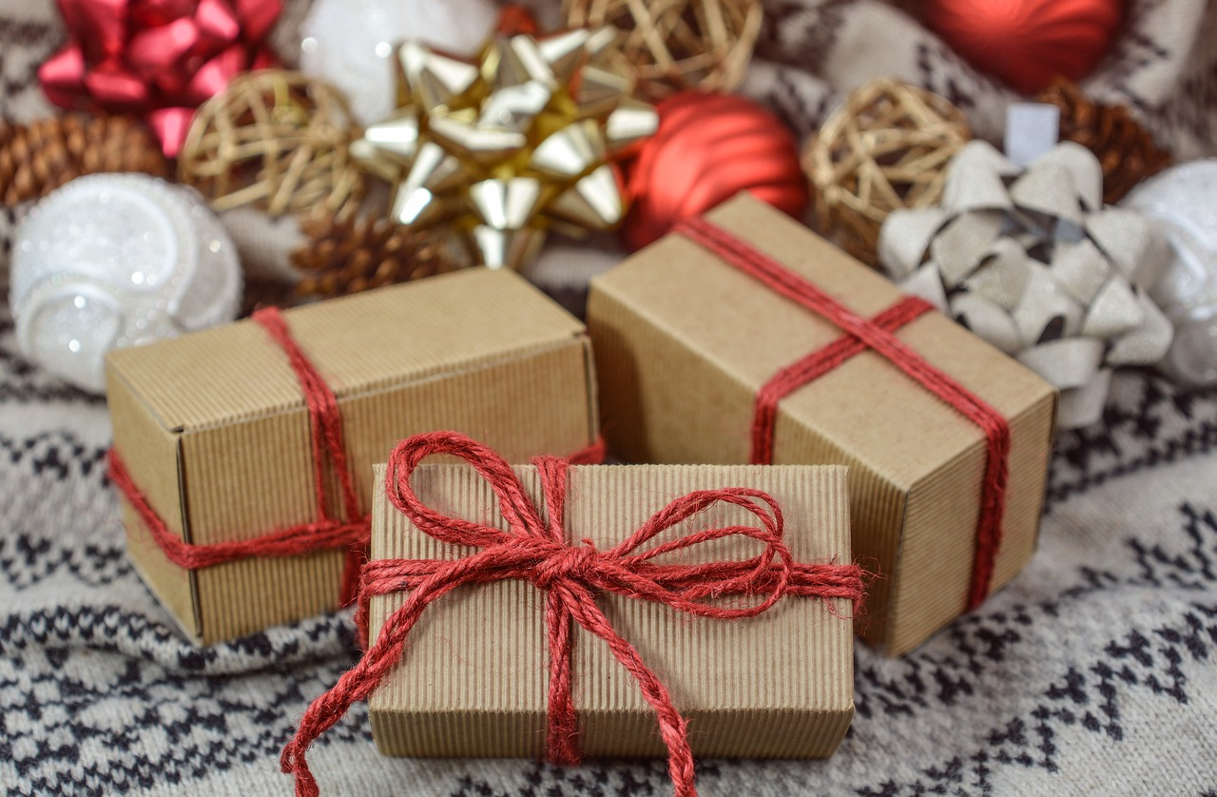
When you make someone a present, it can be “inexpensive” .
Your turn: Have you made someone a present before? Did it cost you a lot of money or was it “inexpensive”?
What “inexpensive” present can you make for your parent?

Slide 14
Let's talk it out!
Say the “in-” word.
Have students say the “in-” word.
Discuss the word meaning (not).
What are some considerate things you can do at school? What would be “inconsiderate”?
What does “inexpensive” mean? How can you make money if something is too expensive to buy?
Being “inactive” is not good for your health. What things can you do to be active?

Slide 15
in-
meaning: not
independent
incorrect
invisible
independent
I can walk to school by myself. I can be ______________.
I can pretend that you can’t seen me and I am _________.
It is OK if your guess is ________ , just try again!
invisible
incorrect
Change words & sentences frequently to review

Slide 16
Let's make new words!:
in + active 🡪
in + accurate🡪
in + valid 🡪
in + visible🡪

Slide 17
dis-
Read with me
meaning: dislike, not, apart
distant
disable
disengage
dispute
disagree
disclose
disappear
discount
distribute
disrupt
discourage
disguise
disarm
discover
disorder

Slide 18
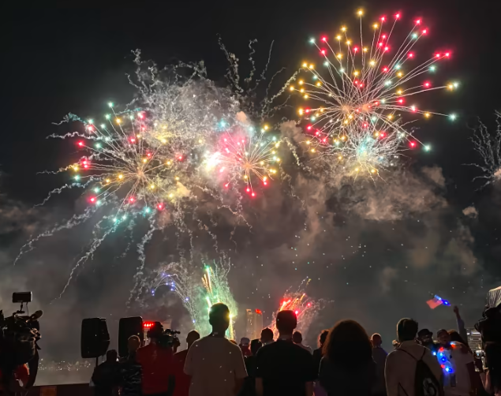
Sparks “discharge” from the Detroit Ford fireworks.
Your turn: Talk about your experience with sparks discharging.
Use “discharge”.

Slide 19
Let's talk it out!
Say the “dis-” word.
Have students say the “dis-” word.
Discuss the word meaning (not, absence of, apart).
When would you “discuss” something?
What do you “dislike”?
When would you “dispose” of something?

Slide 20
dis-
meaning: not, absence of, apart
disrupt
dislike
disappear
dislike
I like carrots, but I ________ green beans.
The teacher told the student to not talk loudly and _________ the class working.
The magician made the rabbit ________ from the stage and then come out of the hat! .
disrupt
disappear
Change words & sentences frequently to review

Slide 21
Let's make new words!:
dis + close 🡪
dis + trust🡪
dis + cover 🡪
dis + appear 🡪
dis + count 🡪

Slide 22
mis-
Read with me
meaning: wrong or bad
misadventure
misspell
misbehave
mismatch
mischief
mistook
misdirect
misstep
misfortune
mishap
mislead
misplace
mistreat
misunderstand
mistake

Slide 23
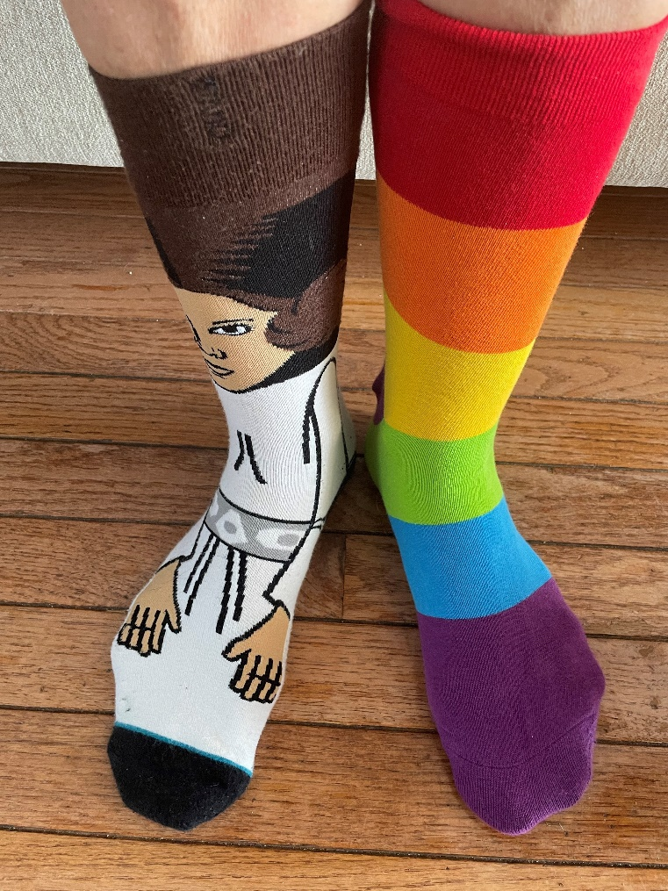
This person grabbed socks out of her drawer and put them on. The socks “mismatch”.
Your turn: Has this happened to you with socks? shoes? mittens?
Use the word “mismatch” in a sentence.

Slide 24
Let's talk it out!
Say the “mis-” word.
Have students say the “mis-” word.
Discuss the word meaning (wrong, bad).
Do you ever “misunderstood” directions that an adult gives you? What can you do to ensure you understand?
Have you “misjudged” the weather and wore the wrong kind of clothes to school?
Sometimes names are hard to say, and they can be “mispronounced”. If someone “mispronounces” your name, what do you do??

Slide 25
mis-
meaning: wrong, bad
misplace
misstep
mistake
mistake
Sometimes if I go to fast doing math, I will make a ________.
I went to step over a puddle and accidently _________ . I fell into the puddle!
I can’t remember where I placed my homework. I must have ________ it.
misstepped
misplaced
Change words & sentences frequently to review

Slide 26
Let's make new words!:
mis + spell 🡪
mis + lead 🡪
mis + take 🡪
mis + treat 🡪
mis + place 🡪

Slide 27
pre-
Read with me
meaning: before
preview
previous
prevent
preheat
precaution
pretend
prescription
prepackage
prefer
prefix
precook
prerecord
prearrange
preschool
prehistoric

Slide 28
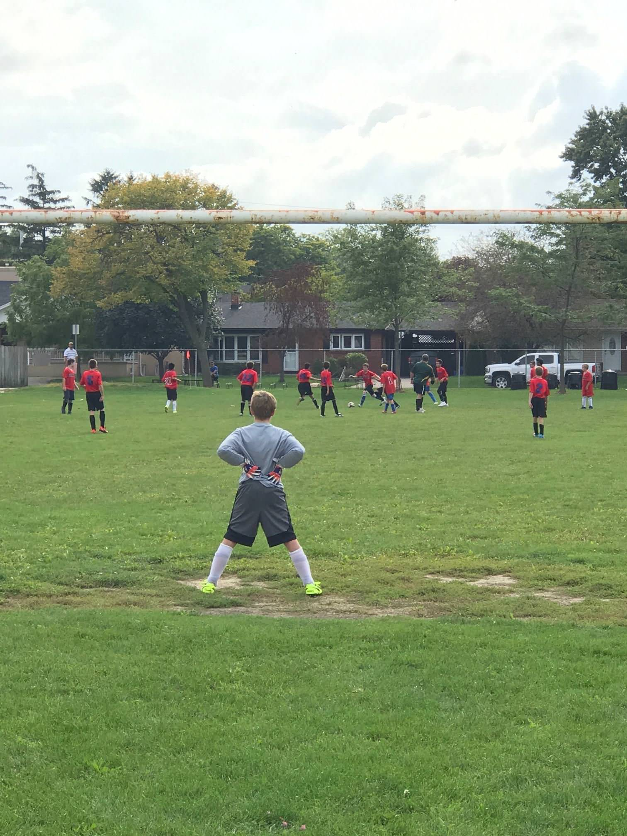
What do you think will happen next?
Your turn: Share your thinking and use the word “predict”.

Slide 29
Let's talk it out!
Say the “pre-” word.
Have students say the “pre-” word.
Discuss the word meaning (before, earlier).
Young children often go to “preschool”. What is it? Did you?
When would you “preorder” something?
What does “preheat” your oven mean?

Slide 30
pre-
meaning: before or earlier
prename
prepack
preview
preview
When I view (watch) some of a movie to see if I like it, I _______ it.
I know I am getting a puppy tomorrow and I have _________ him Fred.
Mom told me to ________ my suitcase the night before the trip.
prenamed
prepack
Change words & sentences frequently to review

Slide 31
Let's make new words!:
pre + view 🡪
pre + vent🡪
pre + tend 🡪
pre + cede 🡪
pre + historic 🡪

Slide 32
de-
Read with me
meaning: from, away from
descend
deactivate
deceive
defeat
derail
defect
delight
deserve
deliver
destroy
deform
debug
defrost
debrief
decode

Slide 33
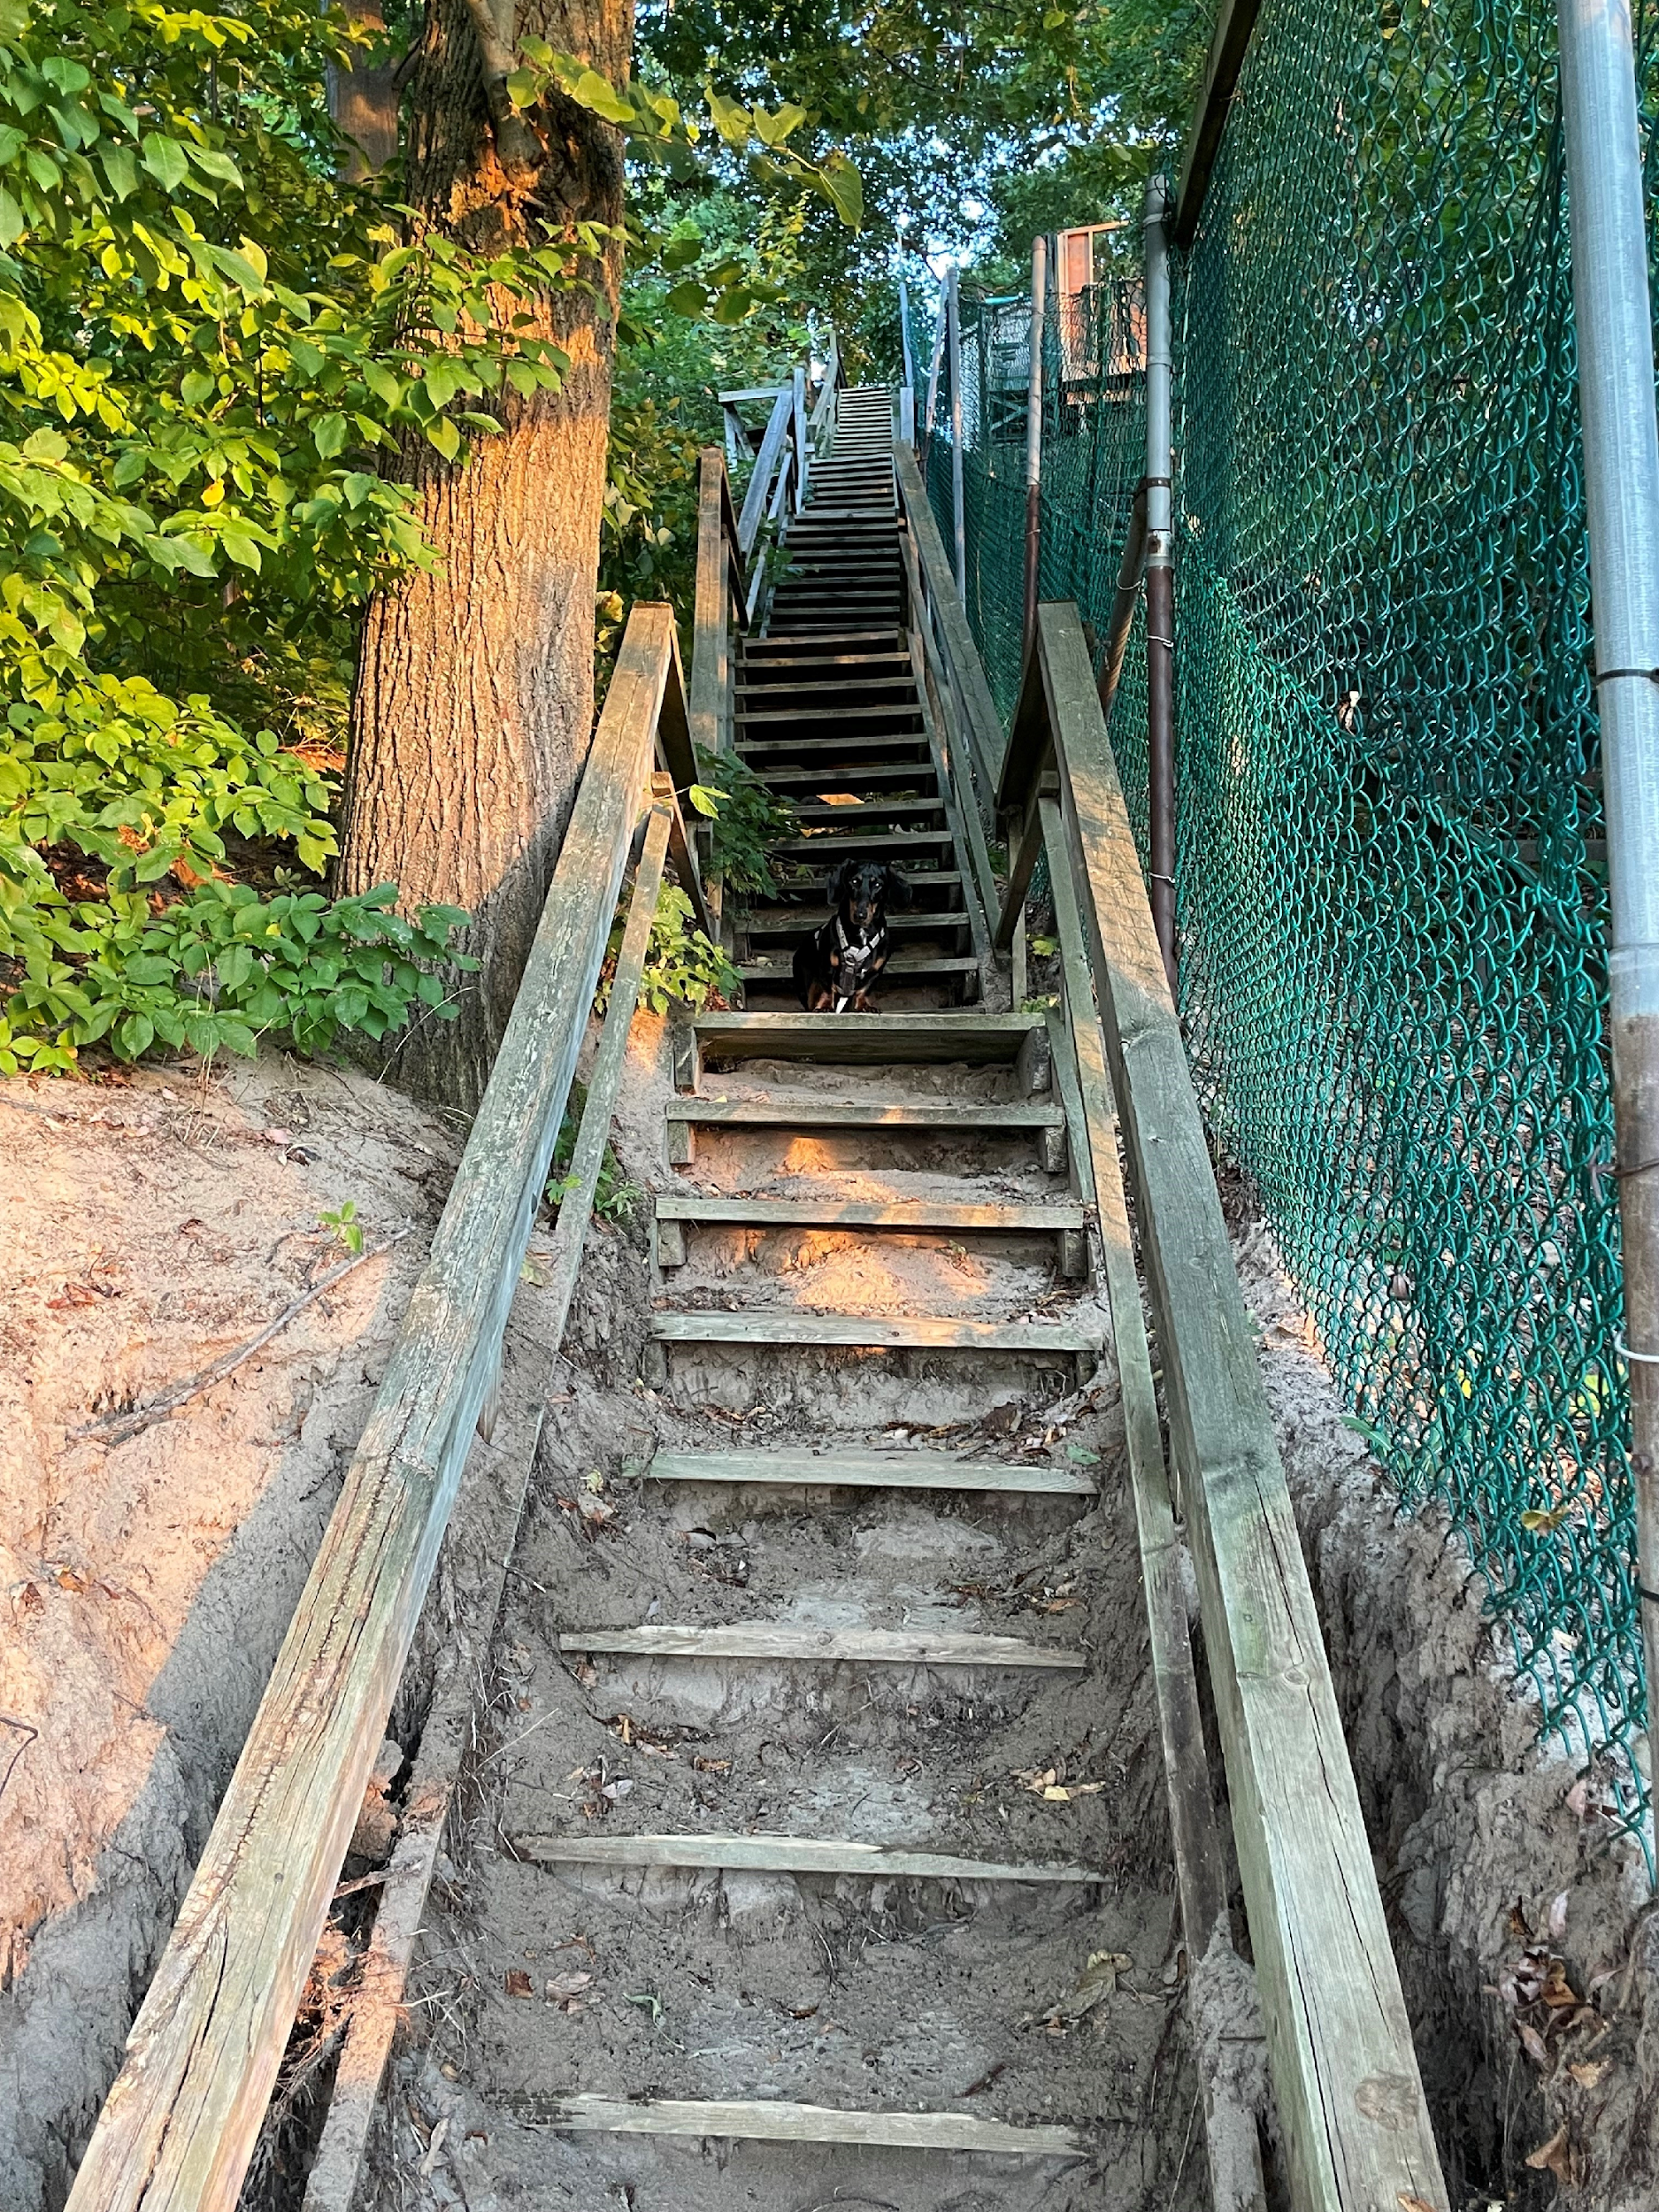
This dog is sitting in the middle of the staircase. He has to descend if he wants to get to the beach!
Your turn: Use the word “descend” in a sentence to describe the picture, what workers do to get into a hole, and what an airplane does as it gets lower.

Slide 34
Let's talk it out!
Say the “de-” word.
Have students say the “pre-” word.
Discuss the word meaning (from, away from).
When would you “defrost” something?
Everyday, we learn how to “decode” words. What are some big words you can “decode” or read?
When have you been “delighted”?

Slide 35
de-
meaning: down, away from
deplane
dethrone
decide
dethrone
When playing chess, the goal is to __________ the king.
The teacher will __________ where the class field trip will be.
We are to _________ in Toronto and then take a train to Ottawa.
decide
deplane

Slide 36
Let's make new words!!
de + scend 🡪
de + flect 🡪
de + lete 🡪
de + crease 🡪
de + activate🡪

Slide 37
a-
Read with me
meaning: on, in, at
across
away
aboard
awake
about
asleep
above
ashore
abuzz
around
aloud
aside
alive
alone
along

Slide 38
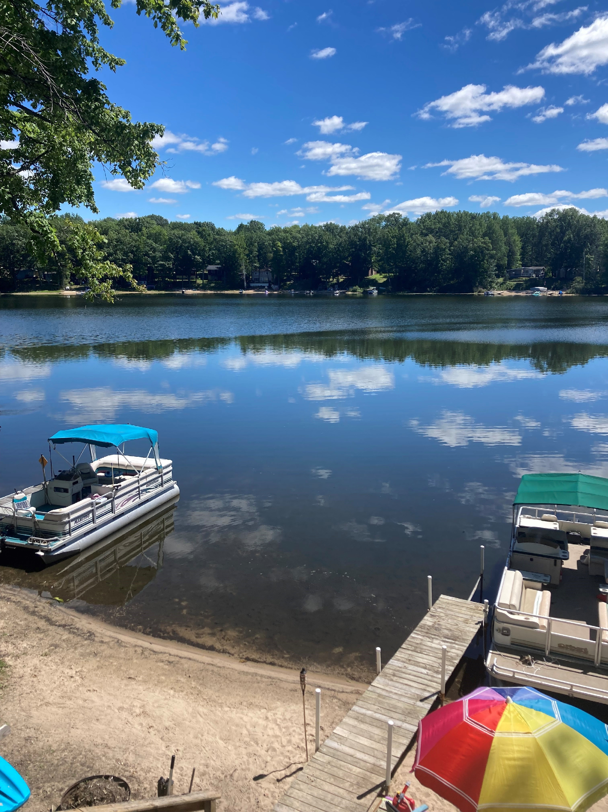
Look at the beautiful lake. The boats are “ashore”
Your turn: What do you think is “across” the lake. Use “across” in a sentence. How would you get there?

Slide 39
Let's talk it out!
Say the “a-” word.
Have students say the “a-” word.
Discuss the word meaning (on, in, at).
Have you been “alone” before? Why?
Can you use “aboard” and “ashore” in the same sentence?
Look up! Name two things that are “above” your head.

Slide 40
a-
meaning: on, in, at
aloud
across
awake
awake
She was lying _________, tossing and turning in bed.
He laughed ___________ at her funny joke.
We are living __________ the street from the park.
aloud
across

Slide 41
Let's make new words!:
a + way 🡪
a + glow🡪
a + new 🡪
a + long 🡪
a + round 🡪

Slide 42
uni-
Read with me
meaning: one, single
uniform
unicorn
university
unison
unit
unite
unicycle
universe
union
unique

Slide 43
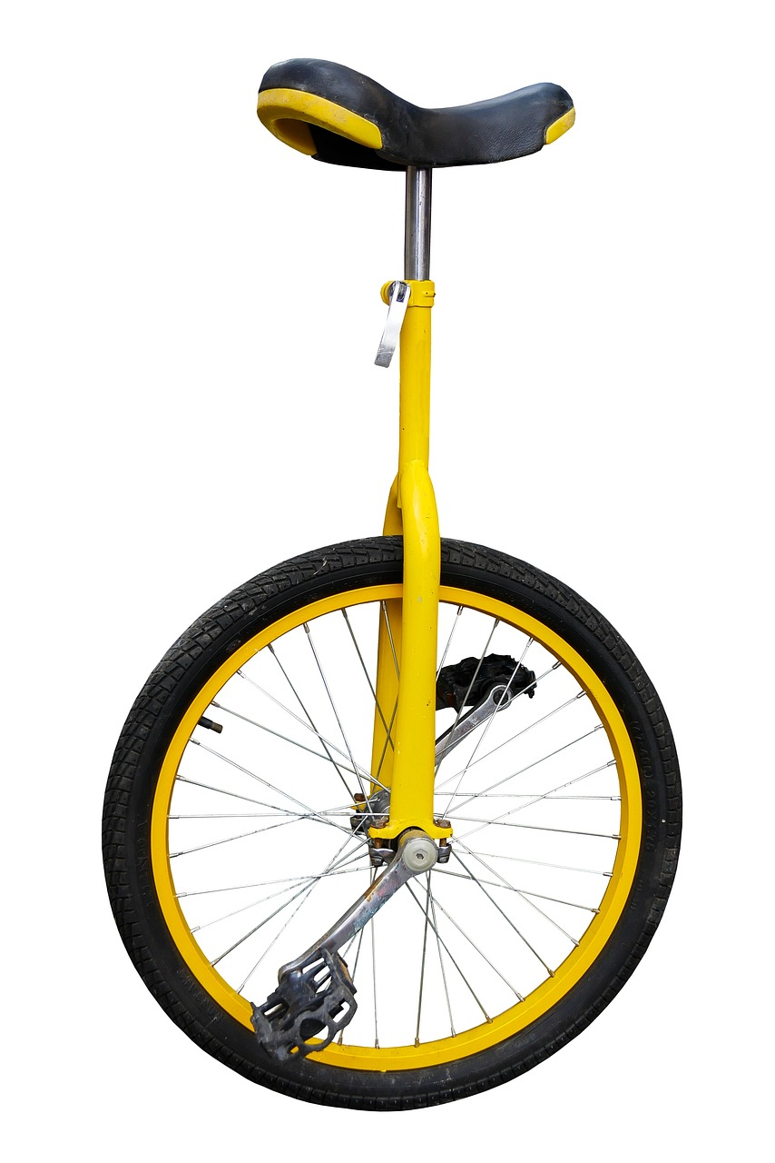
Have you seen one of these things before? It is called a “unicycle”. How many wheels does it have?
Your turn: Use the word “unicycle” in a sentence when you answer. Do you think a “unicycle” is easy or difficult to ride?

Slide 44
Let's talk it out!
Say the “a-” word.
Have students say the “a-” word.
Discuss the word meaning (on, in, at).
Have you been “alone” before? Why?
Can you use “aboard” and “ashore” in the same sentence?
Look up! Name two things that are “above” your head.

Slide 45
uni-
meaning: one, single
universe
unison
unicorn
She had a dream that she was a princess flying on a _________ towards a land made out of candy.
I think Canada is the best place to live in the whole ___________ .
The choir was singing all together in ________.
unicorn
universe
unison

Slide 46
Let's make new words!:
uni + cycle 🡪
uni + corn🡪
uni + verse 🡪
uni + veristy 🡪
uni + son 🡪

Slide 47
bi-
Read with me
meaning: two, twice
bicycle
biceps
binocular
bilingual
bimonthly

Slide 48
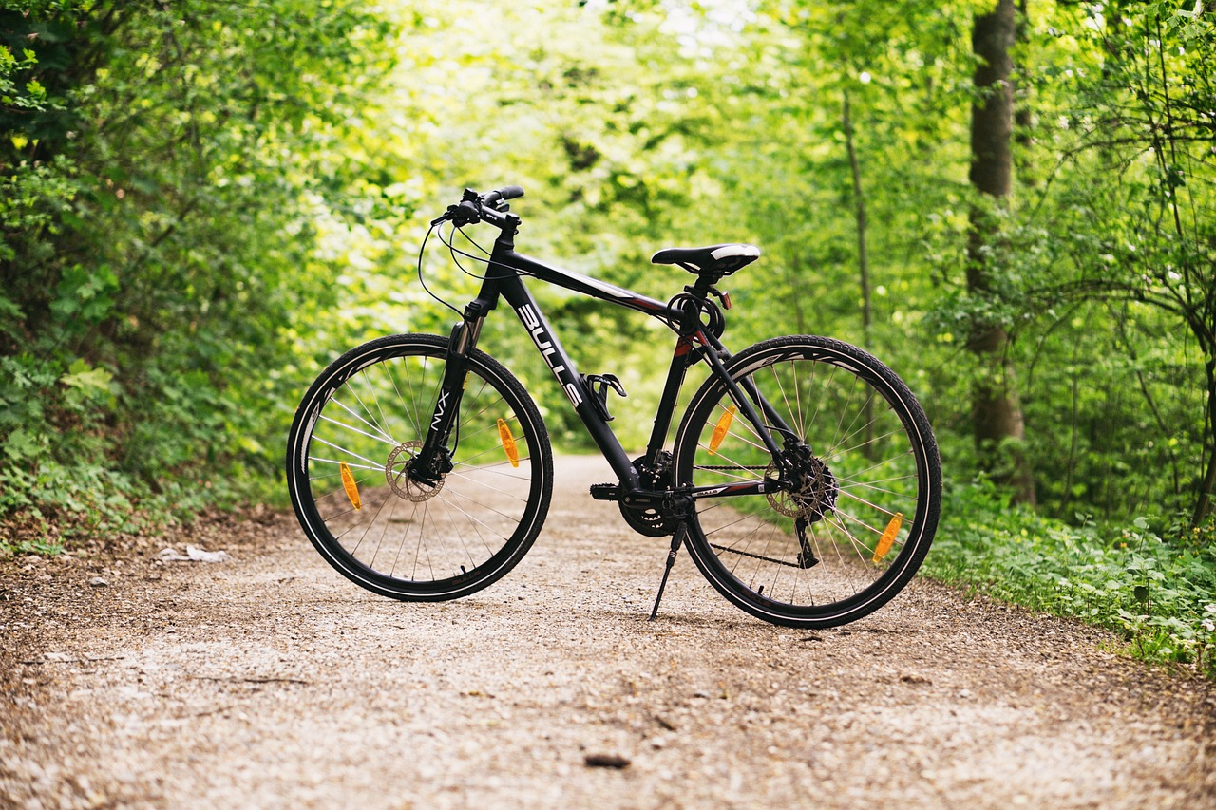
Describe this picture. How many wheels does a bicycle have?
Your turn: Use the word “bicycle” in a sentence when you describe it. Can you ride a “bicycle”?

Slide 49
Let's talk it out!
Say the “bi-” word.
Have students say the “bi-” word.
Discuss the word meaning (two).
What would you use “binoculars” for?
Do you speak another language besides English? What language? If you speak two language you are bilingual. What language would you like to learn to speak?
What is harder - riding a unicycle or a bicycle? Why?

Slide 50
bi-
meaning: two
binoculars
bilingual
biceps
binoculars
She couldn’t see the birds up n the tree, so she got her _________, to look.
I speak English and French so I am __________ .
My sister has been lifting weights everyday to make her arms stronger. You should see her big ___________ .
bilingual
biceps

Slide 51
Let's make new words!:
bi + weekly 🡪
bi + monthly🡪
bi + annual 🡪
bi + cuspid 🡪
bi + focals 🡪

Slide 52
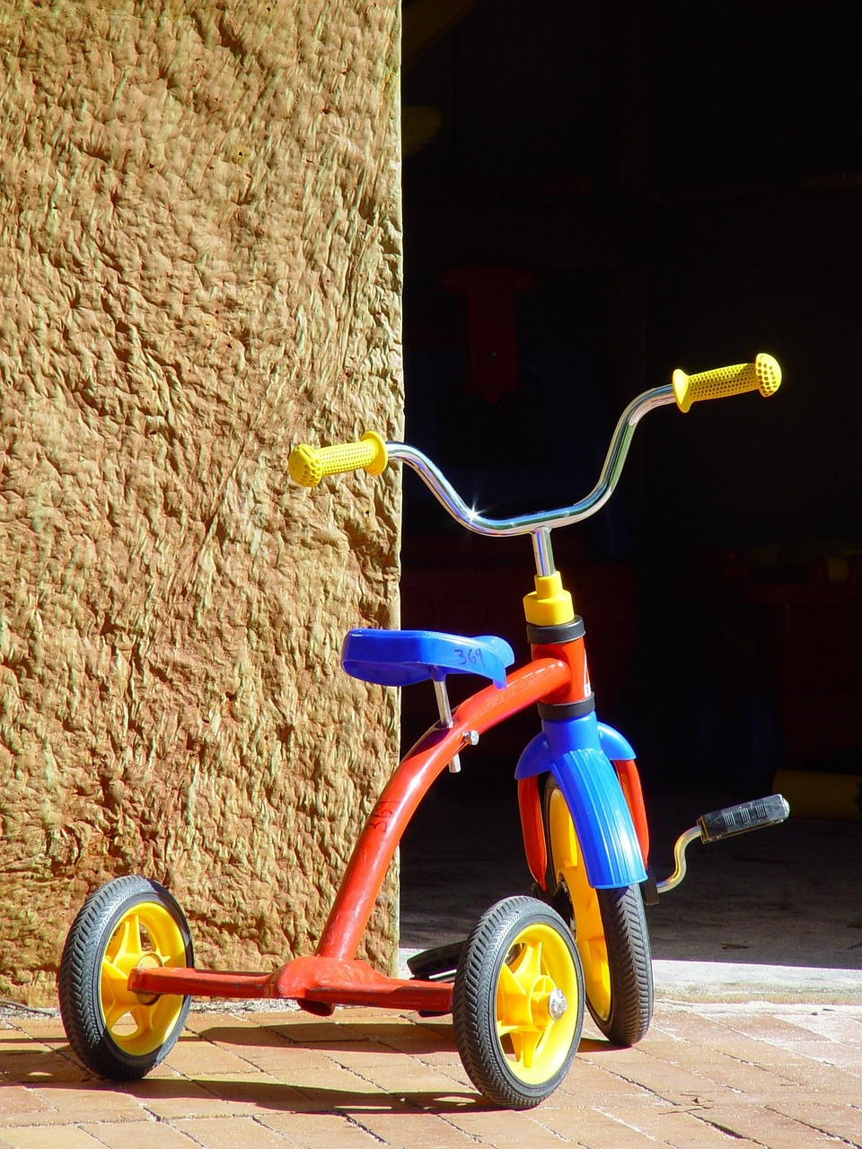
My little brother rides a tricycle. It doesn’t go as fast as my bicycle, but he tries to peddle quickly to keep up.
Your turn: Use the word tricycle in a sentence and mention all or its parts including the number of wheels.

Slide 53
Let's talk it out!
Say the “tri-” word.
Have students say the “tri-” word.
Discuss the word meaning (three).
Can you run, swim and ride a bike. Maybe you want to do a “triathlon”?
Do you play baseball? What is a hitting a “triple” mean?
My neighbours had “triplets” last week. What does this mean? How many highchairs will the family need?

Slide 54
tri-
meaning: three
trio
triangle
triceratops
triceratops
My favourite dinosaur is a _________, because it has three horns.
When three people sing together, it is called a ___________ .
A shape with three sides is called a __________ .
trio
triangle

Slide 55
Let's make new words!:
tri + cycle 🡪
tri + dent🡪
tri + pod 🡪
tri + ceps 🡪
tri + ceratops 🡪

Slide 56
co-
Read with me
meaning: with, together, joint(ly)
cooperate
coordinate
coexist
cofound
cohost
costar
copilot
coexist
coauthor
coworker

Slide 57
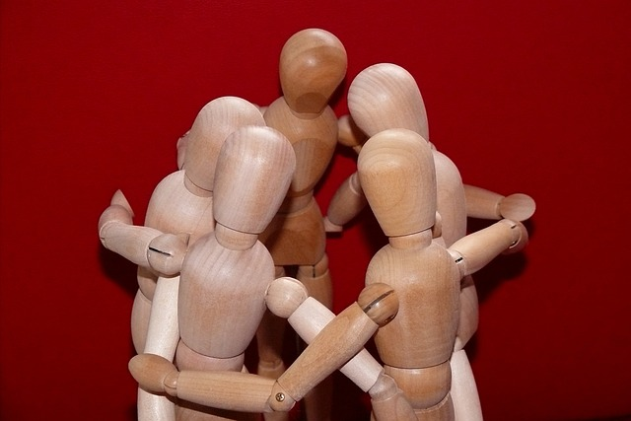
Cooperation means to work together to get something done.
We cooperate when we include friends in a game or in a conversation or work on a project together.
Your turn: Can you think of a time you cooperated with a friend or a group of friends to get something done?

Slide 58
Let's talk it out!
Say the “co-” word.
Have students say the “co-” word.
Discuss the word meaning (join, together).
Do you want to have two teachers in your class? They can “coteach” you. What do you think of this idea?
If you could do a project with someone in your class, who would choose as your “coworker” and why?

Slide 59
co-
meaning: join, together
coauthor
coworker
copilot
When two people write a book together they are called __________.
I ate lunch with my ______________, then we went to a meeting together.
On a long flight, one ________ can sleep while the other manages the controls.
coauthors
coworker
copilot

Slide 60
Let's make new words!!
co + operate 🡪
co + ordinate 🡪
co + exist 🡪
co + star 🡪
co + host 🡪

