Slide 1
Grade 1
Term: 1
Objective: Sentence Expansion –where (oral)
Author: Jasmyn Hall & Janelle Walters

Slide 2












Multiple Choice
Pair Share
Track with me
Pick a Stick/Answer (non-volunteer)
Whiteboards
Vote
Read with me
In Your Workbook

Slide 3
Question Words
Who/what?
(did) What?
When?
Where?
Why?
How?
Display this chart in classroom prior to lesson.
Optional: use Colourful Semantics icons in addition to question words. But please note, TWR does not distinguish between the ‘what doing/did what’ (verb) and the ‘what’ (object). If you are using a Colourful Semantics approach, you will need to consider this.

Slide 4
Learning Objective
We are learning to expand our sentences by adding extra information.

Slide 5
Activate Prior Knowledge
A sentence is a complete thought.
It must contain a subject (or who/what) and a verb (a do).
CFU:
What is the subject and the verb in these sentences?
Examples:
She ran.
Pat sips.
It hops.

Slide 6
Concept Development
A sentence is a complete thought.
It must contain a subject (or who/what) and a verb (a do).
CFU:
What is the subject and the verb in these sentences?
Examples:
She ran.
Pat sips.
It hops.
Boring !
These sentences are boring and do not contain any additional information.

Slide 7
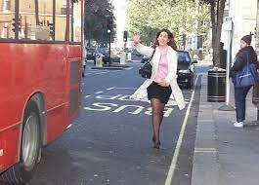


Concept Development
By adding additional information, we can expand sentences to make them more interesting.
Including who, what, and where will make your sentence more informative for the reader:
CFU:
Who ran?
Where?
When?
Where?
Who?
What?
Boring !
Pam ran to the bus.
She ran.

Slide 8
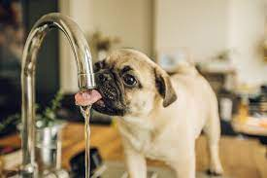
Concept Development
By adding additional information, we can expand sentences to make them more interesting.
Including who, what, and where will make your sentence more informative for the reader:
CFU:
Who sips?
Where?
2. What does ‘it’ refer to in the kernel sentence.
When?
Where?
Who?
What?
It sips.
The pug sips at the tap.
Boring !

Slide 9
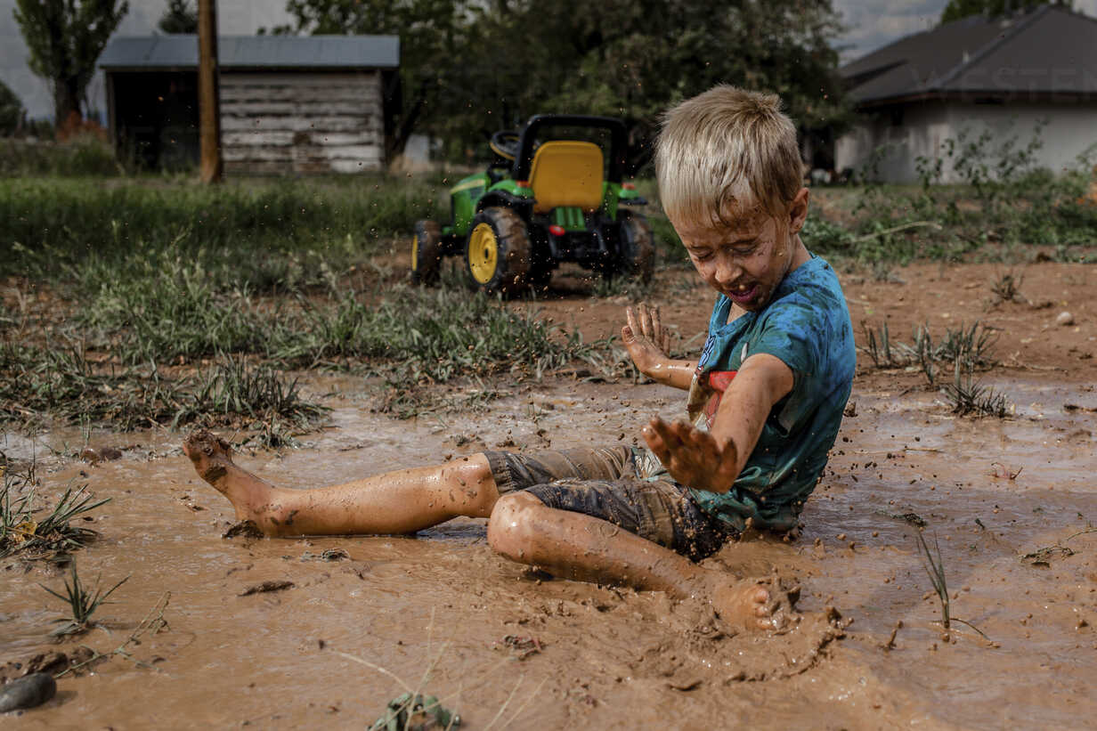
Concept Development
By adding additional information, we can expand sentences to make them more interesting.
Including who, what, and where will make your sentence more informative for the reader:
CFU:
Who is the subject?
What is the action?
Where does it occur?
Sam sat.
Where:
in the mud
Example:
Sam sat in the mud.

Slide 10
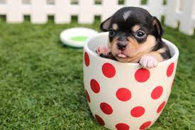
Concept Development
By adding additional information, we can expand sentences to make them more interesting.
Including who, what, and where will make your sentence more informative for the reader:
CFU:
Who is the subject?
What is the action?
Where does it occur?
The dog sat.
Where:
in the cup
The dog sat in the cup.

Slide 11
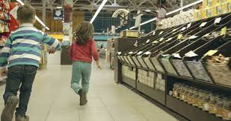

Concept Development
By adding additional information, we can expand sentences to make them more interesting.
Including who, what, and where will make your sentence more informative for the reader:
CFU:
Why is this not an example of an expanded sentence?
The kids run.
Where:
in the shop
Non-Examples:
The kids run.
This sentence does not contain all of the information. It does not have the where.
The kids in the shop.
This sentence does not make sense. It is missing words.

Slide 12

Hinge Point Question
Which sentences contain a WHERE detail?
It swam.
Pip sips at the tap.
The kids jog to the log.
Sam ran at night.

Slide 13
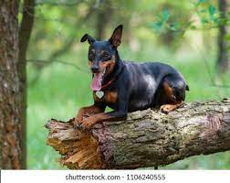
Skill development: I do
Answer the questions in note form
Use the notes to say the sentence, in this order:
who what where.
CFU:
Who is the subject?
What is the action?
Where does it occur?
The dog sat.
Where:
on a log
The dog
sat
on a log.

Slide 14
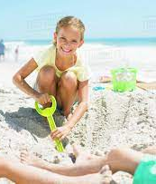
Skill development: I do
Answer the questions in note form
Use the notes to say the sentence, in this order:
who what where.
CFU:
Who is the subject?
What is the action?
Where does it occur?
Pip digs.
Where:
in the sand
Pip
digs
in the sand.

Slide 15
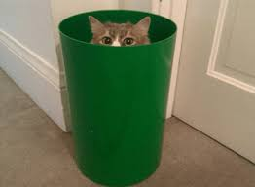
Skill development: We do
Answer the questions in note form
Use the notes to say the sentence, in this order:
who what where.
CFU:
Who is the subject?
What is the action?
Where does it occur?
The cat hid.
Where:
in the bin
Notes:
The cat hid in the bin.

Slide 16
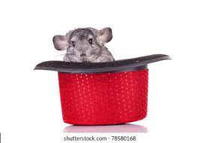
Skill development: You do
Answer the questions in note form
Use the notes to say the sentence, in this order:
who what where.
CFU:
Who is the subject?
What is the action?
Where does it occur?
The rat sat.
Where:
Notes:
The rat sat in the hat

Slide 17

Skill Development: You do
Let’s build some sentences using these pictures.
who what where
Use pictures from texts/topics/knowledge units in class
Students do orally
Teacher models writing

