Slide 1
Grade 1
Term: 1
Objective: Sentence Expansion – when (oral)
Author: Jasmyn Hall & Janelle Walters

Slide 2
Multiple Choice
Pair Share
Track with me
Pick a Stick/Answer (non-volunteer)
Whiteboards
Vote
Read with me
In Your Workbook

Slide 3
Question Words
Who/what?
(did) What?
When?
Where?
Why?
How?
Display this chart in classroom prior to lesson.
Optional: use Colourful Semantics icons in addition to question words. But please note, TWR does not distinguish between the ‘what doing/did what’ (verb) and the ‘what’ (object). If you are using a Colourful Semantics approach, you will need to consider this.

Slide 4
Learning Objective
We are learning to expand our sentences by adding extra information.

Slide 5
Activate Prior Knowledge
A sentence is a complete thought.
It must contain a subject (or who/what) and a verb (a do).
CFU:
What is the subject and the verb in these sentences?
Examples:
She ran.
Pat ate.
Tim napped.

Slide 6
Concept Development
A sentence is a complete thought.
It must contain a subject (or who/what) and a verb (a do).
CFU:
What is the subject and the verb in these sentences?
Examples:
She ran.
Pat ate.
Tim napped.
Boring !
These sentences are boring and do not contain any additional information.

Slide 7
Concept Development
By adding additional information, we can expand sentences to make them more interesting.
Including when, who and what will make your sentence more informative for the reader:
CFU:
Who ate?
When did they eat?
When?
Where?
Who?
What?
During lunchtime, Pat ate his apple.
Boring !
Pat ate.

Slide 8
Concept Development
By adding additional information, we can expand sentences to make them more interesting.
Including when, who and what will make your sentence more informative for the reader:
CFU:
Who splashed?
When did they splash?
2. What does ‘they’ refer to in the kernel sentence.
When?
Where?
Who?
What?
On a rainy day, the two girls splashed.
Boring !
They splashed.

Slide 9
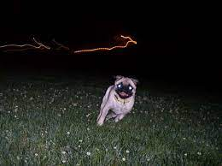
Concept Development
By adding additional information, we can expand sentences to make them more interesting.
Including when, who and what will make your sentence more informative for the reader:
CFU:
Who is the subject?
What is the action?
When does it happen?
The dog ran.
When:
at night
Example:
The dog ran at night.

Slide 10
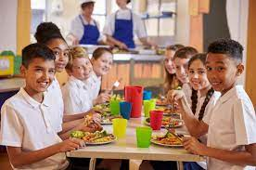
Concept Development
By adding additional information, we can expand sentences to make them more interesting.
Including when, who and what will make your sentence more informative for the reader:
CFU:
Who is the subject?
What is the action?
When does it happen?
The kids sit.
When:
at lunch
The kids sit at lunch.

Slide 11
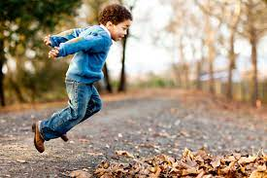
Concept Development
By adding additional information, we can expand sentences to make them more interesting.
Including when, who and what will make your sentence more informative for the reader:
CFU:
Why is this not an example of an expanded sentence?
Tim jumps.
When:
on the weekend
Non-Examples:
Tim jumps.
This sentence does not contain all of the information. It does not have the when.
On the weekend, Tim.
This sentence does not make sense. It is missing words.

Slide 12
Hinge Point Question
Which sentences contain a WHEN detail?
Pip taps.
At midnight, Pip and Tim skip.
Sam fed the pig tonight.
The dog sat.

Slide 13
Skill development: I do
Answer the questions in note form
Use the notes to say the sentence, in this order:
Who what when.
CFU:
Who is the subject?
What is the action?
When does it happen?
Kim runs.
When:
at dusk
Kim
runs
at dusk.

Slide 14
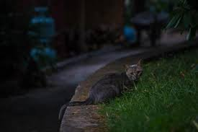
Skill development: I do
Answer the questions in note form
Use the notes to say the sentence, in this order:
Who what when.
CFU:
Who is the subject?
What is the action?
When does it happen?
The cat crept.
When:
at night
The cat
crept
at night.

Slide 15
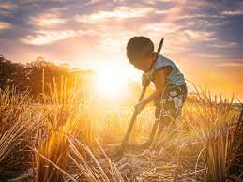
Skill development: We do
Answer the questions in note form
Use the notes to say the sentence, in this order:
Who what when.
CFU:
Who is the subject?
What is the action?
When does it happen?
Jim digs.
When:
at sunset

Slide 16
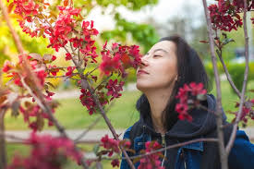
Skill development: You do
Answer the questions in note form
Use the notes to say the sentence, in this order:
Who what when.
CFU:
Who is the subject?
What is the action?
When does it happen?
Pam sniffs.
When:
in spring
Notes:
Pam sniffs in Spring / In Spring, Pam sniffs.

Slide 17
Skill Development: You do
Let’s build some sentences using these pictures.
who what when
Use pictures from texts/topics/knowledge units in class
Students do orally
Teacher models writing

