Slide 1
Grade 1
Term: 1
Objective: Sentence Expansion – when, who (oral)
Author: Jasmyn Hall & Janelle Walters

Slide 2
Multiple Choice
Pair Share
Track with me
Pick a Stick/Answer (non-volunteer)
Whiteboards
Vote
Read with me
In Your Workbook

Slide 3
Question Words
Who/what?
(did) What?
When?
Where?
Why?
How?
Display this chart in classroom prior to lesson.
Optional: use Colourful Semantics icons in addition to question words. But please note, TWR does not distinguish between the ‘what doing/did what’ (verb) and the ‘what’ (object). If you are using a Colourful Semantics approach, you will need to consider this.

Slide 4
Learning Objective
We are learning to expand our sentences by adding extra information.

Slide 5
Activate Prior Knowledge
A sentence is a complete thought.
It must contain a subject (or who/what) and a verb (a do).
CFU:
What is the subject and the verb in these sentences?
Examples:
She ran.
Pat ate.
Tim napped.

Slide 6
Concept Development
A sentence is a complete thought.
It must contain a subject (or who/what) and a verb (a do).
CFU:
What is the subject and the verb in these sentences?
Examples:
She ran.
Pat ate.
Tim napped.
Boring !
These sentences are boring and do not contain any additional information.

Slide 7
Concept Development
By adding additional information, we can expand sentences to make them more interesting.
Including when, who and what will make your sentence more informative for the reader:
CFU:
Who ate?
When did they eat?
When?
Where?
Who?
What?
During lunchtime, Pat ate his apple.
Boring !
Pat ate.

Slide 8
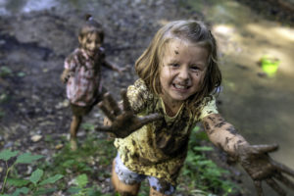
Concept Development
By adding additional information, we can expand sentences to make them more interesting.
Including when, who and what will make your sentence more informative for the reader:
CFU:
Who splashed?
When did they splash?
2. What does ‘they’ refer to in the kernel sentence.
When?
Where?
Who?
What?
On a rainy day, the two girls splashed.
Boring !
They splashed.

Slide 9
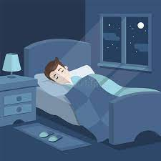
Concept Development
By adding additional information, we can expand sentences to make them more interesting.
Including when, who and what will make your sentence more informative for the reader:
CFU:
Who is the subject?
What is the action?
When does it happen?
He slept.
Who:
When:
George
at night time
Example:
George slept at night time.

Slide 10
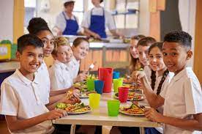
Concept Development
By adding additional information, we can expand sentences to make them more interesting.
Including when, who and what will make your sentence more informative for the reader:
CFU:
Who is the subject?
What is the action?
When does it happen?
They ate.
Who:
When:
the children
at lunch time
At lunch time, the children ate.

Slide 11
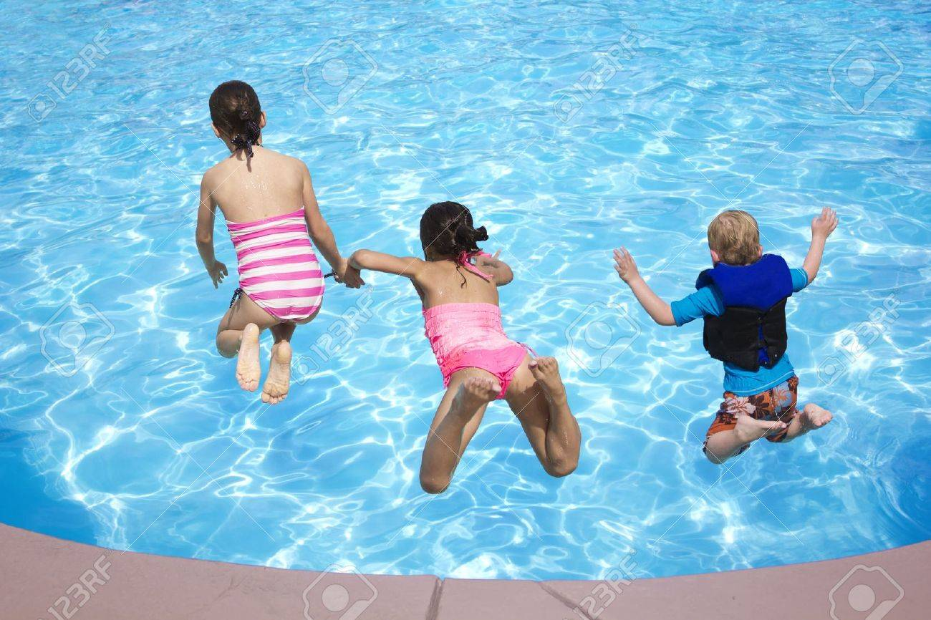
Concept Development
By adding additional information, we can expand sentences to make them more interesting.
Including when, who and what will make your sentence more informative for the reader:
CFU:
Why is this not an example of an expanded sentence?
They swam.
Who:
When:
the children
on a sunny day
Non-Examples:
The children swam.
This sentence does not contain all of the information. It does not have the when.
On a sunny day, swam.
This sentence does not make sense. It is missing words.

Slide 12
Hinge Point Question
Which sentences contain a ‘WHEN’ detail?
They swam.
After school, Sally and Sam skipped.
The dog barked in the night.
The teacher slept.

Slide 13
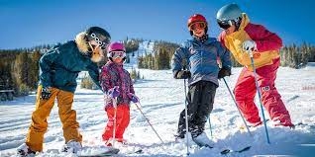
Skill development: I do
Answer the questions in note form
Use the notes to say the sentence, in this order:
When, who what.
3. Check your sentence – does it sound right?
CFU:
Who is the subject?
What is the action?
When does it happen?
They skied.
Who:
When:
the family
winter
The family
skied
in winter.

Slide 14
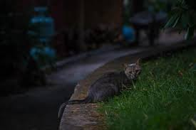
Skill development: I do
Answer the questions in note form
Use the notes to say the sentence, in this order:
When, who what.
3. Check your sentence – does it sound right?
CFU:
Who is the subject?
What is the action?
When does it happen?
It crept.
Who/what:
When:
the cat
late at night
Late at night,
crept.
the cat

Slide 15
Skill development: We do
Answer the questions in note form
Use the notes to say the sentence, in this order:
When, who what.
3. Check your sentence – does it sound right?
CFU:
Who is the subject?
What is the action?
When does it happen?
They bloomed.
Who/what:
When:
the flowers
spring

Slide 16
Skill development: You do
Answer the questions in note form
Use the notes to say the sentence, in this order:
When, who what.
3. Check your sentence – does it sound right?
CFU:
Who is the subject?
What is the action?
When does it happen?
She arrived.
Who:
When:

Slide 17
Skill Development: You do
Let’s build some sentences using these pictures.
when who what
Use pictures from texts/topics/knowledge units in class
Students do orally
Teacher models writing

