Slide 1
Grade 1
Term: 1
Objective: Sentence Expansion –who, where (oral)
Author: Jasmyn Hall, Janelle Walters

Slide 2
Multiple Choice
Pair Share
Track with me
Pick a Stick/Answer (non-volunteer)
Whiteboards
Vote
Read with me
In Your Workbook

Slide 3
Question Words
Who/what?
(did) What?
When?
Where?
Why?
How?
Display this chart in classroom prior to lesson.
Optional: use Colourful Semantics icons in addition to question words. But please note, TWR does not distinguish between the ‘what doing/did what’ (verb) and the ‘what’ (object). If you are using a Colourful Semantics approach, you will need to consider this.

Slide 4
Learning Objective
We are learning to expand our sentences by adding extra information.

Slide 5
Concept Development
A sentence is a complete thought.
It must contain a subject (or who/what) and a verb (a do).
CFU:
What is the subject and the verb in these sentences?
Examples:
She ran.
Pat sips.
It hops.

Slide 6
Concept Development
A sentence is a complete thought.
It must contain a subject (or who/what) and a verb (a do).
CFU:
What is the subject and the verb in these sentences?
Examples:
She ran.
Pat sips.
It hops.
Boring !
These sentences are boring and do not contain any additional information.

Slide 7
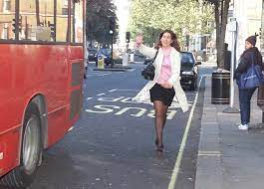
Concept Development
By adding additional information, we can expand sentences to make them more interesting.
Including who, what, and where will make your sentence more informative for the reader:
CFU:
Who ran?
Where?
When?
Where?
Who?
What?
Boring !
Pam ran to the bus.
She ran.

Slide 8
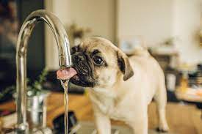
Concept Development
By adding additional information, we can expand sentences to make them more interesting.
Including who, what, and where will make your sentence more informative for the reader:
CFU:
Who sips?
Where?
2. What does ‘it’ refer to in the kernel sentence.
When?
Where?
Who?
What?
It sips.
The pug sips at the tap.
Boring !

Slide 9
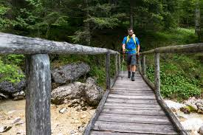
Concept Development
By adding additional information, we can expand sentences to make them more interesting.
Including who and where will make your sentence more informative for the reader:
CFU:
Who is the subject?
What is the action?
Where does it occur?
He walked.
Who:
Where:
Michael
across the bridge
Example:
Michael walked across the bridge.

Slide 10
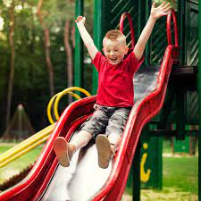
Concept Development
By adding additional information, we can expand sentences to make them more interesting.
Including who and where will make your sentence more informative for the reader:
CFU:
Who is the subject?
What is the action?
Where does it occur?
He slid.
Who:
Where:
The little boy
down the slide
The little boy slid down the slide.

Slide 11
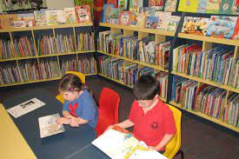
Concept Development
By adding additional information, we can expand sentences to make them more interesting.
Including who and where will make your sentence more informative for the reader:
CFU:
Why is this not an example of an expanded sentence?
They read.
Who:
Where:
the kids
in the library
Non-Examples:
The kids read.
This sentence does not contain all of the information. It does not have the where.
The kids library.
This sentence does not make sense. It is missing words.

Slide 12
Hinge Point Question
Which sentences contain a ‘where’ detail?
It swam.
Katie eats at the dinner table.
The dogs run at the park.
Sam ran.

Slide 13
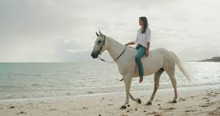
Skill development: I do
Answer the questions in note form
Use the notes to say the sentence, in this order:
who what where.
3. Check your sentence – does it sound right?
CFU:
Who is the subject?
What is the action?
Where does it occur?
She rode a horse.
Who:
Where:
The woman
along the beach
The woman
rode a horse
along the beach.

Slide 14
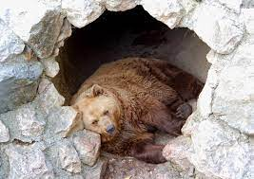
Skill development: I do
Answer the questions in note form
Use the notes to say the sentence, in this order:
who what where.
3. Check your sentence – does it sound right?
CFU:
Who is the subject?
What is the action?
Where does it occur?
It slept.
Who:
Where:
the bear
in the cave
The bear
slept
in the cave.

Slide 15
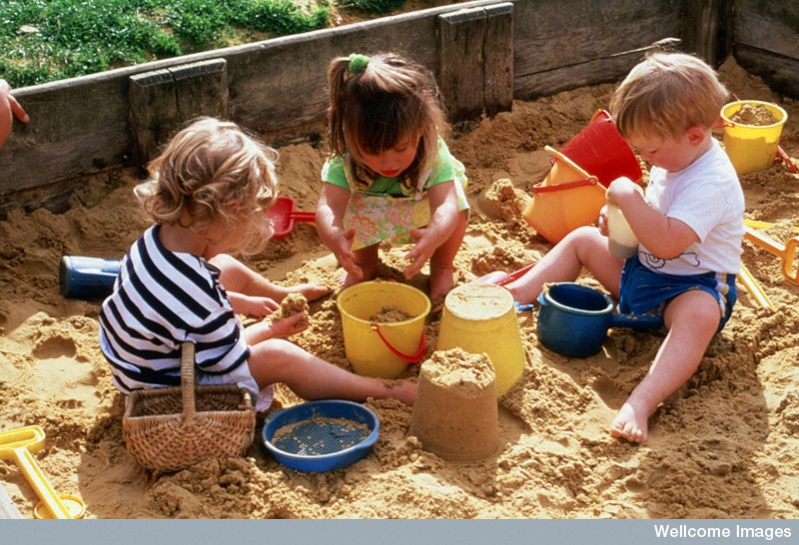
Skill development: We do
Answer the questions in note form
Use the notes to say the sentence, in this order:
who what where.
3. Check your sentence – does it sound right?
CFU:
Who is the subject?
What is the action?
Where does it occur?
They dig.
Who:
Where:
the children
in the sandpit

Slide 16
Skill development: You do
Answer the questions in note form
Use the notes to say the sentence, in this order:
who what where.
3. Check your sentence – does it sound right?
CFU:
Who is the subject?
What is the action?
Where does it occur?
He waited.
Who:
Where:

Slide 17
Skill Development: You do
Let’s build some sentences using these pictures.
who what where
Use pictures from texts/topics/knowledge units in class
Students do orally
Teacher models writing

