Slide 1
Grade 1
Term: 1
Objective: Construct simple oral sentences (who/what + what doing) (oral)
Author: Stephanie Le Lievre & Nathaniel Swain

Slide 2












Multiple Choice
Pair Share
Track with me
Pick a Stick/Answer (non-volunteer)
Whiteboards
Vote
Read with me
In Your Workbook

Slide 3
Question Words
Who/what?
(did) What?
When?
Where?
Why?
How?
Display this chart in classroom prior to lesson.
Optional: use Colourful Semantics icons in addition to question words. But please note, TWR does not distinguish between the ‘what doing/did what’ (verb) and the ‘what’ (object). If you are using a Colourful Semantics approach, you will need to consider this.

Slide 4
Learning Objective
We are learning to write sentences containing a
WHO/WHAT (subject) + WHAT DOING (verb).

Slide 5



Concept Development
A sentence is a complete thought that makes sense.
A sentence must:
make sense
have a WHO/WHAT
and a WHAT DOING

Slide 6

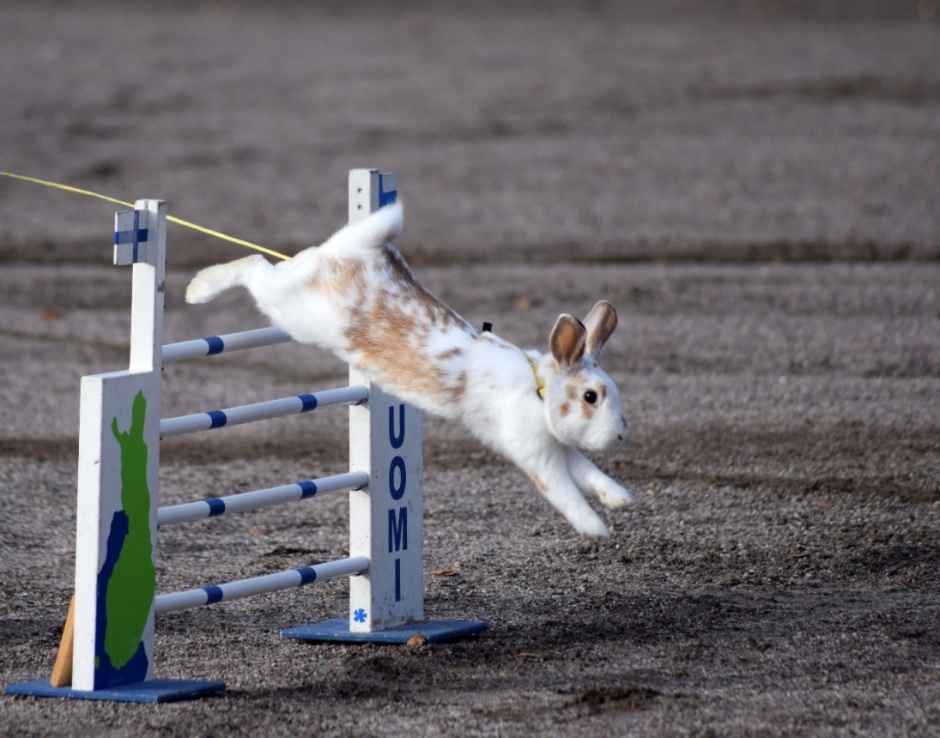
Concept Development
A sentence is a complete thought that makes sense.
A sentence needs a ‘who/what’ and a ‘what doing’ (or a who and a do)
The who/what is the subject.
The ‘what doing’ contains the verb.
CFU:
Say the sentence.
What’s the ‘who’ of the sentence?
What’s the verb of the sentence?
Example:
WHO/WHAT?
WHAT DOING?
The rabbit jumps.

Slide 7
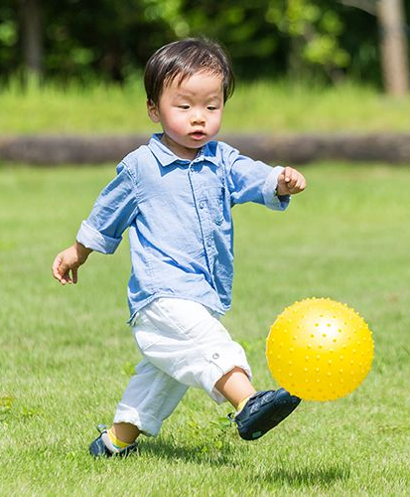
Concept Development
A sentence is a complete thought that makes sense.
A sentence needs a ‘who/what’ and a ‘what doing’ (or a who and a do)
CFU:
What is a sentence?
What does a sentence need?
Example:
WHO?
WHAT DOING?
The boy is kicking a ball.

Slide 8

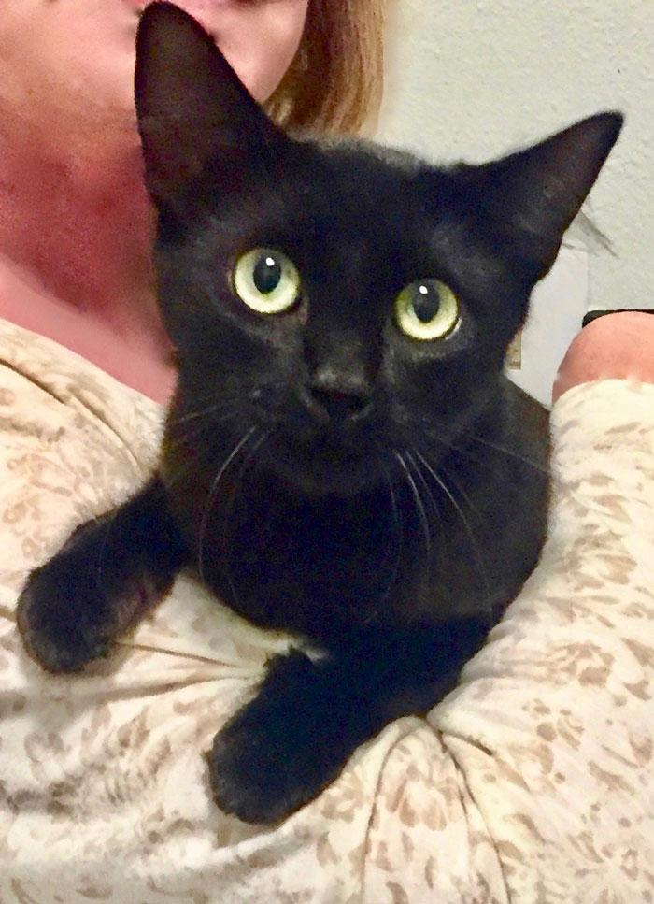
Concept Development
The ‘who’ is the subject of the sentence. It is a noun.
Let’s name these nouns. We have to put ‘the’ or ‘a’ in front of it.
The cat
A cat

Slide 9
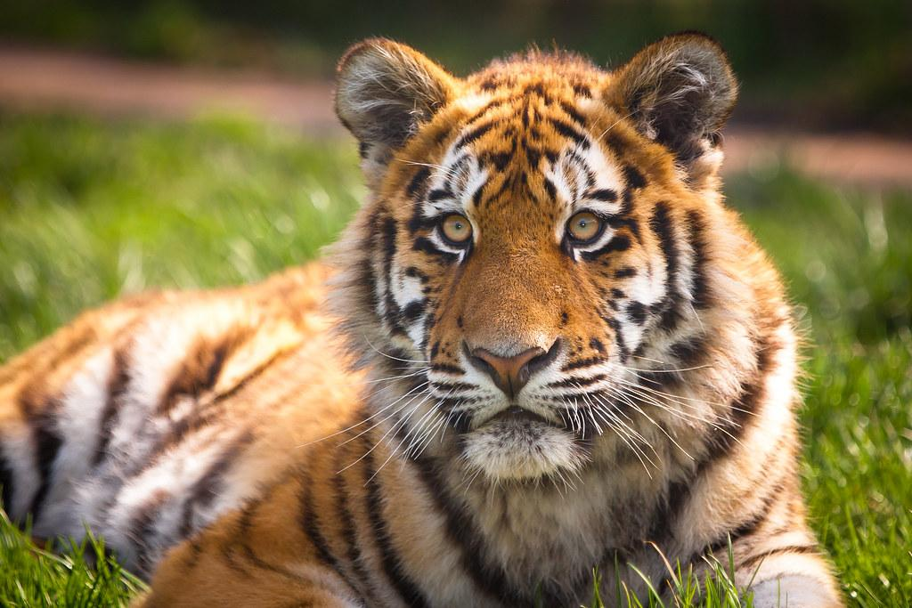
Concept Development
The ‘who’ is the subject of the sentence. It is a noun.
Let’s name these nouns. We have to put ‘the’ or ‘a’ in front of it.
The tiger
A tiger

Slide 10
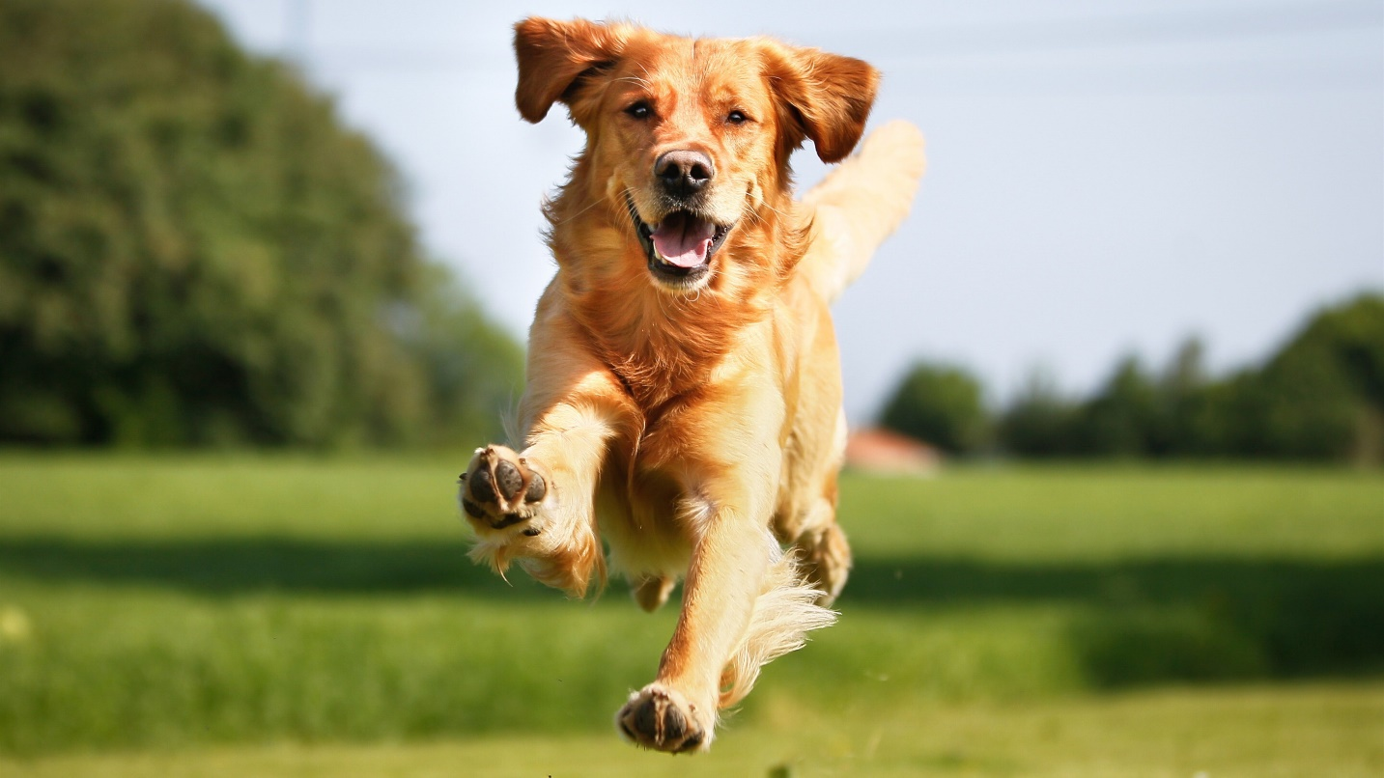
Concept Development
The ‘who’ is the subject of the sentence. It is a noun.
Let’s name these nouns. We have to put ‘the’ or ‘a’ in front of it.
The dog
A dog

Slide 11
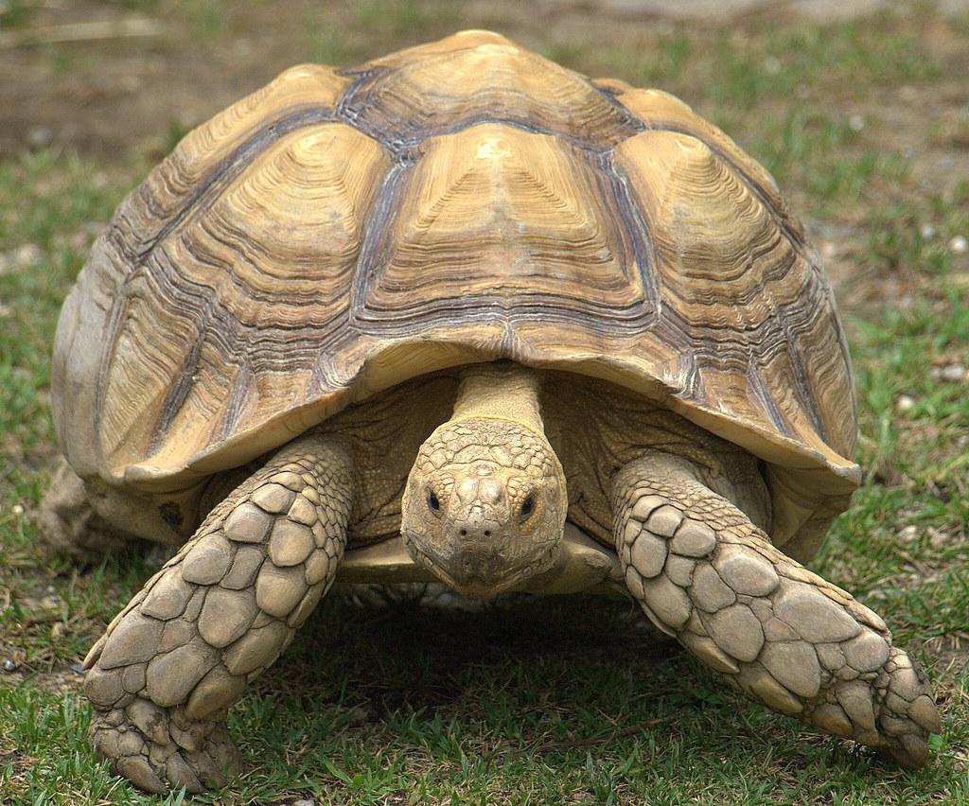
Concept Development
The ‘who’ is the subject of the sentence. It is a noun.
Let’s name these nouns. We have to put ‘the’ or ‘a’ in front of it.
The tortoise
A tortoise

Slide 12
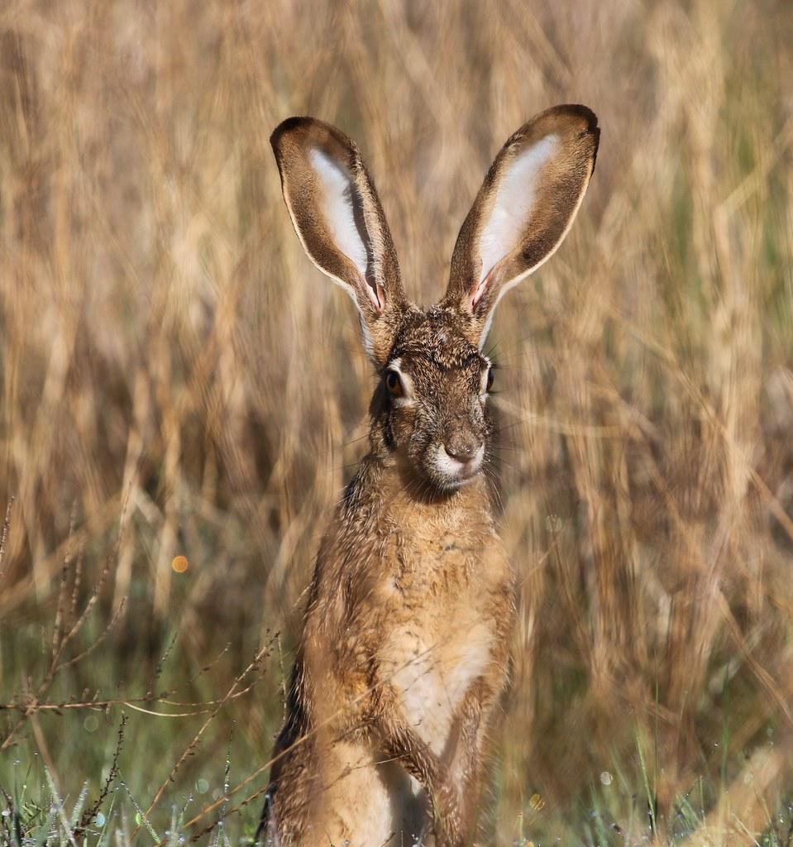
Concept Development
The ‘who’ is the subject of the sentence. It is a noun.
Let’s name these nouns. We have to put ‘the’ or ‘a’ in front of it.
The hare
A hare

Slide 13
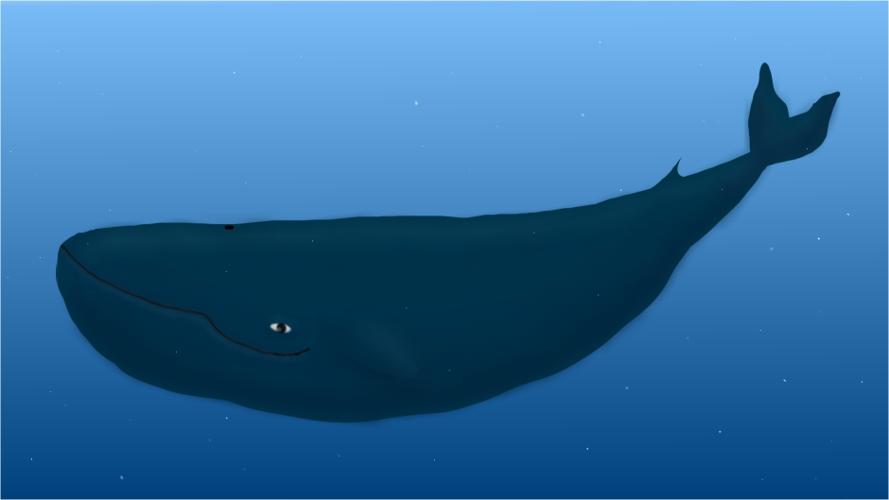
Concept Development
The ‘who’ is the subject of the sentence. It is a noun.
Let’s name these nouns. We have to put ‘the’ or ‘a’ in front of it.
The whale
A whale

Slide 14
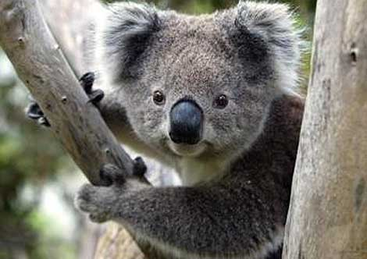
Concept Development
The ‘who’ is the subject of the sentence. It is a noun.
Let’s name these nouns. We have to put ‘the’ or ‘a’ in front of it.
The koala
A koala

Slide 15
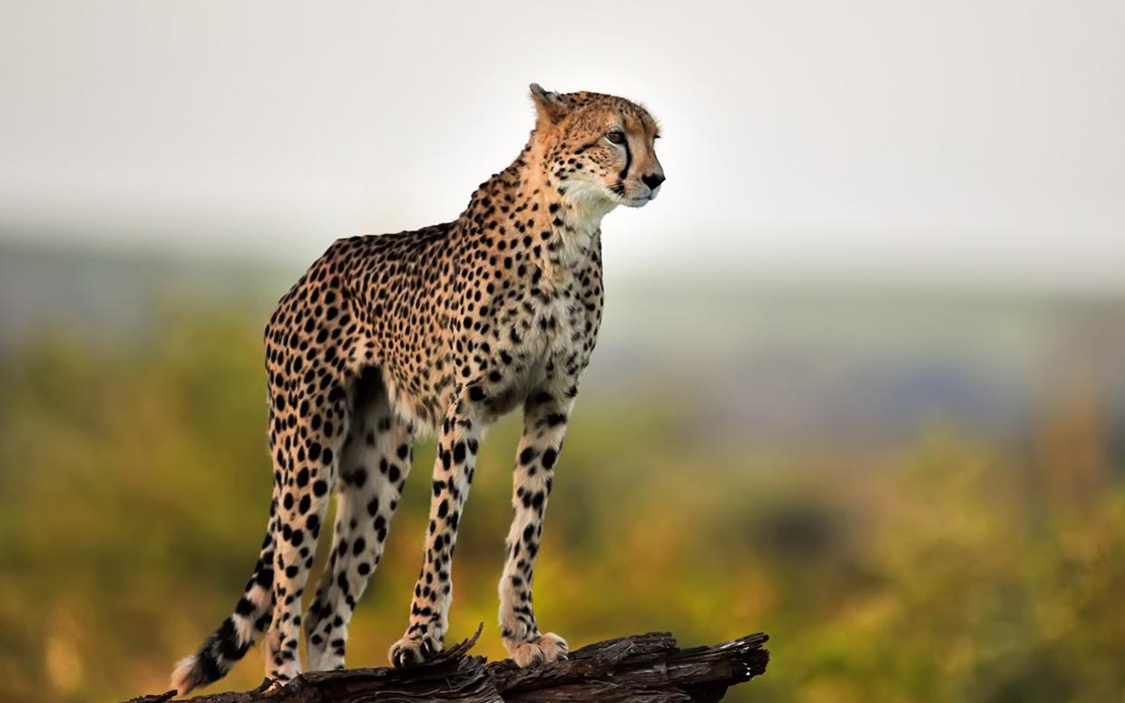
Concept Development
The ‘who’ is the subject of the sentence. It is a noun.
Let’s name these nouns. We have to put ‘the’ or ‘a’ in front of it.
The cheetah
A cheetah

Slide 16
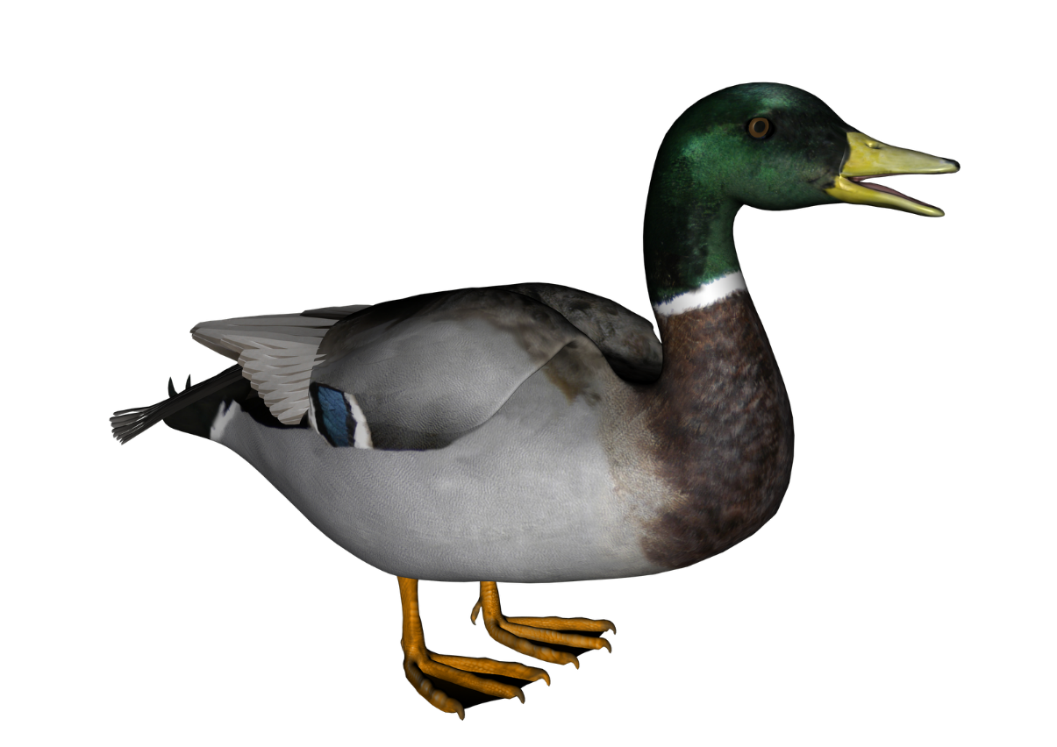
Concept Development
The ‘who’ is the subject of the sentence. It is a noun.
Let’s name these nouns. We have to put ‘the’ or ‘a’ in front of it.
The duck
A duck

Slide 17
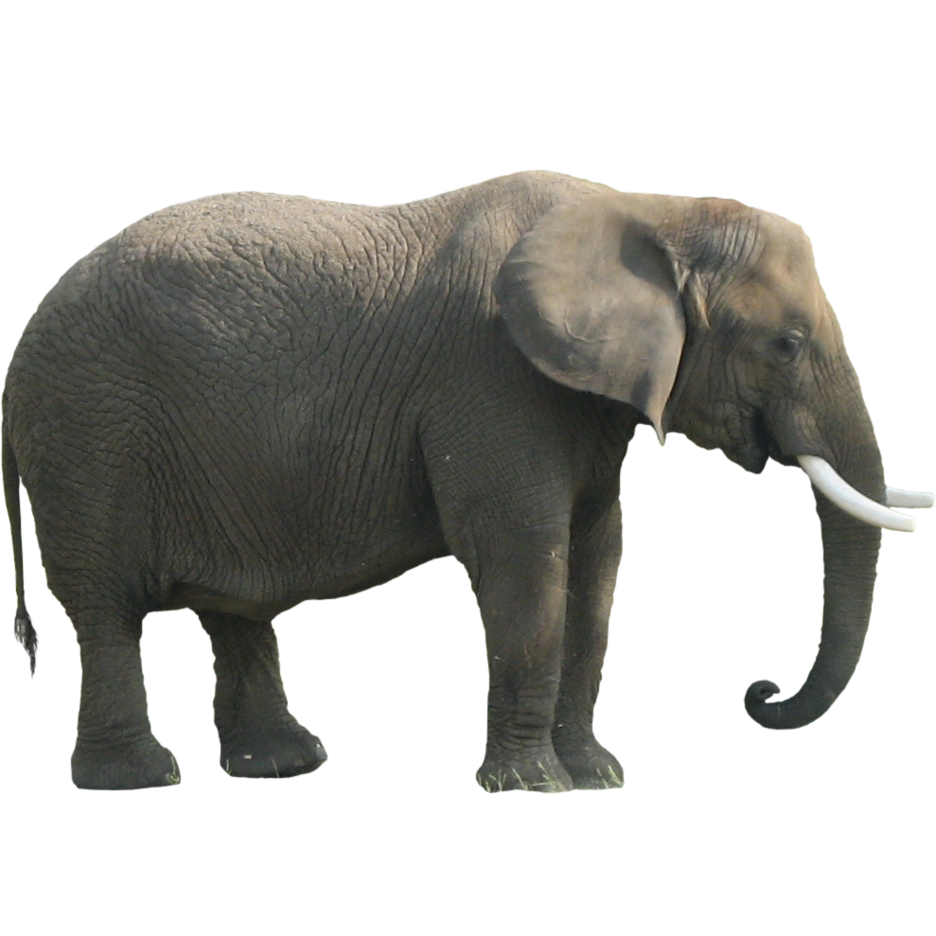
Concept Development
The ‘who’ is the subject of the sentence. It is a noun.
Let’s name these nouns. We have to put ‘the’ or ‘a’ in front of it.
The elephant
An elephant
This Photo by Unknown Author is licensed under CC BY-NC

Slide 18
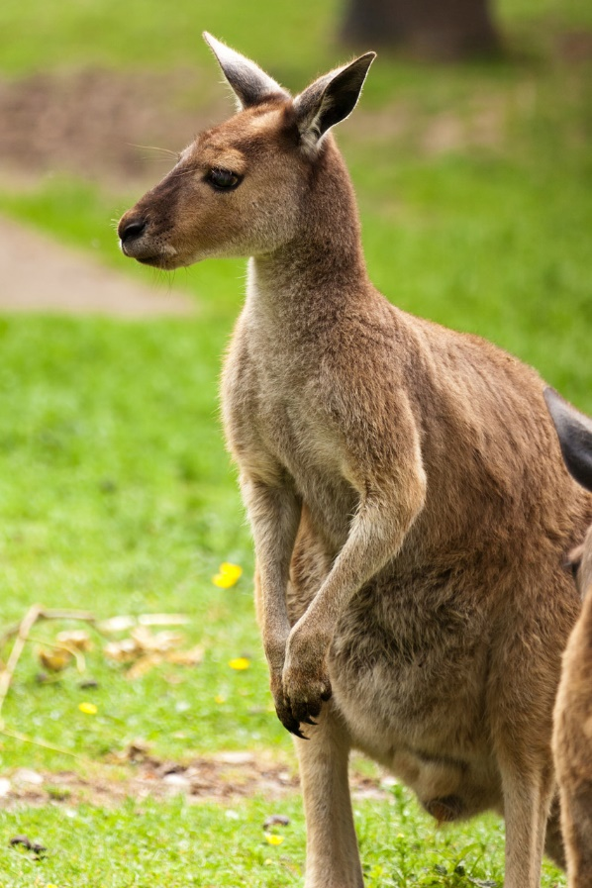
Concept Development
The ‘who’ is the subject of the sentence. It is a noun.
Let’s name these nouns. We have to put ‘the’ or ‘a’ in front of it.
The kangaroo
A kangaroo

Slide 19
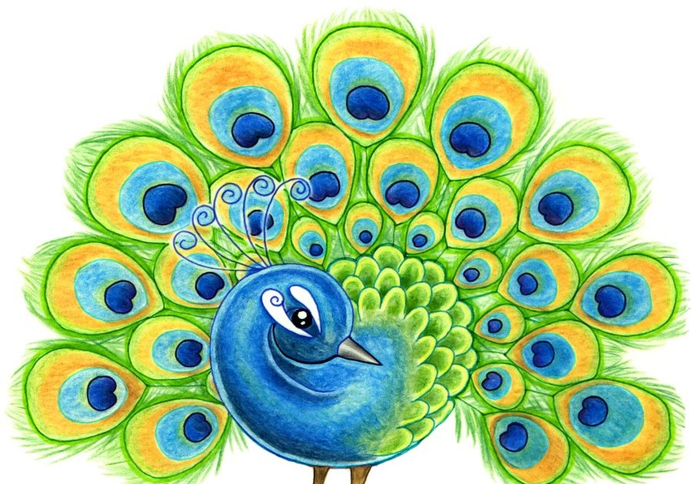
Concept Development
The ‘who’ is the subject of the sentence. It is a noun.
Let’s name these nouns. We have to put ‘the’ or ‘a’ in front of it.
The peacock
A peacock

Slide 20
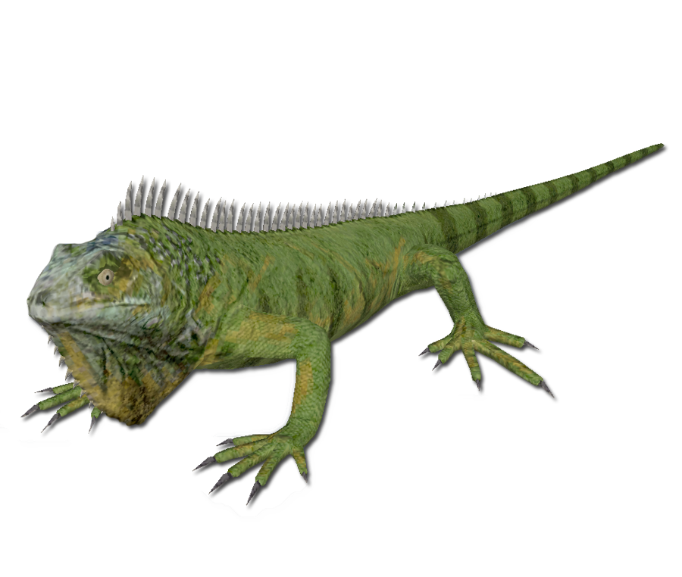
Concept Development
The ‘who’ is the subject of the sentence. It is a noun.
Let’s name these nouns. We have to put ‘the’ or ‘a’ in front of it.
The iguana
An iguana

Slide 21
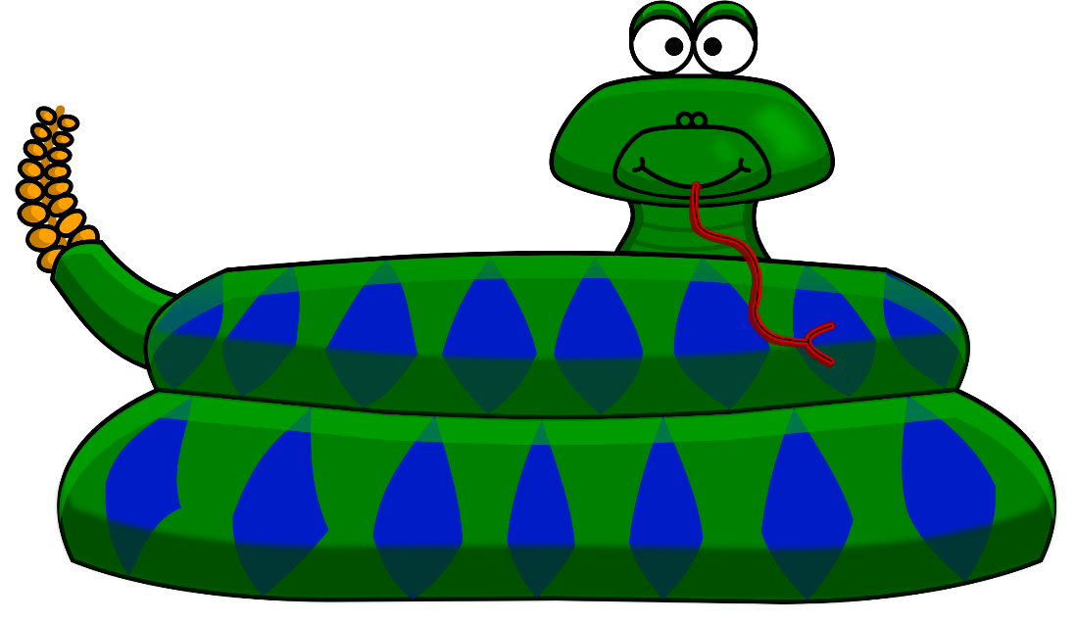
Concept Development
The ‘who’ is the subject of the sentence. It is a noun.
Let’s name these nouns. We have to put ‘the’ or ‘a’ in front of it.
The snake
A snake

Slide 22

Concept Development
The ‘what doing’ contains the verb.
Let’s name these verbs.
walking
walks

Slide 23
Concept Development
The ‘what doing’ contains the verb.
Let’s name these verbs.
blowing
blows

Slide 24
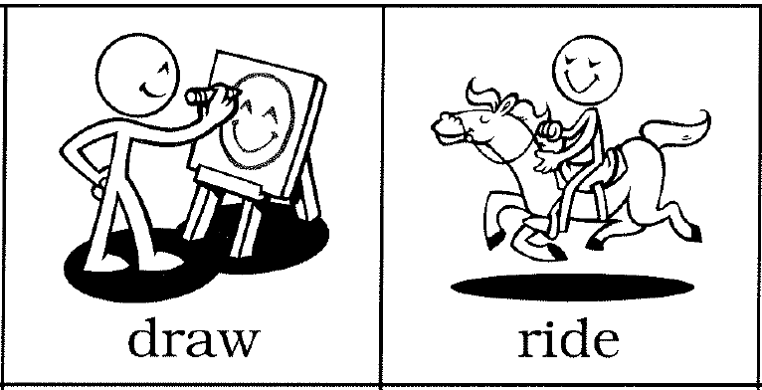
Concept Development
The ‘what doing’ contains the verb.
Let’s name these verbs.
drawing
draws

Slide 25
Concept Development
The ‘what doing’ contains the verb.
Let’s name these verbs.
riding
rides

Slide 26
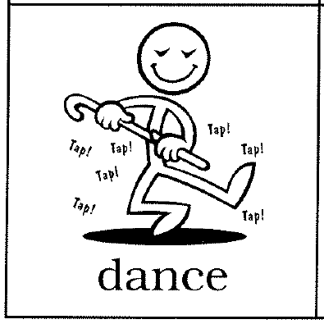
Concept Development
The ‘what doing’ contains the verb.
Let’s name these verbs.
dancing
dances

Slide 27
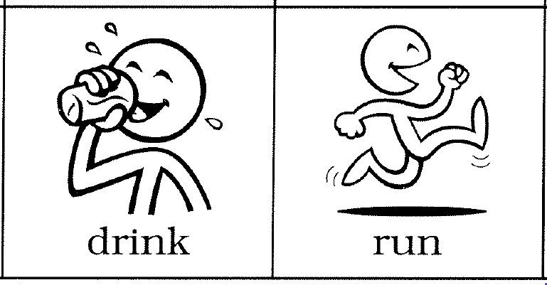
Concept Development
The ‘what doing’ contains the verb.
Let’s name these verbs.
drinking
drinks

Slide 28
Concept Development
The ‘what doing’ contains the verb.
Let’s name these verbs.
running
runs

Slide 29
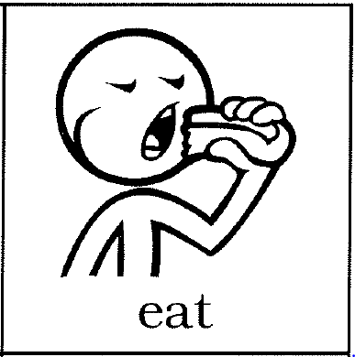
Concept Development
The ‘what doing’ contains the verb.
Let’s name these verbs.
eating
eats

Slide 30

Concept Development
The ‘what doing’ contains the verb.
Let’s name these verbs.
listening
listens

Slide 31

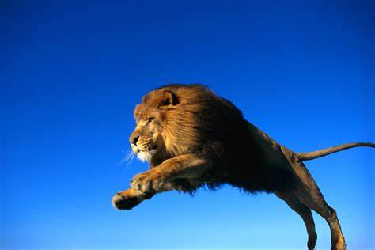
Skill Development: I do
Let’s build some sentences using these pictures.
who/what what doing
CFU:
What’s the sentence? What is the who/what? What is the do?
Students do orally
Teacher models writing

Slide 32
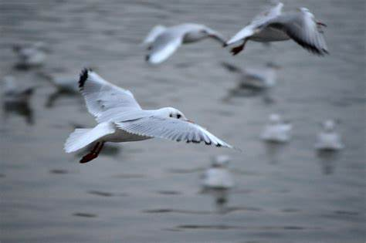
Skill Development: We do
Let’s build some sentences using these pictures.
who/what what doing
CFU:
What’s the sentence? What is the who/what? What is the do?
Students do orally
Teacher models writing

Slide 33
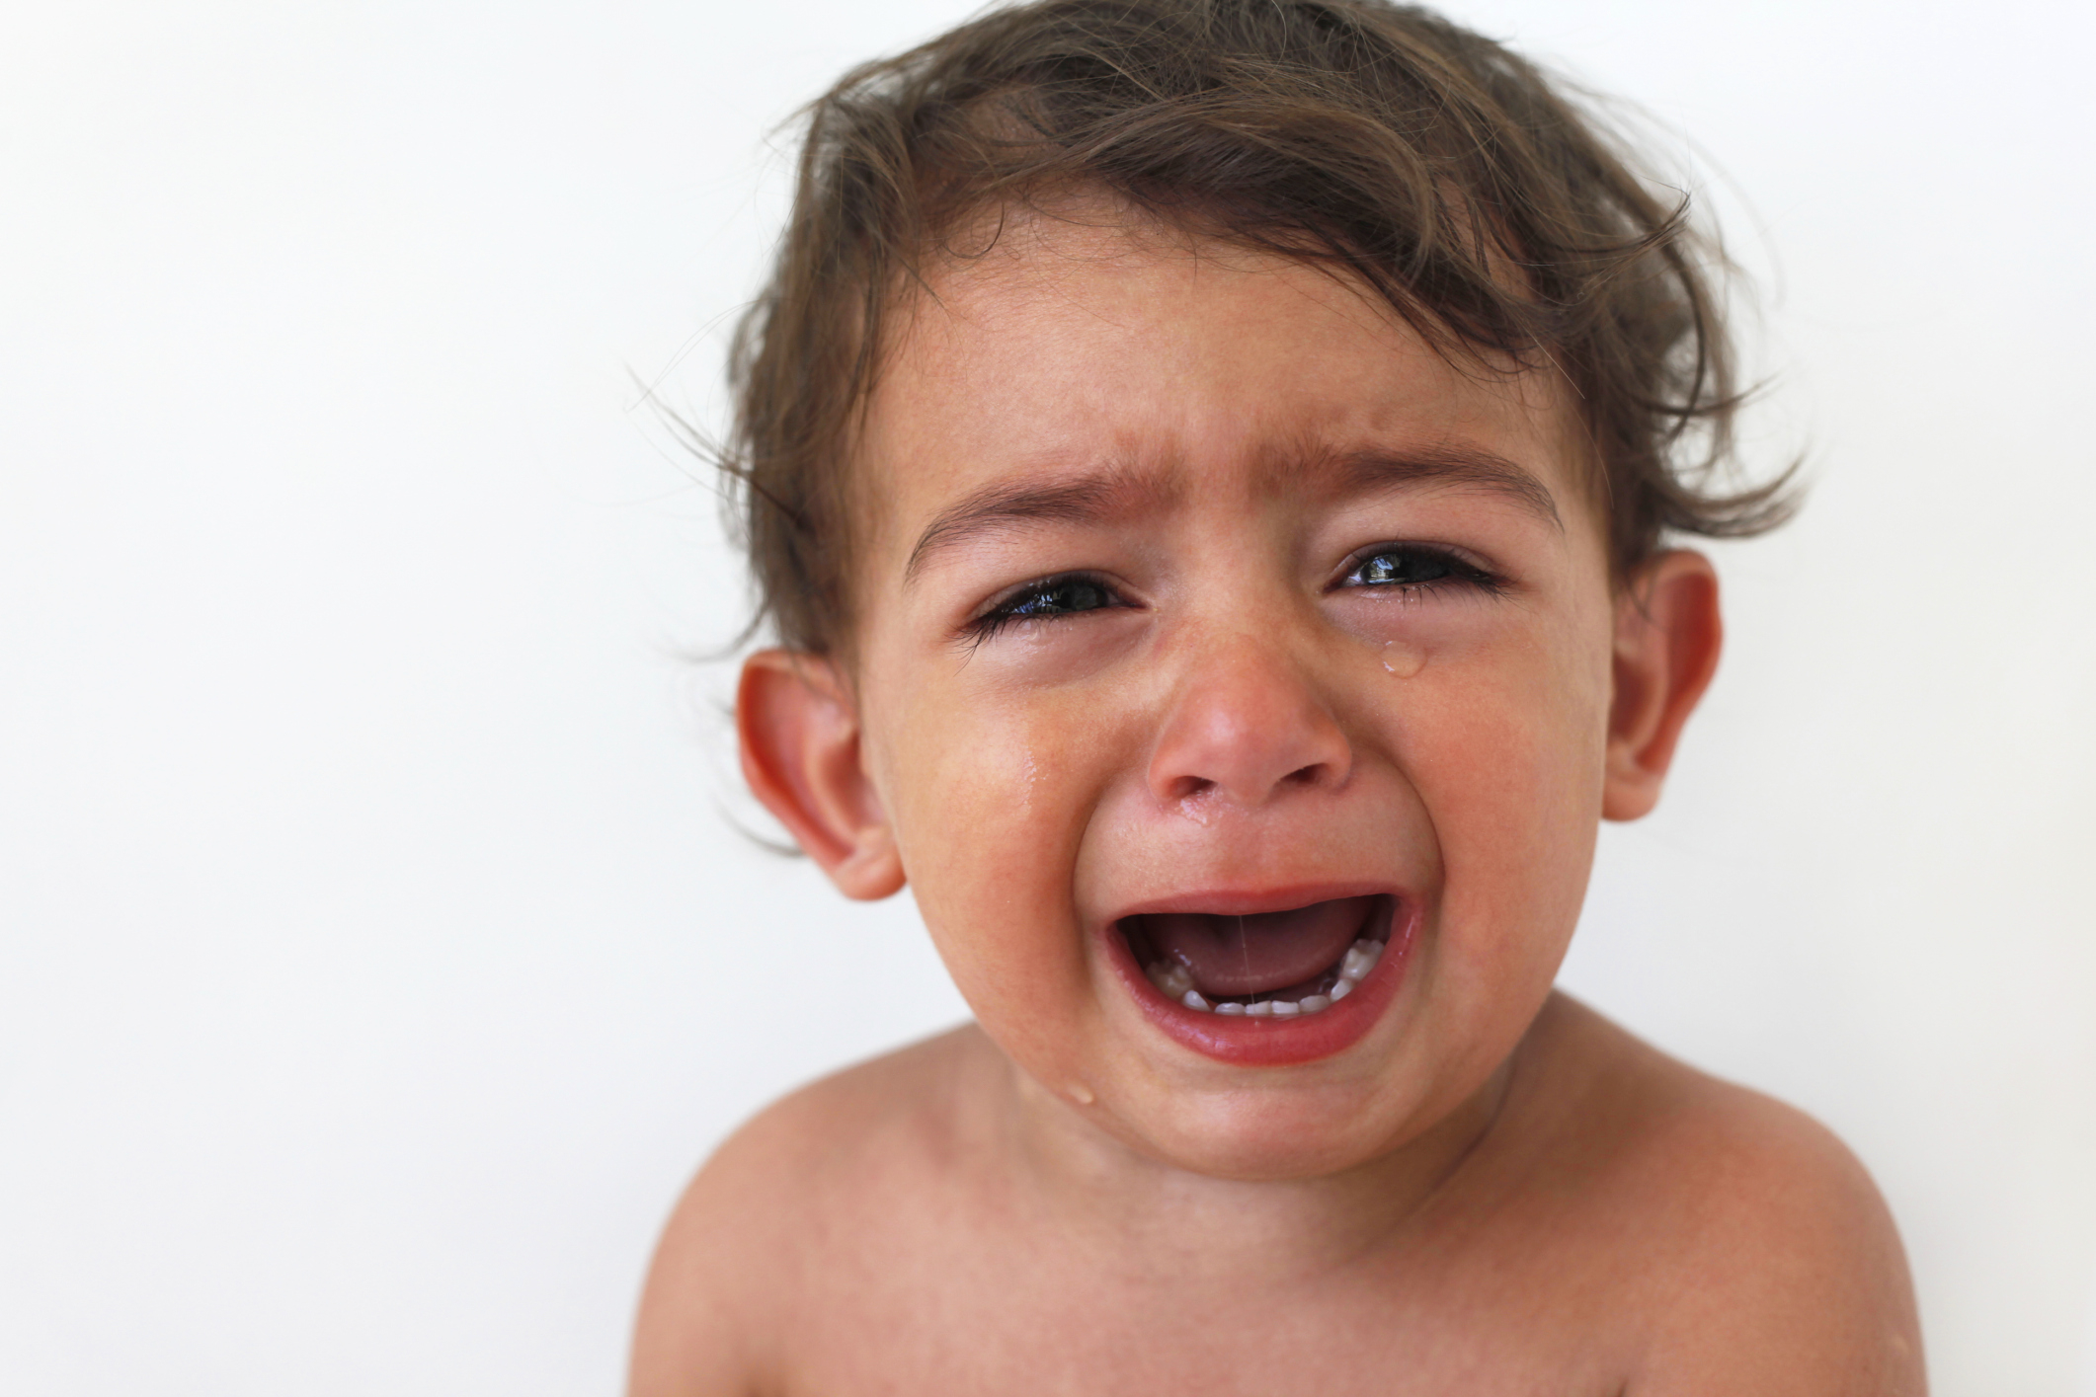
Skill Development: We do
Let’s build some sentences using these pictures.
who/what what doing
CFU:
What’s the sentence? What is the who/what? What is the do?
Students do orally
Teacher models writing

Slide 34
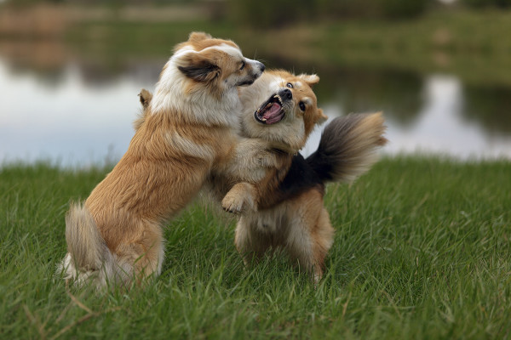
Skill Development: We do
Let’s build some sentences using these pictures.
who/what what doing
CFU:
What’s the sentence? What is the who/what? What is the do?
Students do orally
Teacher models writing

Slide 35
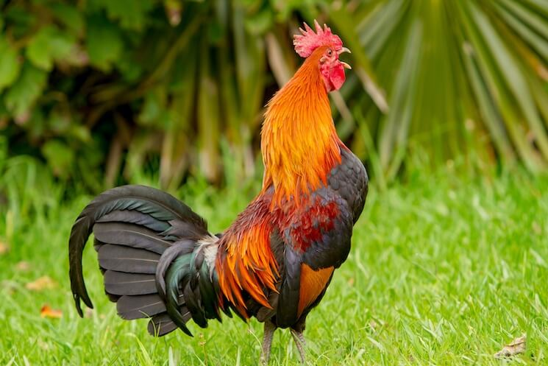
Skill Development: We do
Let’s build some sentences using these pictures.
who/what what doing
CFU:
What’s the sentence? What is the who/what? What is the do?
Students do orally
Teacher models writing

Slide 36
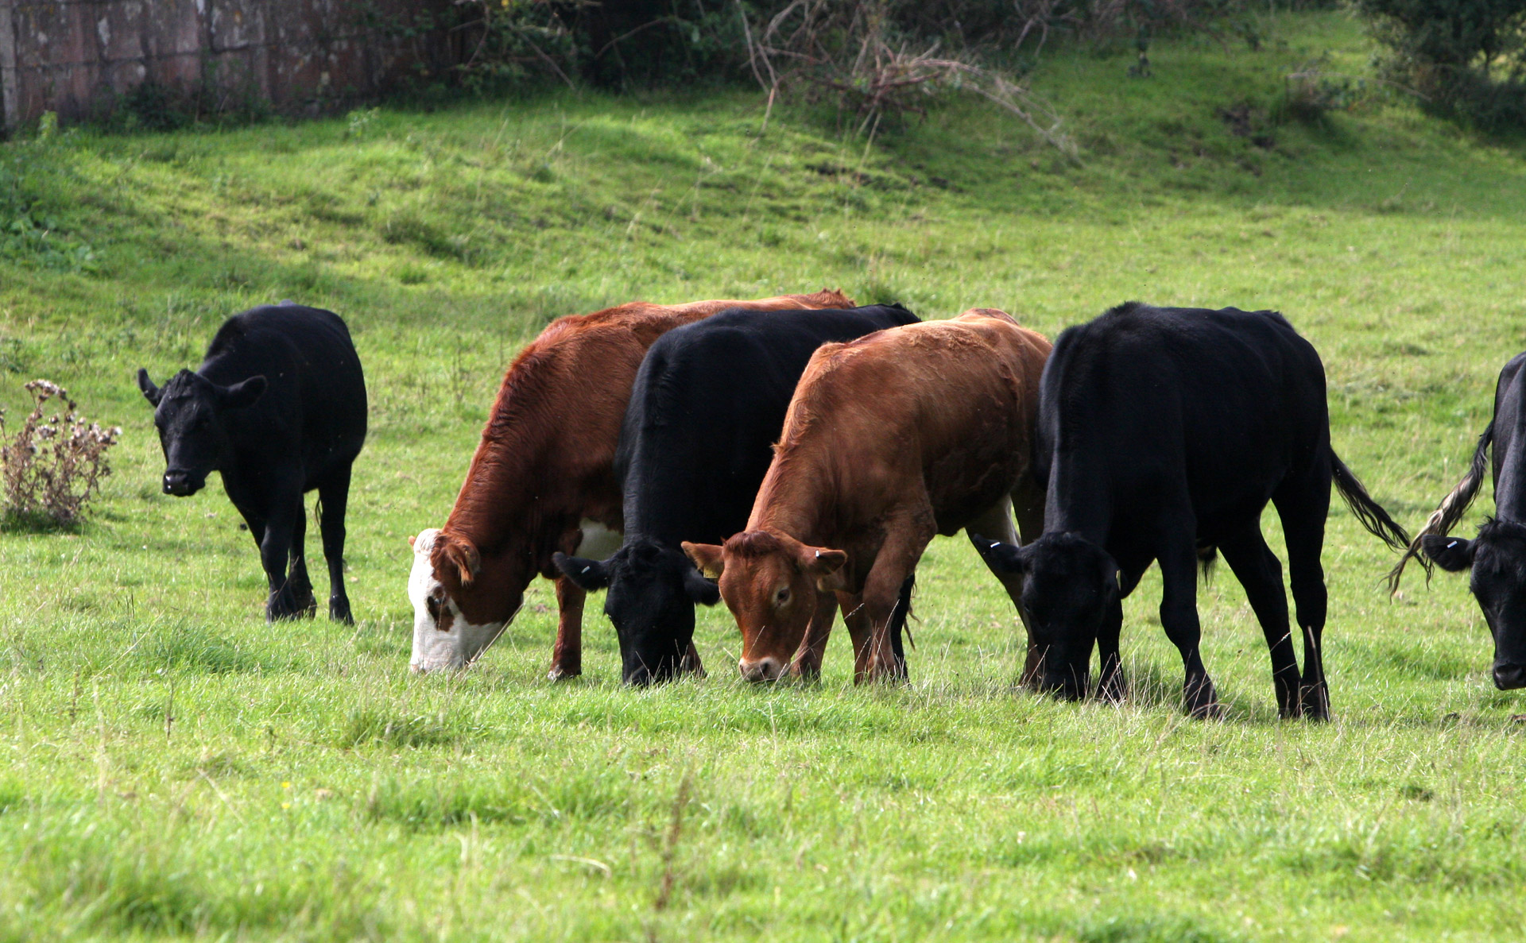
Skill Development: You do
Let’s build some sentences using these pictures.
who/what what doing
Students do orally
Teacher models writing

Slide 37

Skill Development: You do
Let’s build some sentences using these pictures.
who/what what doing
Students do orally
Teacher models writing

Slide 38
Skill Development: You do
Let’s build some sentences using these pictures.
who/what what doing
Use pictures from texts/topics/knowledge units in class
Students do orally
Teacher models writing

