Slide 1
Grade 1
Term: 1
Objective: Sentence Expansion – when, where (oral)
Author: Jasmyn Hall & Janelle Walters

Slide 2












Multiple Choice
Pair Share
Track with me
Pick a Stick/Answer (non-volunteer)
Whiteboards
Vote
Read with me
In Your Workbook

Slide 3
Learning Objective
We are learning to expand our sentences by adding extra information.

Slide 4
Question Words
Who/what?
(did) What?
When?
Where?
Why?
How?
Display this chart in classroom prior to lesson.
Optional: use Colourful Semantics icons in addition to question words. But please note, TWR does not distinguish between the ‘what doing/did what’ (verb) and the ‘what’ (object). If you are using a Colourful Semantics approach, you will need to consider this.

Slide 5
Activate Prior Knowledge
A sentence is a complete thought.
It must contain a subject (or who/what) and a verb (a do).
CFU:
What is the subject and the verb in these sentences?
Examples:
Jan hops.
The kids sat.
Tim ran.

Slide 6
Concept Development
A sentence is a complete thought.
It must contain a subject (or who/what) and a verb (a do).
CFU:
What is the subject and the verb in these sentences?
Examples:
Jan hops.
The kids sat.
Tim ran.
Boring !
These sentences are boring and do not contain any additional information.

Slide 7
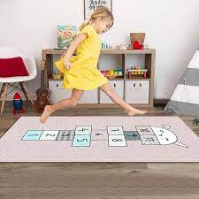


Concept Development
By adding additional information, we can expand sentences to make them more interesting.
Including when, what, and where will make your sentence more informative for the reader:
CFU:
Who jumps?
Where?
When did they jump?
When?
Where?
Who?
What?
Boring !
On Sunday, Kim jumps on the mat.
Kim jumps.

Slide 8

Concept Development
By adding additional information, we can expand sentences to make them more interesting.
Including when, what, and where will make your sentence more informative for the reader:
CFU:
Who splashed?
Where?
When did they splash?
2. What does ‘they’ refer to in the kernel sentence.
When?
Where?
Who?
What?
One day, the kids splash in the mud.
Boring !
They splash.

Slide 9

Concept Development
By adding additional information, we can expand sentences to make them more interesting.
Including when, what, and where will make your sentence more informative for the reader:
CFU:
Who is the subject?
What is the action?
Where does it occur?
When does it happen?
The kids sit.
Where:
When:
on the rug
at night
The kids sit on the rug at night.

Slide 10
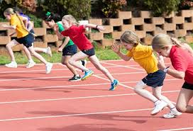

Concept Development
By adding additional information, we can expand sentences to make them more interesting.
Including when, what, and where will make your sentence more informative for the reader:
CFU:
Why is this not an example of an expanded sentence?
The kids run.
Where:
When:
on the track
at lunch
Non-Examples:
The kids run on the track.
This sentence does not contain all of the information. It does not have the when.
run at lunch.
This sentence does not make sense. It is missing words.

Slide 11

Hinge Point Question
Which sentences contain a WHEN and a WHERE detail?
It hops on a log.
Kim and Ted jump on the bed in the morning.
Mum skipped to the shop on Sunday.
The dog naps in his bed.
CFU:
Why is it/ isn’t it a an example of a an expanded sentence?

Slide 12
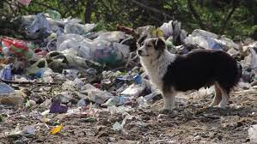
Skill development: I do
Answer the questions in note form
Use the notes to say the sentence, in this order:
Who what where when.
CFU:
Who is the subject?
What is the action?
Where does it occur?
When does it happen?
The dog ran.
Where:
When:
to the tip
on Sunday
The dog
ran
to the tip
on Sunday.

Slide 13

Skill development: I do
Answer the questions in note form
Use the notes to say the sentence, in this order:
Who what where when.
CFU:
Who is the subject?
What is the action?
Where does it occur?
When does it happen?
Pam skips.
Where:
When:
to the shop
after school
Pam
skips
to the shop
after school.

Slide 14
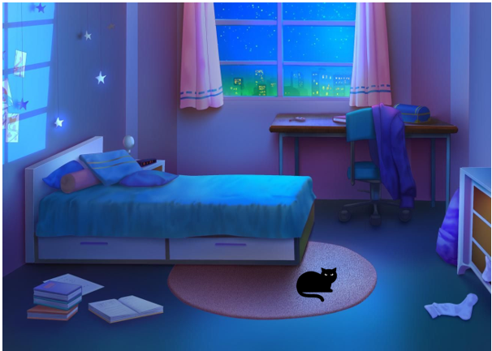
Skill development: We do
Answer the questions in note form
Use the notes to say the sentence, in this order:
Who what where when.
CFU:
Who is the subject?
What is the action?
Where does it occur?
When does it happen?
The cat sat.
Where:
When:
on the mat
at night

Slide 15
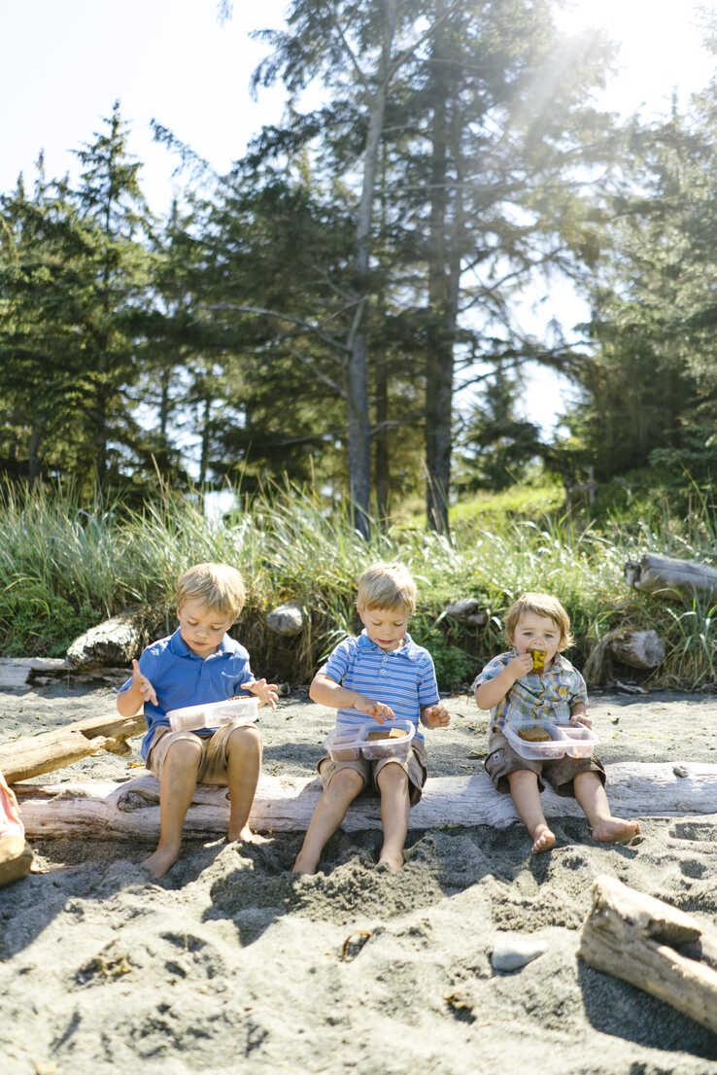
Skill development: You do
Answer the questions in note form
Use the notes to say the sentence, in this order:
Who what where when.
CFU:
Who is the subject?
What is the action?
Where does it occur?
When does it happen?
The kids sit.
Where:
When:
Notes:
The kids sit on the mat at lunch.

Slide 16

Skill Development: You do
Let’s build some sentences using these pictures.
who what where when
Use pictures from texts/topics/knowledge units in class
Students do orally
Teacher models writing

