Slide 1
Grade 1
Term: 1
Objective: We are learning to speak in full sentences (oral)
Author: Mandy Carlin & Stephanie Le Lievre

Slide 2
Multiple Choice
Pair Share
Track with me
Pick a Stick/Answer (non-volunteer)
Whiteboards
Vote
Read with me
In Your Workbook

Slide 3
Learning Objective
We are learning to speak in full sentences.

Slide 4
Concept Development
A sentence is a complete thought that makes sense.
A sentence must:
make sense
have a WHO/WHAT
and a WHAT DOING

Slide 5
Concept Development
Let’s clap out the words in these sentences:
Teacher reads:
The dog is barking.

Slide 6
Concept Development
Let’s clap out the words in these sentences:
Teacher reads:
The cat is licking the milk.

Slide 7
Concept Development
Let’s clap out the words in these sentences:
Teacher reads:
The birds are singing in the tree.

Slide 8
Concept Development
Let’s clap out the words in these sentences:
Teacher reads:
Lucy and Mary played together.

Slide 9
Concept Development
Let’s clap out the words in these sentences:
Teacher reads:
Ben and Raj are laughing.

Slide 10
Concept Development: I do
Let’s find the ‘who’ and the ‘do’ in these sentences
CFU:
What’s the WHO of the sentence?
What’s the DO of the sentence?
Teacher reads:
The dog barked.
A sentence must:
make sense
have a WHO/WHAT
and a WHAT DOING

Slide 11
Concept Development: We do
Let’s find the ‘who’ and the ‘do’ in these sentences
CFU:
What’s the WHO of the sentence?
What’s the DO of the sentence?
Teacher reads:
The cat licked.
A sentence must:
make sense
have a WHO/WHAT
and a WHAT DOING

Slide 12
Concept Development: We do
Let’s find the ‘who’ and the ‘do’ in these sentences
CFU:
What’s the WHO of the sentence?
What’s the DO of the sentence?
Teacher reads:
The girls played.
A sentence must:
make sense
have a WHO/WHAT
and a WHAT DOING

Slide 13
Concept Development: We do
Let’s find the ‘who’ and the ‘do’ in these sentences
CFU:
What’s the WHO of the sentence?
What’s the DO of the sentence?
Teacher reads:
The birds sang.
A sentence must:
make sense
have a WHO/WHAT
and a WHAT DOING

Slide 14
Concept Development: We do
Let’s find the ‘who’ and the ‘do’ in these sentences
CFU:
What’s the WHO of the sentence?
What’s the DO of the sentence?
Teacher reads:
The horse galloped.
A sentence must:
make sense
have a WHO/WHAT
and a WHAT DOING

Slide 15
Concept Development: We do
Let’s find the ‘who’ and the ‘do’ in these sentences
CFU:
What’s the WHO of the sentence?
What’s the DO of the sentence?
Teacher reads:
The tree swayed.
A sentence must:
make sense
have a WHO/WHAT
and a WHAT DOING

Slide 16
Concept Development: We do
Let’s find the ‘who’ and the ‘do’ in these sentences
CFU:
What’s the WHO of the sentence?
What’s the DO of the sentence?
Teacher reads:
The alien landed.
A sentence must:
make sense
have a WHO/WHAT
and a WHAT DOING

Slide 17
Skill development: I do
Make a sentence up about this picture.
CFU:
Does your sentence make sense?
Does your sentence have a WHO?
Does your sentence have a DO?
A sentence must:
make sense
have a WHO/WHAT
and a WHAT DOING

Slide 18
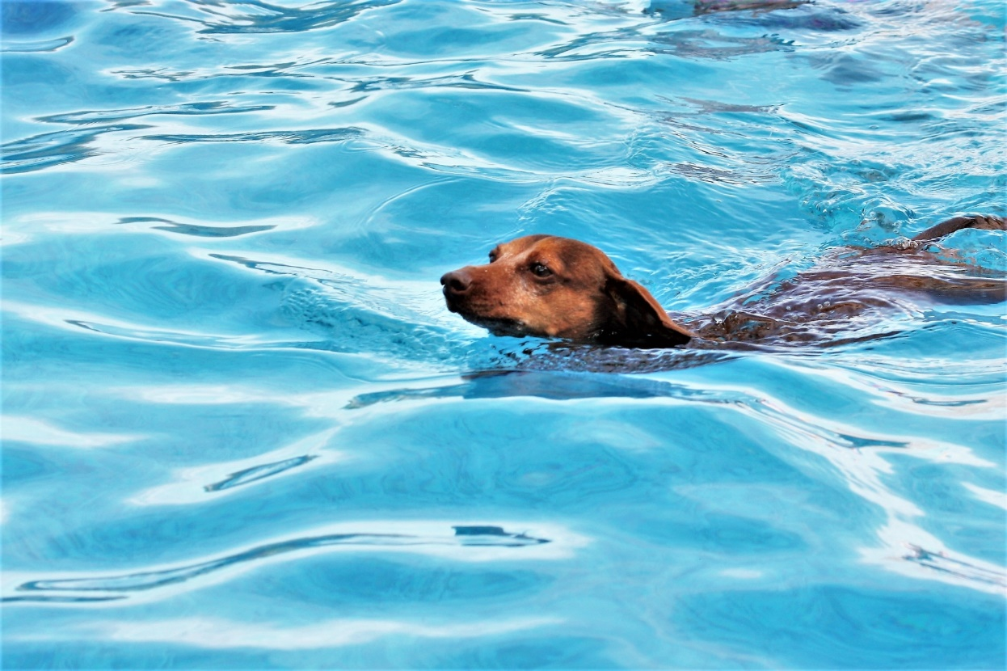
Skill development: We do
Make a sentence up about this picture.
CFU:
Does your sentence make sense?
Does your sentence have a WHO?
Does your sentence have a DO?
A sentence must:
make sense
have a WHO/WHAT
and a WHAT DOING

Slide 19
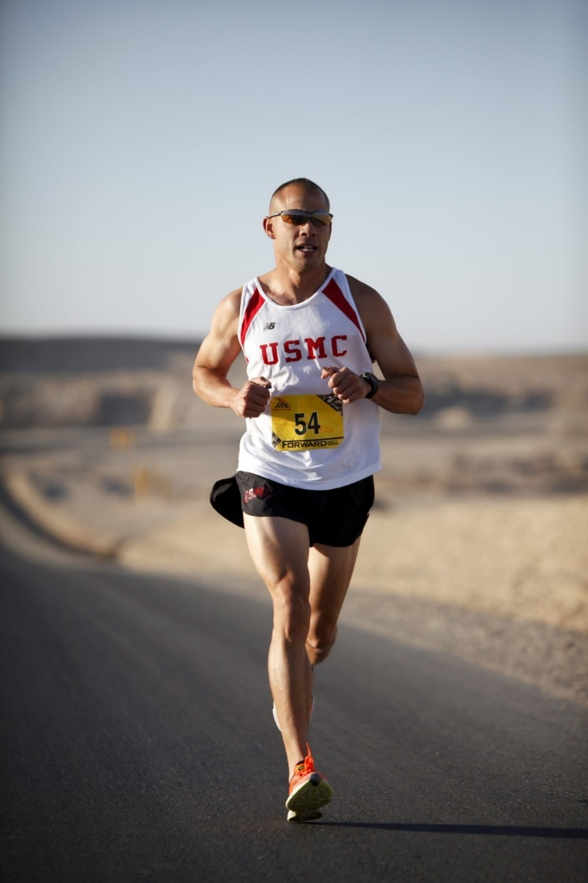
Skill development: We do
Make a sentence up about this picture.
CFU:
Does your sentence make sense?
Does your sentence have a WHO?
Does your sentence have a DO?
A sentence must:
make sense
have a WHO/WHAT
and a WHAT DOING

Slide 20
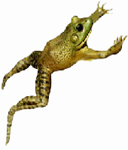
Skill development: We do
Make a sentence up about this picture.
CFU:
Does your sentence make sense?
Does your sentence have a WHO?
Does your sentence have a DO?
A sentence must:
make sense
have a WHO/WHAT
and a WHAT DOING

Slide 21
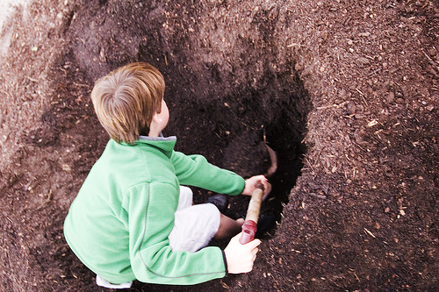
Skill development: We do
Make a sentence up about this picture.
CFU:
Does your sentence make sense?
Does your sentence have a WHO?
Does your sentence have a DO?
A sentence must:
make sense
have a WHO/WHAT
and a WHAT DOING

Slide 22
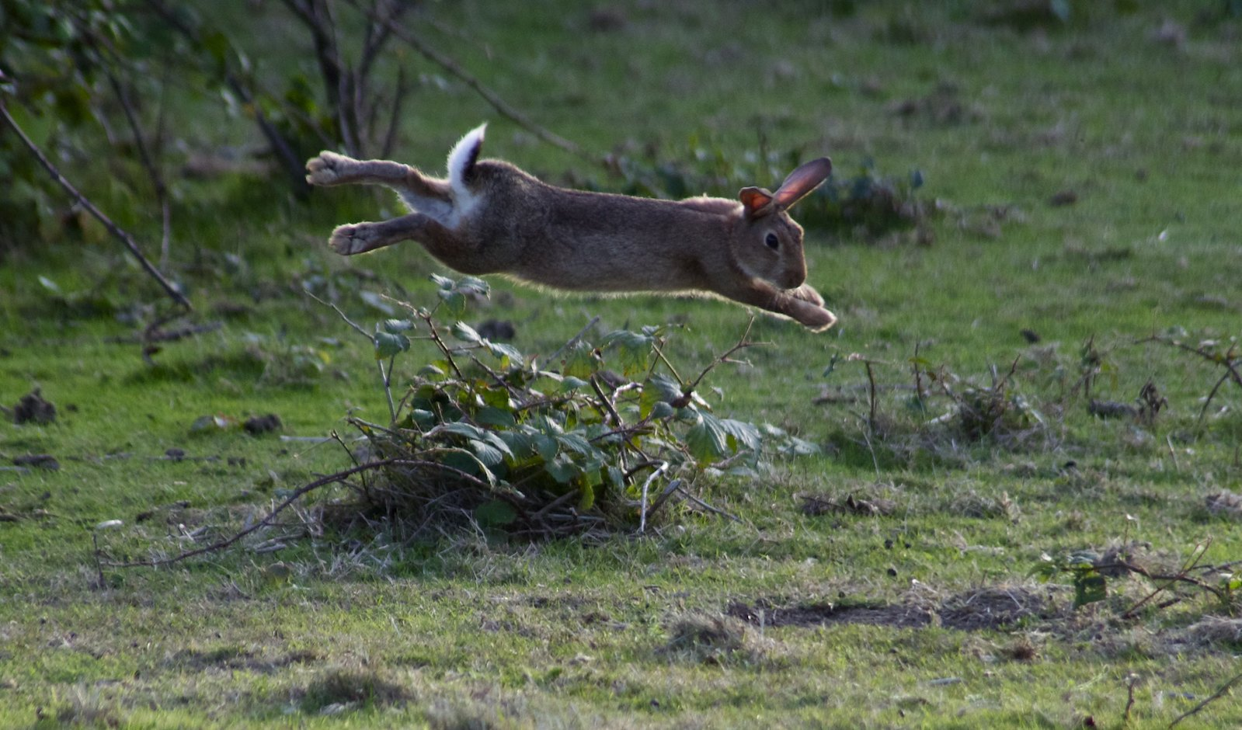
Skill development: We do
Make a sentence up about this picture.
CFU:
Does your sentence make sense?
Does your sentence have a WHO?
Does your sentence have a DO?
A sentence must:
make sense
have a WHO/WHAT
and a WHAT DOING

Slide 23
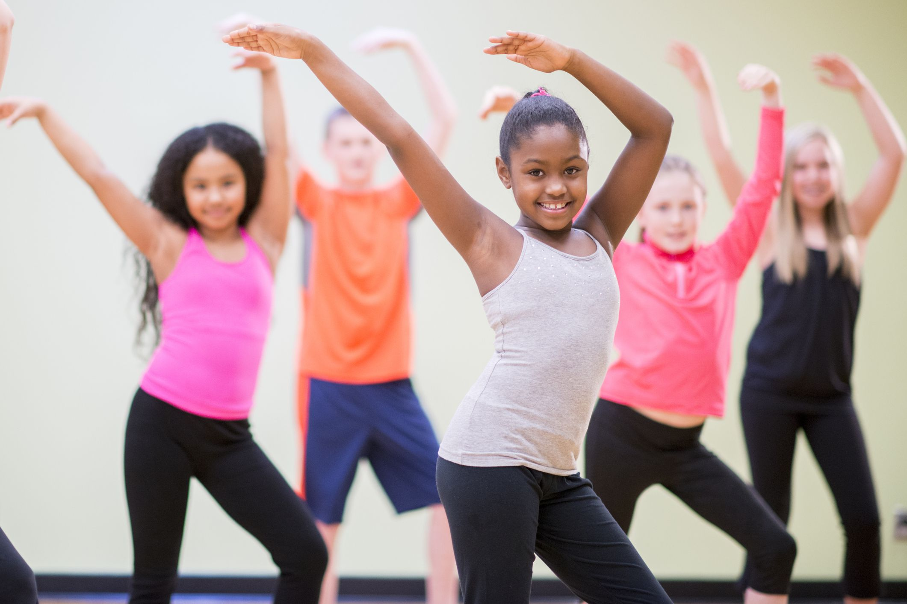
Skill development: We do
Make a sentence up about this picture.
CFU:
Does your sentence make sense?
Does your sentence have a WHO?
Does your sentence have a DO?
A sentence must:
make sense
have a WHO/WHAT
and a WHAT DOING

Slide 24
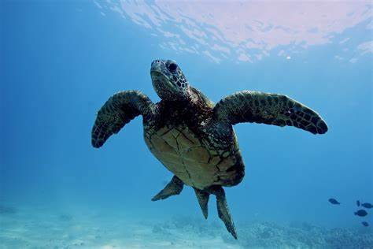
Skill development: We do
Make a sentence up about this picture.
CFU:
Does your sentence make sense?
Does your sentence have a WHO?
Does your sentence have a DO?
A sentence must:
make sense
have a WHO/WHAT
and a WHAT DOING

Slide 25
Skill development: We do
Make a sentence up about this picture.
CFU:
Does your sentence make sense?
Does your sentence have a WHO?
Does your sentence have a DO?
A sentence must:
make sense
have a WHO/WHAT
and a WHAT DOING

Slide 26
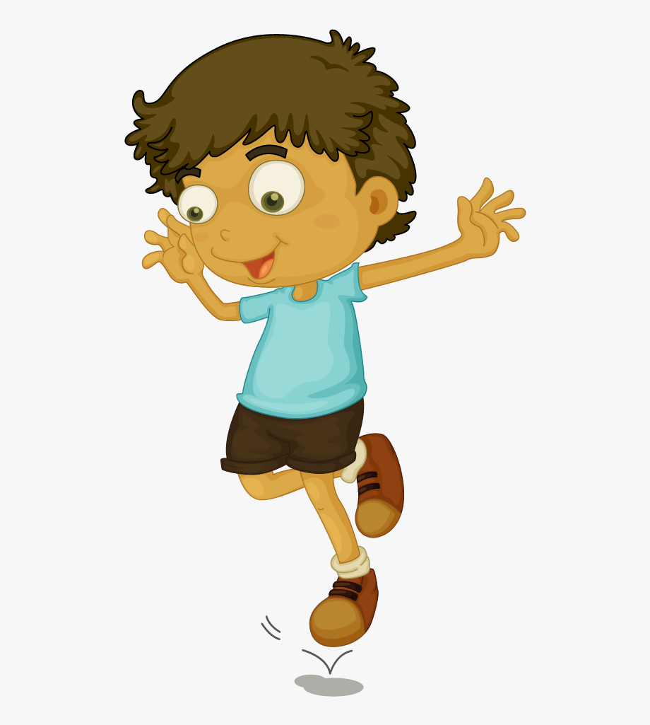
Skill development: We do
Make a sentence up about this picture.
CFU:
Does your sentence make sense?
Does your sentence have a WHO?
Does your sentence have a DO?
A sentence must:
make sense
have a WHO/WHAT
and a WHAT DOING

Slide 27
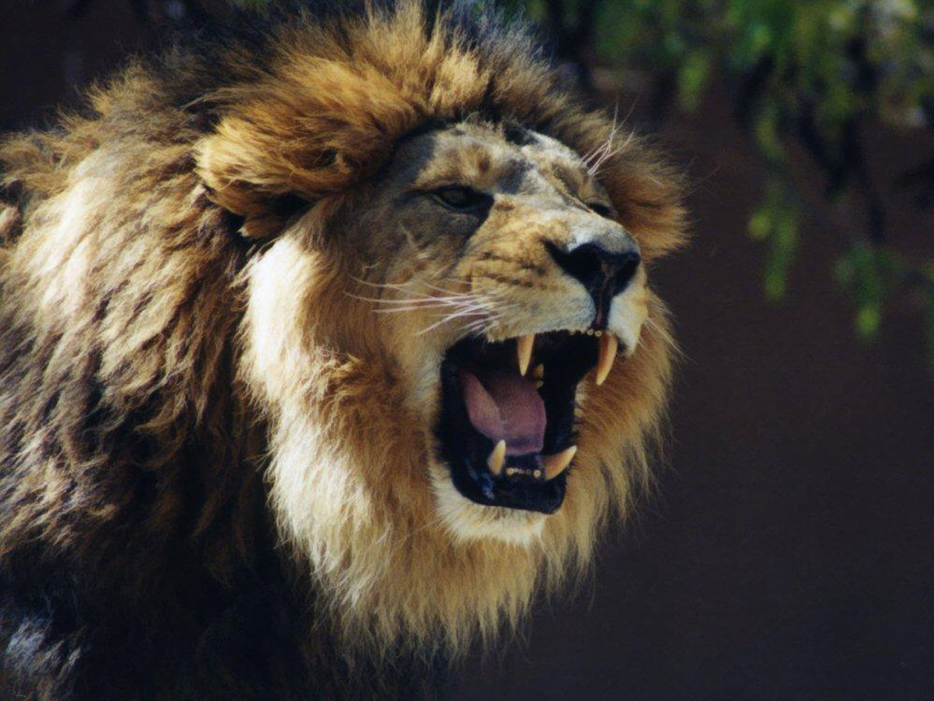
Skill development: We do
Make a sentence up about this picture.
CFU:
Does your sentence make sense?
Does your sentence have a WHO?
Does your sentence have a DO?
A sentence must:
make sense
have a WHO/WHAT
and a WHAT DOING

Slide 28
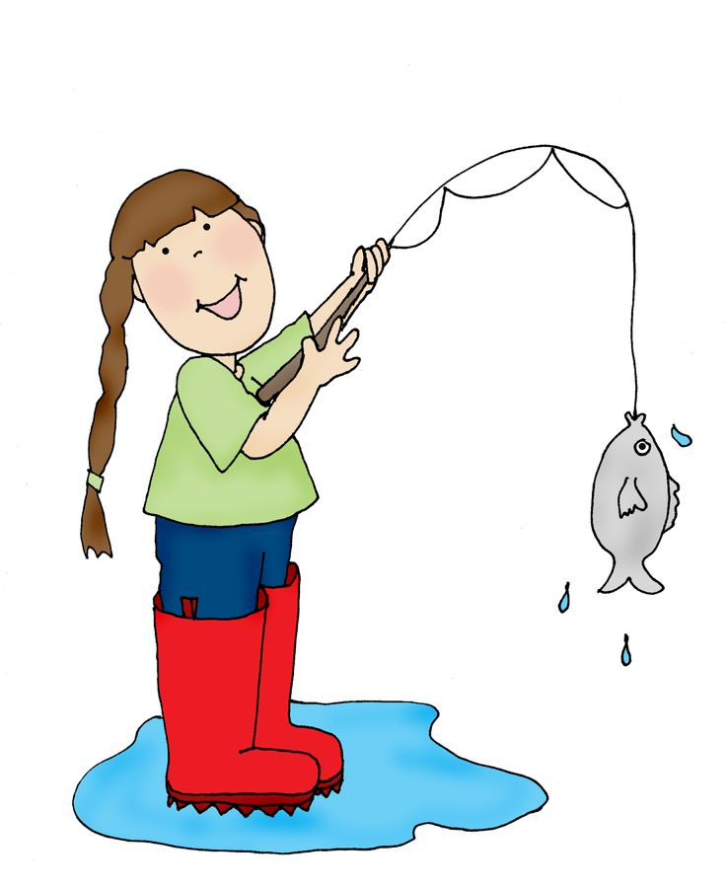
Skill development: We do
Make a sentence up about this picture.
CFU:
Does your sentence make sense?
Does your sentence have a WHO?
Does your sentence have a DO?
A sentence must:
make sense
have a WHO/WHAT
and a WHAT DOING

Slide 29
Skill development: We do
Make a sentence up about this picture.
CFU:
Does your sentence make sense?
Does your sentence have a WHO?
Does your sentence have a DO?
A sentence must:
make sense
have a WHO/WHAT
and a WHAT DOING
Choose pictures from texts/topics/knowledge units used in class.

